Slide 1










THANK YOU TO OUR GENEROUS SPONSORS
FOR SUPPORTING THE CALTECH SPACE CHALLENGE

Slide 2




Project Explorer
Lunar – reDirected Orbiting Resource Asteroid Demonstration and Operation
27 March 2015

Slide 3
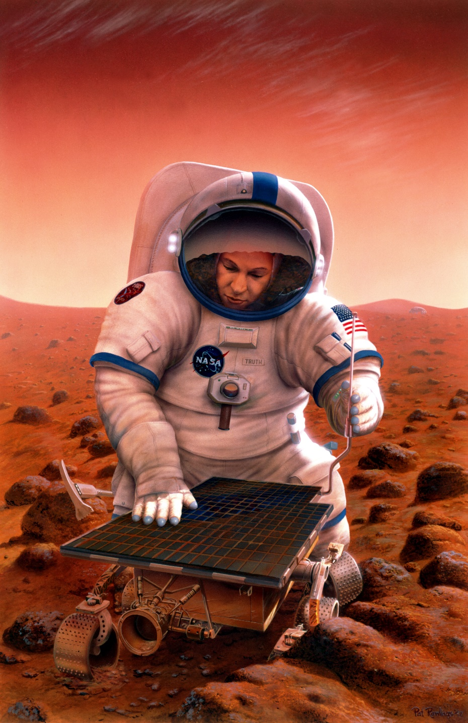
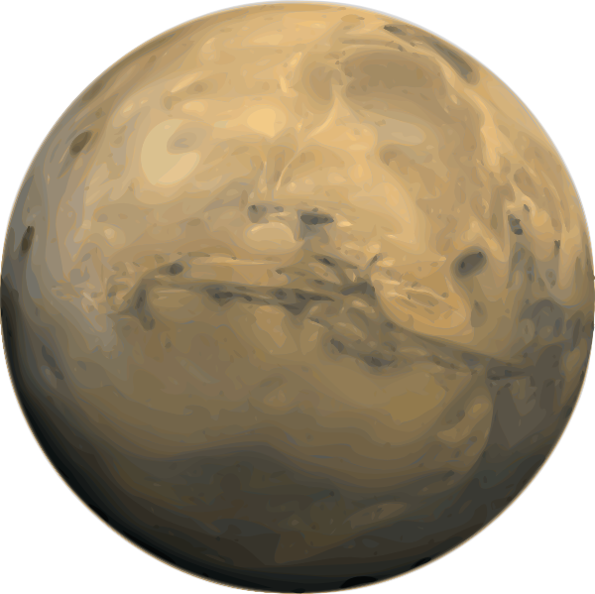
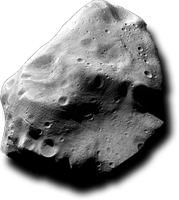



The Big Picture
Project Explorer brings astronauts to the lunar orbiting ARM asteroid in 2025 to characterize, extract, and utilize its resources in order to demonstrate the potential benefits for humanity and future exploration missions.

Slide 4
Executive Summary
Two rockets: One for cargo and one for crew
The Eureka science module launches in August 2024 and heads to the asteroid
A 3-person crew launches in February/March 2025
8.5 day prograde lunar flyby trajectory to reach the asteroid
22 days of on-asteroid operations
  Characterization of the asteroid and its environment
  Resource extraction, processing, and utilization
  Public outreach
8.5 day trajectory to return to earth
Abort options drive mass and schedule design limits
Uses Orion and SLS architecture
$3.1 billion projected cost ($1.8 Billion without launch costs)

Slide 5

Presentation Flow
Build the foundation
Make it flexible
Make it creative
Make it fun

Slide 6
Table of Contents
Mission Context
Mission Overview
Trajectory and Launch
Science and Technology Demos
Human Factors and ECLSS
System Engineering
Public Outreach
Budget
Conclusions

Slide 7
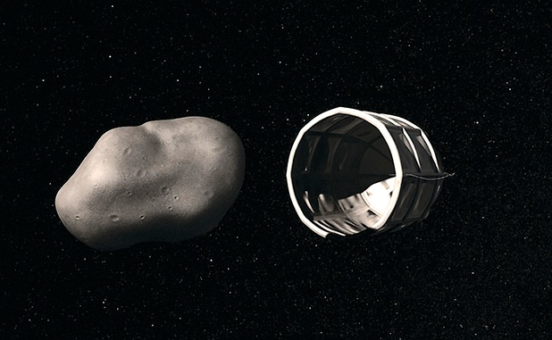
Introduction: Step One

Slide 8
Introduction: Step Two
Now What?

Slide 9


Critical Ground Rules and Assumptions
In place by 2024
Class “C” Asteroid
500 metric tons
Design for A or B
ARM Power can be used
Use SLS and Orion for Crew
Block 1, 1B Available
Block 2 Maybe Not
2+ Astronauts
TRL 8+
Standard NASA Procedures
International Cooperation
Public Outreach is Critical
Planetary Protection Mandate

Slide 10
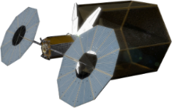
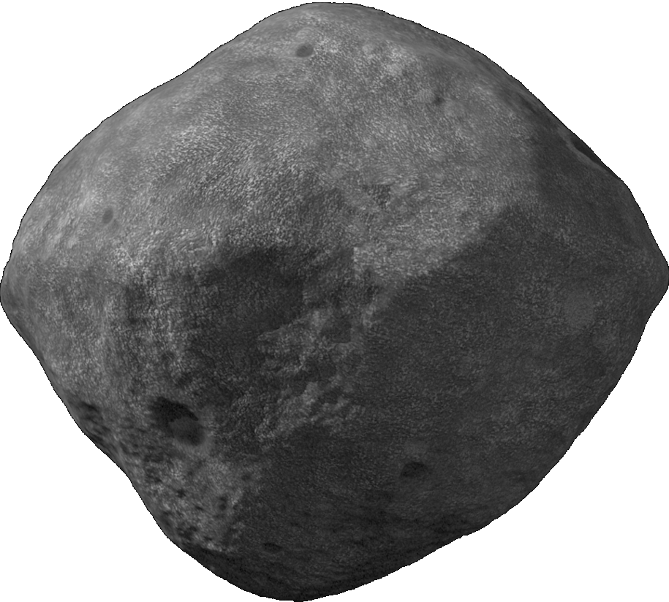
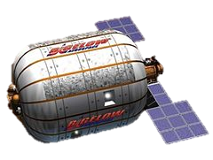
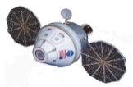


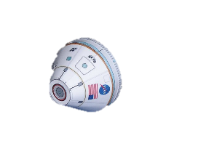



Mission Overview
DRO
Orbit Insertion (318 m/s)
DRO Departure
(318 m/s)
Moon flybys
Scientific Exploration:
22 days
Moon
Prograde Lunar Flyby
(190 m/s)
Lunar Flyby
(190 m/s)
Low-energy Ballistic Capture
(0 m/s)
Outbound TOF: 8.6 days
Inbound TOF: 8.6 days
Reentry Velocity: ~11 km/s
LEO
Cargo Mission
Falcon Heavy
Crew Vehicle Launch
SLS Block 1 B
TOF: 4-6 months
Crew TOF: 39 days
Return as heroes!
Earth
August 2024
February-March 2025
Time
Notes:
For H Transfer of Cargos → Estimated Time: 7-8 months

Slide 11
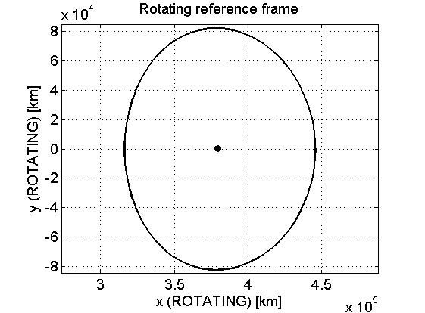
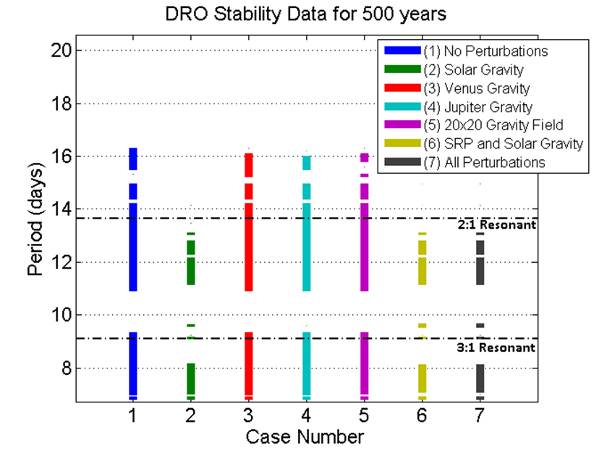
Trajectory Planning: The Asteroid’s Orbit
61,500 km
Our DRO
Period of DRO = 11+ days
Bezrouk, Collin, and Jeffrey Parker. "Long Duration Stability of Distant Retrograde Orbits." AAS (2014): n. pag. Web.
Notes:
We computed the points of the DRO

Slide 12









Launch strategy
Core & Upper Stage Separation
T + 476s
Upper Stage Ignition
T + 486s
Upper Stage Separation
T + 1,821 s
Payload Fairing and
Launch Abort Jettison
T + 472 s
2 Launches
SRB Jettison
T + 128 s
Rocket | Mass to TLI (t) | Payload | Payload mass (t) | Launch date
Falcon Heavy | ≤ 18 | Eureka | 17.2 | August 2024
SLS Block 1B | ~ 47 | Orion | 36 | February 20, 2025
Liftoff
T = 0 s
SLS may only be able to launch once per year; need SLS for Orion launch
Baseline: Launch 1 - Falcon Heavy, Launch 2 - Orion
SLS Block 2 can be used if available (2024?) -> Only one launch needed
SLS Launch Sequence

Slide 13
Transit: Eureka Trajectory
Low-Energy Ballistic Capture
Maneuvers for Outbound Trajectory | Time since launch [mo.] | Δv [m/s]
Launch “cleanup” | ~ 0 | 15
Rendezvous/Docking | 4-6 | 15
$ΔV_{tot}=$ 30 m/s
SEP was also considered but not selected because of additional system complexity
Herman, Jonathan F.C., and Jefferey S. Parker. "Low-Energy, Low-Thrust Transfers Between Earth and Distant Retrograde Orbits about the Moon." Annual AAS Guidance & Control Conference (2015): n. pag. Web.

Slide 14
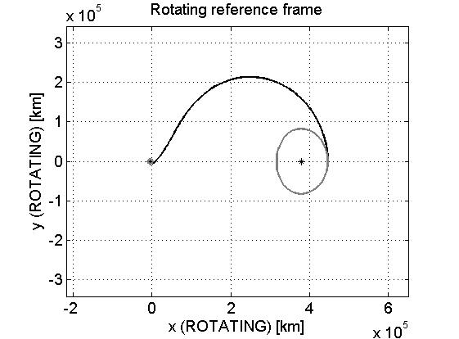
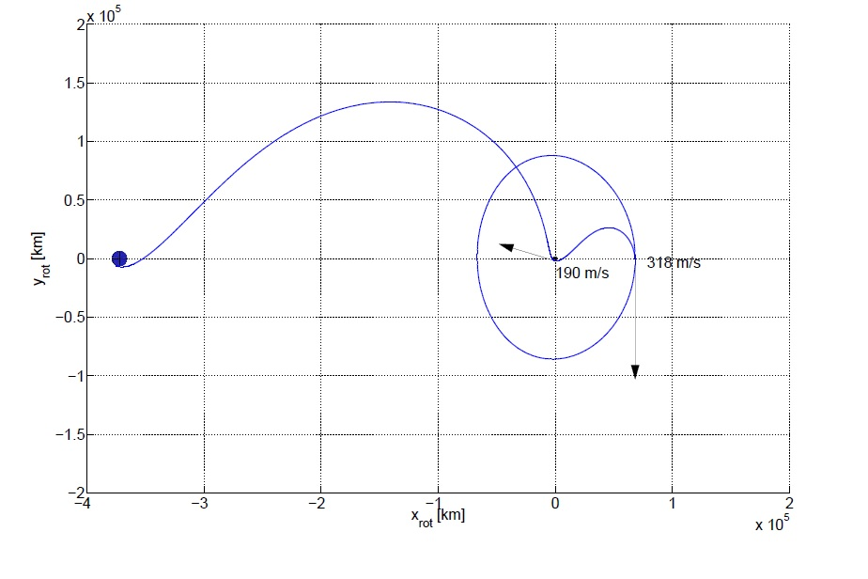
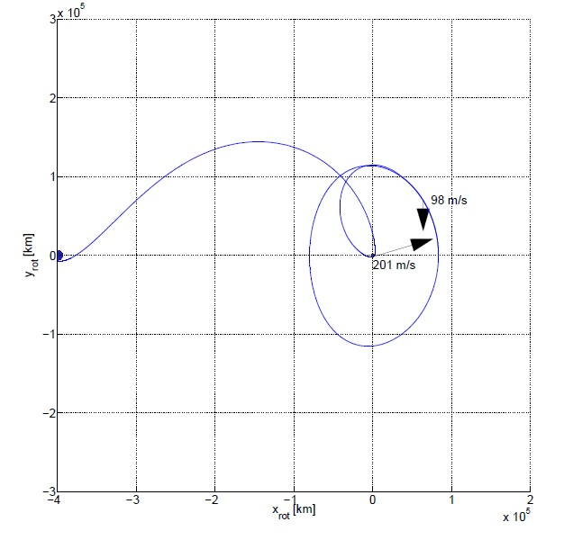
Transit: Crew Trajectory Options
$$600 m/s$$
Direct Transfer
Prograde Powered Lunar Gravity Assist
Retrograde Powered Gravity Assist
Outbound/Inbound Option | Δv [m/s] (one-way) | TOF [days]
Direct Transfer | 600 | 5.9
Prograde Powered Lunar Gravity Assist | 508 | 8.6
Retrograde Powered Lunar Gravity Assist | 299 | 13.5
Landgraf M., Duering M., and Renk F. “Mission Design Aspect of European Elements in the International Space Exploration Framework”

Slide 15


Transit: Crew Trajectory
Maneuvers for Outbound Trajectory | Time since launch [days] | Δv [m/s]
Launch “cleanup” | ~ 0 | 20
Gravity Assist | 4.6 | 190
DRO Injection | 8.6 | 318
Rendezvous/Docking | 8.9 | 15
Maneuver for Inbound Trajectory | Time since launch [days] | Δv [m/s]
DRO Departure | 30.6 | 318
Gravity Assist | 34.6 | 190
Landgraf M., Duering M., and Renk F. “Mission Design Aspect of European Elements in the International Space Exploration Framework”
$ΔV_{tot}=$ 1051 m/s
$ΔV_{ava}=$ 1338 m/s

Slide 16
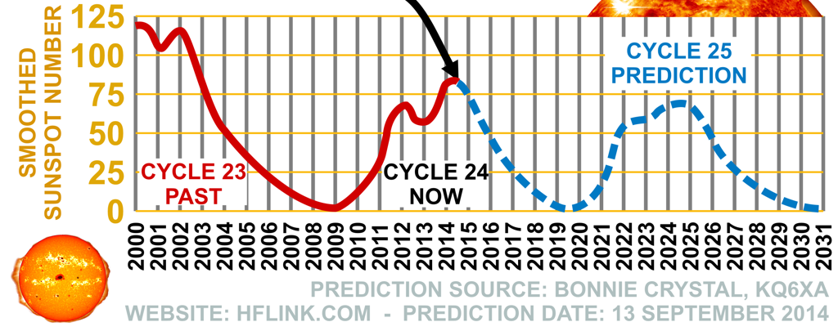
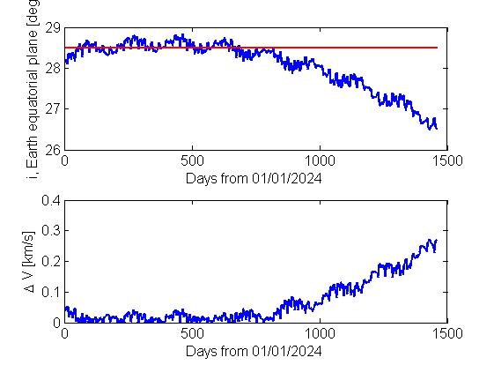
Transit: Launch Date and Time Selection
Moon orbit plane (inclination and RAAN)
Cargo Launch
08/2024
Crew Launch
03/2025
Preferred Launch Dates
Optimal Launch Opportunity: Arriving at DRO at the lunar perigee within the above windows. (reduced time of flight and ΔV)
RAAN: one launch opportunity per day
http://qrznow.com/wp-content/uploads/2014/09/Prediction_Solar_Cycle_-25_HFLINK-190x122.png

Slide 17
Science and Tech Demonstration Objectives
 | Decadal Survey/Stratgic Knowledge Gap | Objectives
S1 | Understanding Solar System Beginnings | Quantify composition, characterize surface processes, probe internal structure, characterize water phases
S2 | Revealing Planetary Processes through Time
S3 | Searching for the Requirements for Life | Detect and identify organic compounds
T1 | In-situ Excavation of Small Body Material | Excavate enough rocks for 5 kg of water
T2 | Extraction of Resources from Excavated Material | Extract water, separate oxides
T3 | Demonstrate Utilization of Extracted Resources | Steam rocket, H/O, sintering, radiation+thermal shielding experiment, experimental garden

Slide 18
Operations Plan – Days 1-11
science drilling campaign
pyrolysis
1
2
3
4
5
6
7
8
9
10
11
adaptation
EVA 1
set up science
drill
collect surface
samples
install pyrolysis
chamber
EVA 2
-operate
plasma drill
-collect
science core
-load pyrolysis
chamber
samples analysis
begin breathing protocol
+ surface sample analysis
samples analysis
begin breathing protocol
testing surface samples
surface samples analysis
surface samples analysis
radiation shielding exp. prep.

Slide 19
Operations Plan – Days 12-22
experimental garden
pyrolysis
shielding experiments campaign
12
13
14
15
16
17
18
19
20
21
22
EVA 3
-collect
pyrolysis
end-product
-sinter
-shielding
experiment
-load steam
rocket
-deploy
SPHEREs
-outreach
steam rocket
+ electrolysis (H/O)
samples analysis
+ astronaut sorbet
samples analysis
samples analysis
oxides separation
samples analysis
samples analysis
packing and disposal
water purification
+ start experimental garden
radiation shielding exp. testing
More science on Earth:
dating, isotopes, space weathering,
oxides, silicates, etc.

Slide 20
Science: Primary Instruments
Imaging
Mineralogy
Sampling
High-Res Camera
Microscopic Imager
Active hyperspectral VISIR spectrometer
X-Ray Diffractometer
Coring Drill
Chisel-in-a-Cup
Chemistry
Structure
Organics
Alpha Particle X-Ray
Density Probe
Neutron Probe
Gamma Ray Probe
Thermocouples
Gas Chromatography -Mass Spectrometer
Radiation
Radiation Detectors

Slide 21
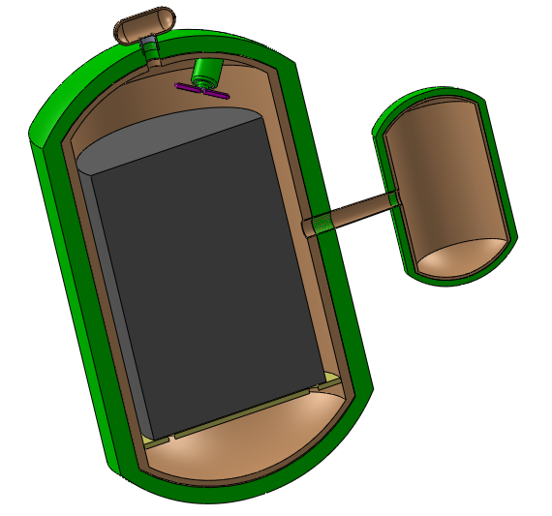

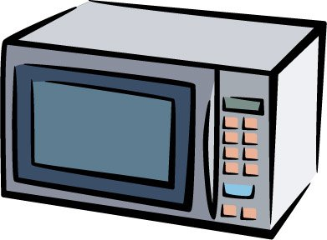
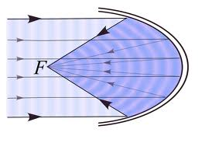
ISRU: Extracting Volatiles from Ore
Water chamber for initial advection gas
Circulation Propeller
Pressure valve opens to condenser at 1 atmosphere
  Initially water vapor and then liquid water in container
Heating via resistance heaters and propeller for circulation
Minimum 5 kg water extracted
Centrifuge then separates volatiles
MLI
Wire mesh ore carrier
Condenser 10°C
Pyrolysis Chamber (400-600°C)
Max ore capacity = 250 kg
0.5 m internal diameter

Slide 22
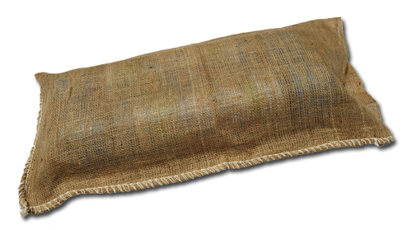
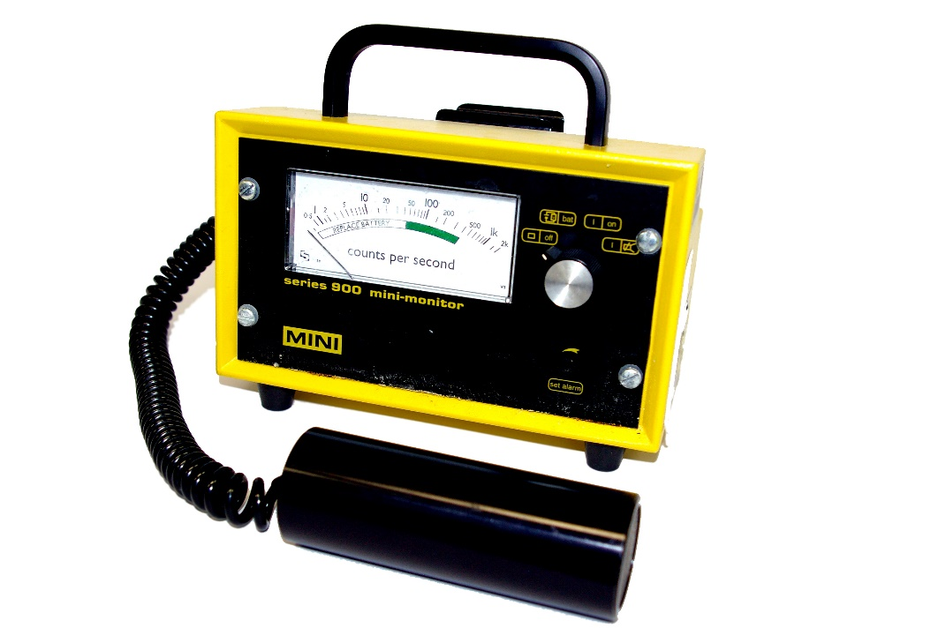
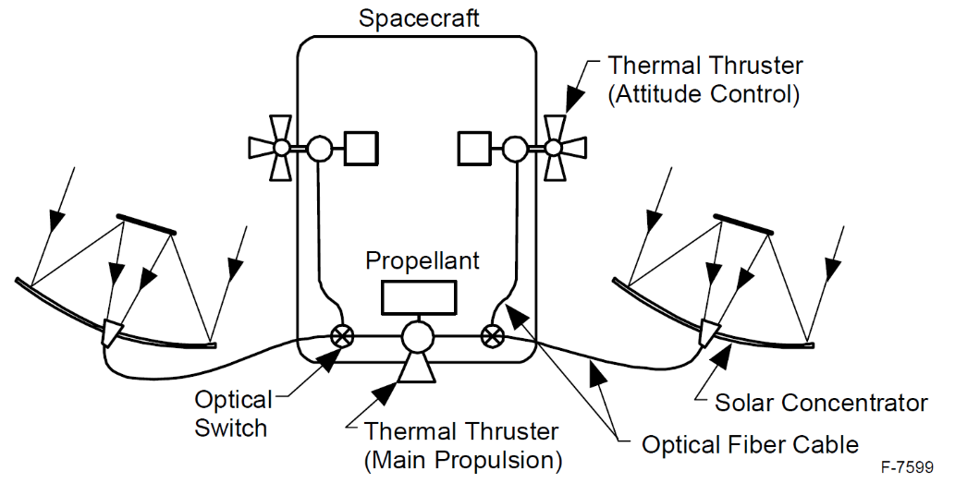
Tech Demos: Steam Rocket, Radiation Shielding
Test 15 kg steam rocket
  Concentrated sunlight vaporizes asteroid water → thrust
  Low ISP (~40 sec)
Good for on/near asteroid operations
  Rugged, simple engine
  Fuel easy to store as ice
Steam Rocket (Nakamura)

Slide 23
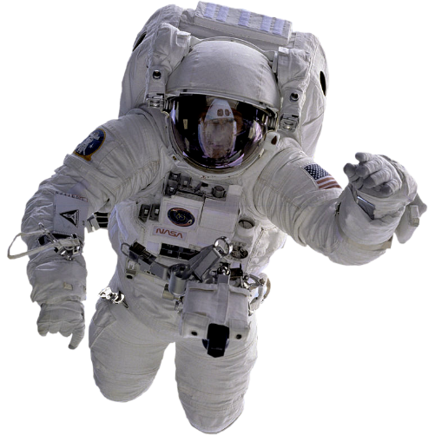

Tech Demo: Semi-Autonomous Robotic Swarm
Derived from the MIT SPHERES-project
Allow for remote and local control
Leave behind as “inhabitants”
Augment situational awareness
Increase outreach capabilities

Slide 24
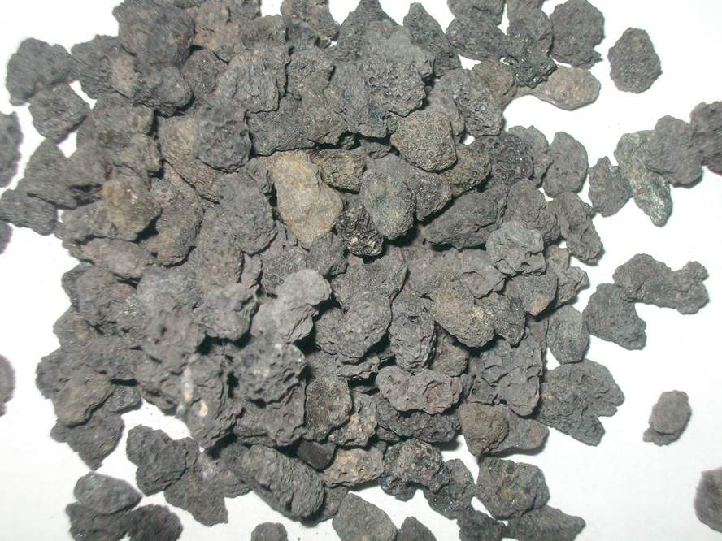
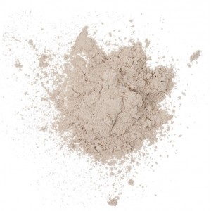


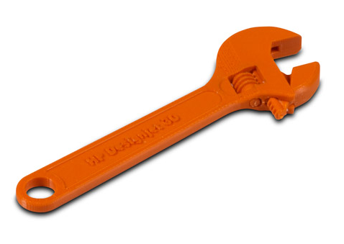
ISRU: Solar Powered Sintering

Slide 25





ISRU: Plant Experiment

Slide 26





Adding Value: Use ARM’s 50 kW Power and Eureka
50 Kilowatt Deep Space Network
Resource Depot
Moon/Mars Abort Station
Wireless Power Demo

Slide 27
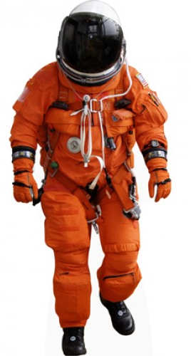
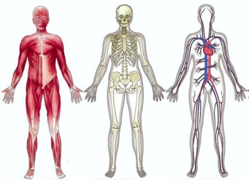
Physiological Deconditioning & Countermeasures
Crew Size, Selection, Training
Selection
- 2 x scientists, 1 x engineer
- odd numbered crew to avoid decisional splits
- people of task-focused styles perform better: aptitude, personality, attitudes, experiences, communication skills
-Typical countermeasures for in-flight, pre-landing, post landing
-Resistive Exercise Device: Rotary MR Damper
-current TRL level of 3, expected TRL level of 7 at TOF
-specifically developed for compact volumes
-Radiation Protection: water walls in Eureka, X-ray monitoring using GOES
-no risk of GCR / risk of SPE
-changes in HR, cephalic fluid shift, bone mass density loss, cardiovascular changes, muscle atrophy, radiation protection
-Psychological training
-Survival training
-Group building activities
-Training together
Training
Notes:
bone mass loss rates, resorption vs formation

Slide 28
ECLSS: Understanding Orion

Slide 29
ECLSS: Building an Independent System

Slide 30


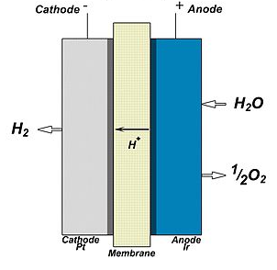
ECLSS: Eureka Environmental Control & Life Support Systems
Atmospheric Monitoring & Regulation
CO2 Reduction: Sabatier (chosen over Bosch and LiOH)
Non-regenerable O2 generation: O2 tanks
Sensor suite for monitoring
TCCS: charcoal sorbent bed to catalytic oxidizer
Fire detection & suppression: JPL E-Nose
Demonstration for future ECLSS Reservoirs
Water Recovery & Purification
-Vapor Phase Catalytic Ammonia Removal (VPCAR) System
-Trades included ISS Water Recovery System & Forward Osmosis Bag
Oxygen Generation with H2 byproduct as Rocket Fuel Source
Solid Polymer Electrolyte Water Electrolysis
-scaled down electrolysis
-typical of ISS Oxygen Gen
Assembly
-demo for future O₂ and H₂
reserves

Slide 31

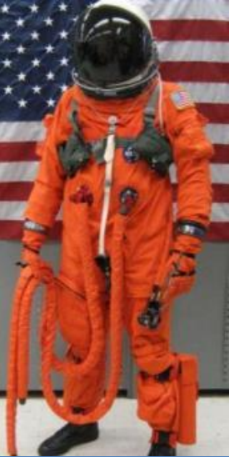
ECLSS: IVA Space Suit Selection
ACES (Advanced Crew Escape Suit)
MACES (Modified ACES)
9 | Current TRL | 6
9 | 2025 TRL | 8
41.7 | Total Mass (kg) | 16
Shuttle | Vehicle Design Fit | Orion
Vehicle Provided - Open-loop | Primary Life Support | Vehicle Provided - Closed-loop
No | EVA Capability | Yes
$180,000 | Cost | Unknown (Est. $360,000)

Slide 32
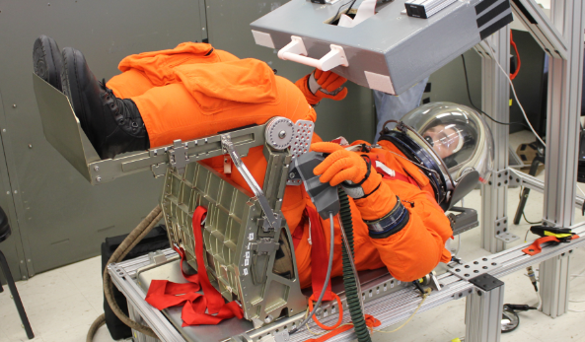
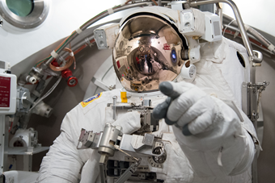
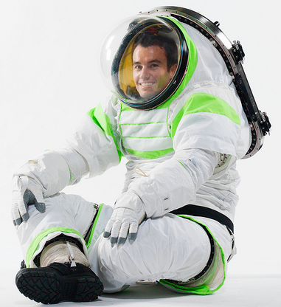
ECLSS: EVA Space Suit Selection
EMU (Extravehicular
Mobility Unit)
MACES (Modified ACES) Suit
Z-3 (Z-Series) Exploration Suit
- TRL Level 6: Demonstrated
- Expected TRL Level 9 by 2022
- Suit Mass: 65 kg
- Life Support: PLSS 3.0
- Nominal EVA Time: 10 hours
- Mobility: High
- Future Mars Exploration Suit
- TRL Level 9: Flight Proven
- Suit Mass: 55.3 kg
- Life Support: PLSS
- Nominal EVA Time: 8 hours
- EVA Mobility: Moderate
- TRL Level 7: Demonstrated in
operational environment
- Suit Mass: 36 kg
- Life Support: PLSS 3.0
- Nominal EVA Time: 10 hours
- Mobility: Low

Slide 33
Systems Engineering: Requirements
All of the requirements are driven by four functional objectives:
# | Functional Objective
1 | Safely bring and return humans to the ARM asteroid
2 | Characterize the asteroid and its environment
3 | Demonstrate the feasibility of in situ resource use for long term missions
4 | Involve and inspire the public
These functional objectives have children requirements. For example:
# | Functional Objective
1 | Safely bring and return humans to the ARM asteroid
1.1 | Protect the crew from the aerospace environment.
1.2 | Provide sufficient propulsion capability to meet the science and demonstration objectives.
1.3 | Design abort options to minimize crew return delays.

Slide 34
Systems Engineering
Payload Budget - Orion
Payload Budget - Eureka
System | Mass [t] | Volume[m³]
Orion | 10.2
Fairing, LAS, Docking | 9.5
Service Module | 16.0
Human Factors | 0.65 | 3
Astronauts | 0.29 | 6
Total | 0.94 | 9
Margin | 0.2 | 0.2
Total + Margin | 36.82 | 10
System | Mass [t] | Volume[m³] | Power avg. [kW]
Habitat | 3.3
Science | 0.98 | 13.4
ECLSS | 8.75 | 3.6 | 2.3
Workspace |  | 10.8
EPS | 0.23 |  | 3.0
TCS | 0.04 | 0.1 | 1.5
GNC | 0.93 |  | 257.4
COM | 0.08 |  | 72.0
OBDH | 0.01 |  | 20.2
Module Structure | 0.5
Total | 14.35 | 28.0 | 2.6
Margin | 0.2 | 0.2 | 0.2
Total + Margin | 17.22 | 33.6 | 3.2
Total
 | Mass [t] | Power [kW]
Total | 51.0 | 47.2
Margin | 0.2 | 0.2
Total + Margin | 54.1 | 56.7

Slide 35
EPS
Power Budget
Primary and secondary batteries in Eureka
Solar array sizing includes required battery charge power
Peaks covered by batteries

Slide 36
Risk management
Risks related to all subsystems are rated according to the NASA risk management standard.
Mitigation strategies are implemented according to the severity
Almost all critical risks reduced to LOM
10: Partial failure of critical system shortly after TLI → Trajectories and maneuvers devised to bring crew back to earth
Consequence Index/ Probability Index | 1 | 2 | 3 | 4 | 5
5 | 23 |  | 8
4 |  |  | 30 | 21/22
3 | 31 | 12 | 11/16/17/20/24 |  | 10
2 | 3/15 | 18 | 2/25/26/27 | 5/6/7/13 | 14
1 | 4 | 1 |  | 29 | 9/19/28

Slide 37
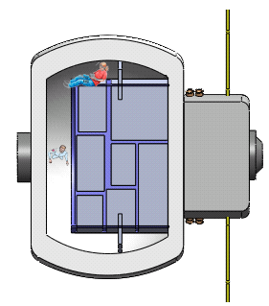
Science Habitat - Eureka
Inflatable
Based on TransHab studies and Bigelow
Mass interpolated from available data
Augments Orion capabilities
Length: 7m
Diameter: 7.5m
SPE Shelter Area
0.5m thick inflatable skin
48m³ in center axis
for instruments/equipment
40m³ additional space
Eureka Service Module
Docking adapters

Slide 38
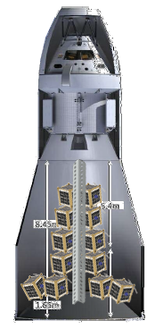
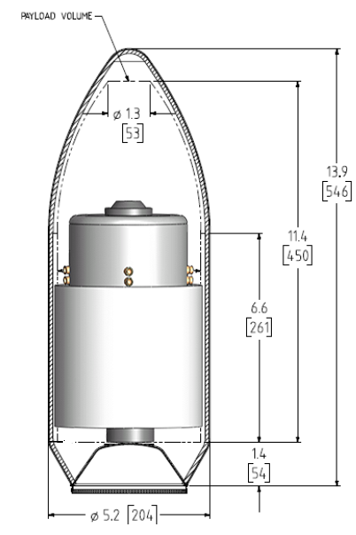
Launch configuration
SLS Block 1B
Falcon Heavy
Deflated Eureka
Secondary payload
→ Outreach

Slide 39
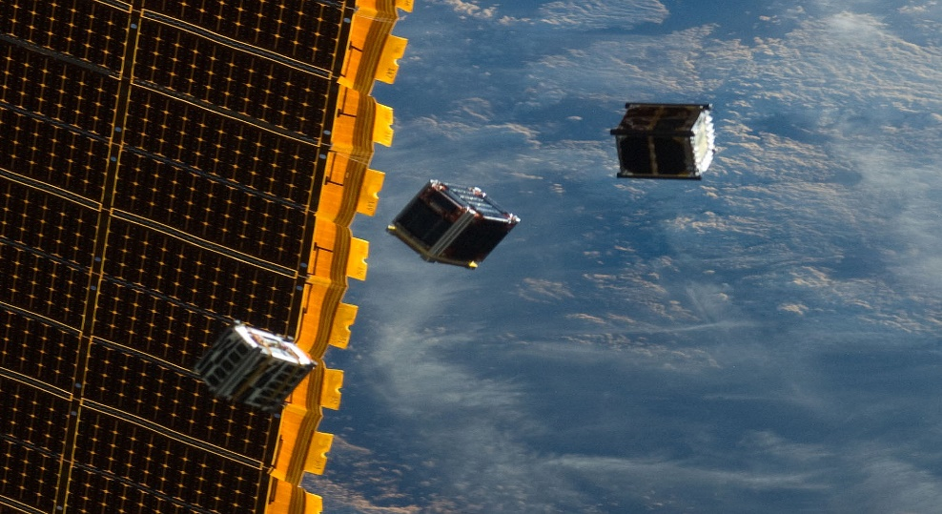
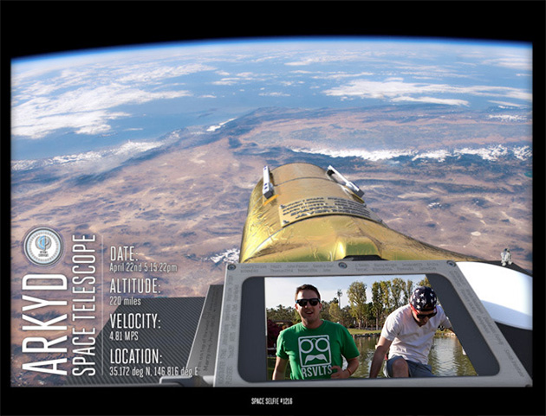

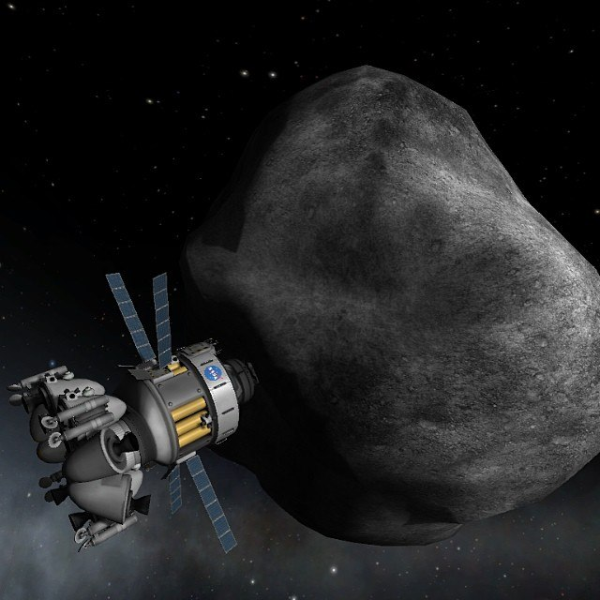
Public Outreach: Tangible Experiences
Space selfies
CubeSats Released at Moon (After Mission)
Arm-Chair Astronauts
Astronaut Sorbet from Processed Water

Slide 40

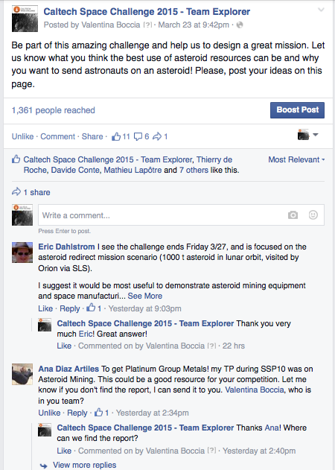
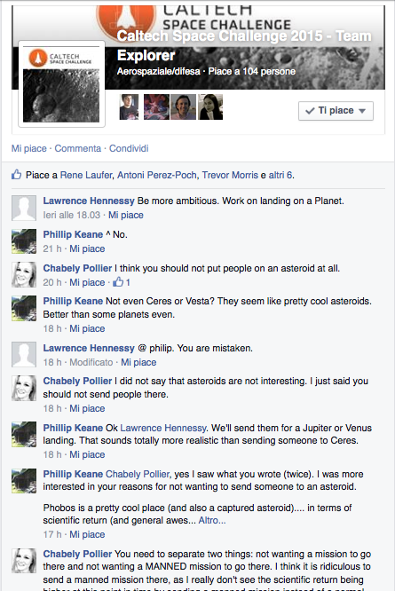
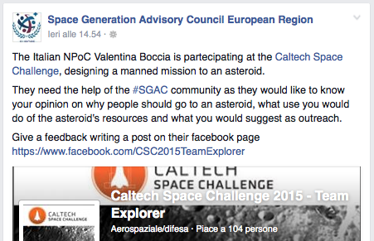
Public Outreach: Social Media in Action
Created a Facebook Page
Picked up by the Space Generation Advisory Council
1,500+ People Reached
Discussion on the International Space University Page

Slide 41
Programmatic Considerations: Budget
Rough estimates of the mission cost are based on the Space Mission Analysis and Design handbook
Launch costs are best guess and do not include development costs
Development of common technologies not included: Orion and SLS program, Orion Service Module (MPCV-ESM), Space suit, annual cost of launch and NASA facilities, Bigelow space module
Item | ROM cost (M$)
2.0 Launch Vehicle
2.1 First launch (Falcon Heavy) | 270
2.2 Second launch incl. Orion capsule and service module (SLS block 1B) | 2,000
Total | 2,270 M$
Launch costs

Slide 42
Programmatic Considerations: Budget
Rough estimates of the mission cost are based on the Space Mission Analysis and Design handbook
Launch costs are best guess and do not include development costs
Development of common technologies not included: Orion and SLS program, Orion Service Module (MPCV-ESM), Space suit, annual cost of launch and NASA facilities, Bigelow Module
Item | ROM cost (M$)
1 Science vehicle assembly
1.1. Inflatable structure | 150
1.2. Custom service module | 250
1.3. Science and tech demo | 700
3.0 Ground Command & Control | 50
4.0 Program level | 220
7.0. Operations | 130
Total (with 20% margin) | 1,800 M$
Vehicle and operation costs

Slide 43



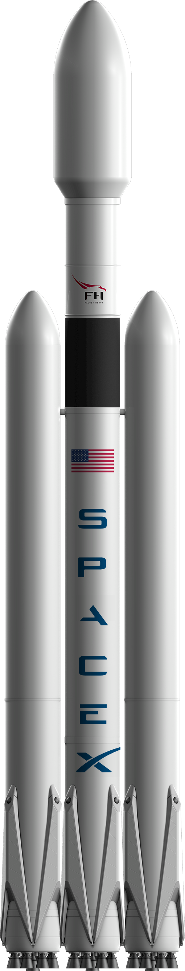
Conclusions: Mission Overview
39
Days
+
x3

Slide 44



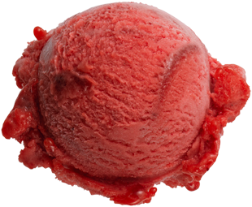
Conclusions: Measure, Treasure, and Pleasure
Science
Utilization
Outreach

Slide 45

Conclusions: We Should be Having Fun Too!

Slide 46










But Seriously…
Moore-Hufstedler Fund
mhf.Caltech.edu
And to the Caltech Space Challenge mentors, speakers, and organizers!

Slide 47





Slide 48
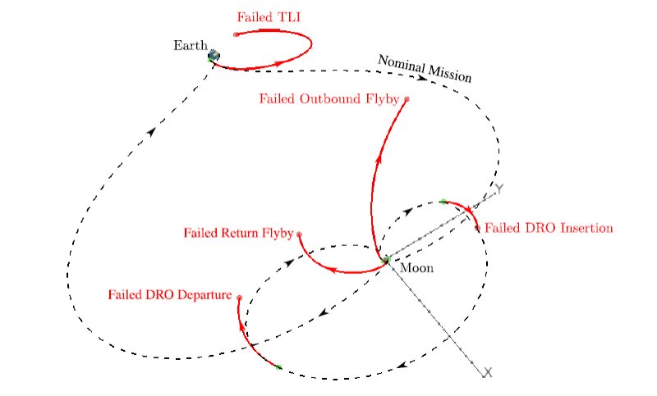
Trajectory Planning: Direct Transfer Abort Option
TOF = 6 days
$$600 m/s$$
Williams & Condon, “Contingency Trajectory Planning for the Asteroid Redirect Crewed Mission,” Paper AIAA 2014-1697

Slide 49
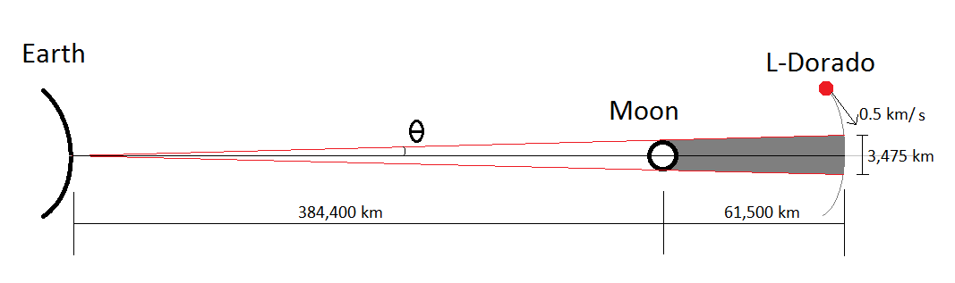
Communications, Command and Data Handling
Two links :
Telemetry link
Crew voice communiction link
High system complexity : Science Data, HD cameras, housekeeping data
C&DH system : 10 kg, 15 dm³ and consume 25 W (‘SMAD’, Wertz)
Time of lunar blackout time ~ 2 h (no operations that require communications fidelity.
ARCHITECTURE
Link budget assumptions:
Data rate: 12 Mbps
X-band frequencies : ~8 GHz
Total losses : 12 dB
Thermal noise : neglected
Ground station : 15 m dish, 200 W
Various losses outside line losses: 12 dB
S/C dish of 10 cm diameter and a power of 20 W
Link closes with margins of 20 dB on the up- and 11 dB downlink.

Slide 50
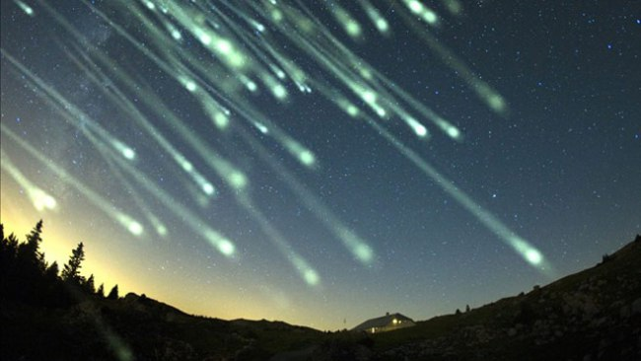
We Had Fun (Ridiculous) Ideas Too
Break up the asteroid and send it to earth to create a spectacular meteor shower.
Expect a huge spike in weddings and wedding proposals on the day of the event.

Slide 51
Back-up Slides

Slide 52
“Hot” Issues
Working hard across disciplines to get everything in one launch. Going to be close.
Difficult to find mass, power, volume, cost, etc… information on existing science instruments.
In situ resource processing doesn’t have much real-world experiments to study.
Looking to push the envelope on creativity. Would like to get your feedback on some concepts. (See back up slides)

Slide 53
Science Missions
Use the resources for future moon and mars missions.
Use a mirror to focus the sun to sinter material.
Build a symbiotic greenhouse where microbes create the resources needed to fuel the plants.
Leave an autonomous station that continues to research and process the asteroid
Use the asteroid as a platform for deep space communications. It could feature both laser powered as well as traditional EM technology. It may be even more valuable as a telecommunications platform if it's in a polar orbit around the moon.
Install telescopes that will benefit from using the asteroid as an effective sun and earth shield.
Use it as an emergency station for moon travelers.
Use the gases and water collected from the asteroid to power a small rocket that navigates around, or possibly to, the moon. It would be more of a steam rocket then a high Isp rocket.
The asteroid's relatively wide orbit around the moon may make it a good platform for radio wavelength observations. The asteroid would also help block polluting signals from the earth.
Use the asteroid to demonstrate micro-gravity refueling.
Use the asteroid for radiation protection, either by boring into it or breaking it into smaller pieces that are installed around a vehicle.

Slide 54
Science Missions
Use bacteria or microbes to digest the asteroid over time. A bag or balloon around the asteroid collects the gases for analysis and use later.
Use the mass of the asteroid to help demonstrate artificial gravity methods.
Use the asteroid as a platform for the Mars Cycler concept.
Beam the 50 kWatts from the ARM to earth to study space-based energy sources. Alternatively, beam the power to a relatively nearby test unit.
Cut the asteroid in half with a laser. Science!
Lunar science base. Green house on moon. Futuristic approach. Telerobot control
Crash the asteroid on the moon, Mars, Venus, etc... to create a plume that can be studied.
Use the minerals from the asteroid to create a solar panel.
Use the moon's tidal forces to break apart the asteroid.
Break the asteroid into pieces, then embed life in the asteroid and send them outside the solar system.
Demonstrate the ability to precisely target and collide with another asteroid.
Use a laser to shape the asteroid, get it to start spinning, and become a reaction wheel.
Testing asteroid deflection technologies for earth protection.
Break up the asteroid and send it to earth to create a spectacular meteor shower. Expect a big spike in wedding proposals.

Slide 55






Launch 1: Falcon Heavy Launch
Core & Upper
Stage Separation
T + 210 s
Upper Stage Ignition
T + 220 s
Payload Fairing Jettison
T + 225 s
Upper Stage
Separation
T + 600 s
Launch Date:
January 4th, 2024
Payload: Science Module
Boosters Jettison
T + 165 s
Rocket | Mass to TLI (kg)
Delta IV Heavy | 11,350
Falcon Heavy | 16,280
SLS Block 1 | 21,660
Must deliver science module mass of 12,000 kg to Trans-Lunar Injection (TLI)
Liftoff
T = 0 s
Only Falcon Heavy and Space Launch System (SLS) are sufficient
SLS may only be able to launch once per year; need SLS for Orion launch
Thus, Falcon Heavy will be used to launch science module

Slide 56
Launch 2: Space Launch System 1B Launch
Core & Upper Stage Separation
T + 476s
Upper Stage Ignition
T + 486s
Upper Stage Separation
T + 1,821 s
Launch Date:
January 4th, 2025
Payload: Orion
Payload Fairing and
Launch Abort Jettison
T + 472 s
SRB Jettison
T + 128 s
SLS Variant | Total Delivered Mass to TLI (kg) | Supplementary Mass (kg)
Block 1 | 28,990 | not available
Block 1B | 46,960 | 11,580
Block 2 | 52,410 | 17,030
Supplementary mass is total mass subtracted by Orion launch mass of 35,385 kg
Liftoff
T = 0 s
Space Launch System Block 1B (available 2021) and Block 2 (available 2024?) are sufficient
SLS Block 1B will be used; SLS Block 2 can be used if available -> Only one launch needed
Stage breakdown by thrust, specific impulse, and mass available in backup slides

Slide 57
Launch Backup
Stage | Variant | Rocket Engine | Thrust (kN)* | Isp (s)^ | Burn Time (s) | Dry Mass (t)* | Propellant Mass (t)*
0 | 1/1B | 2x Modified SS SRBs | 28024 | 252.2 | 128.4 | 104 0. | 631.5
 | 2 | 2x New Composite ATK Boosters | 40031 | 272.5 | 110 | 84 | 790
1 | 1/1B/2 | 4x RS-25D/E | 8277 | 409.1 | 476 | 102 | 979.5
2 | 1 | 1x RL-10-B2 | 110 | 461.5 | 1118 | 3.8 | 26.9
 | 1B/2 | 4x RL-10-C1 | 425 | 448.5 | 1335 | 15 | 129

Slide 58
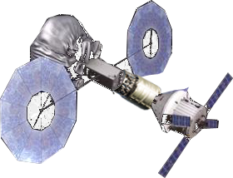
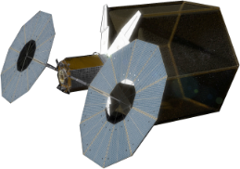
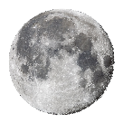




ARM Option A
Lunar DRO
Configuration Change
Delta IV Heavy
SLS Block 1B
Return
2019
2025
2028-2029
Team Explorer

Slide 59





Mission Overview
Stay at asteroid: 11 days
Time
DRO
DRO Departure
(318 m/s)
Orbit Insertion (318 m/s)
Prograde Lunar Flyby
(190 m/s)
Moon
Lunar Flyby
(190 m/s)
Reentry Velocity: ~11 km/s
LEO
TLI
(3.1 km/s)
Crew TOF: 28 days
Crew Vehicle Launch
SLS Block 1b
Return as National Heroes
Timeline not to scale
Earth
March-April 2025
Time

Slide 60

Trajectory Planning: Reentry Velocity
v = ~11 km/s

Slide 61


Tech Demo: Plasma Drill and Radiation Protection

Slide 62

ARC (Asteroid Regolith Crusher)
Cone crusher
Used on earth
Development needed for deep space implementation
Needs self cleaning environment
Spring loaded feeder
Reciever (vacuum cleaner bag)
Crushing surfaces
Pressurized gaz container
Rotating cone
Drive

Slide 63



ISRU: Microbe Powered Greenhouse
+
=

Slide 64

Alternative Pyrolysis Heating Methods (Backup)
30 kW microwave emitter
  ~65-78 % efficiency – difficult to remove waste heat
  Safety concerns with crew nearby
Solar thermal – parabolic mirrors
  Long set up time, limited EVAs
  Area >20m2
  Pyrolysis chamber must be uninsulated
  Astronauts could pass in front of beam

Slide 65
Engineering
Engineering of the vehicles, tools, and instruments primarily relies on the subcontractors.
The program levies requirements based on mission level analysis and assigns factors of safety they must work to.
The general concept is to define what they must not do and not how they must do it.

Slide 66
Programmatic Considerations (Backup)
Cost
Item | ROM cost (M$) | Comment | Num FTE over 10 years
1.0 Space Vehicle
1.1. Orion capsule with service module | 1000 | From web
1.2. Service transfer vehicle | 0 | Assumes European contribution
1.3. Science payload
1.3.1. Laboratory structure | 148 | USCM8: ~(23 k$/kg * 4000kg * 150%)
1.3.2. Laboratory thermal control | 6 | USCM8: ~(23 k$/kg * 136kg * 150%)
1.3.3. Science instruments | 500 | 20 instruments @ 20 M$ + 25%
2.0 Launch Vehicle (launch cost) | 1000 | From web
3.0 Ground Command & Control | 5 | 3% of laboratory cost
4.0 Program level
4.1. System engineering | 31 | 20% of laboratory cost (not instruments) | 16
4.2. Program management | 24 | 15% of laboratory cost | 12
4.3. System integration and test | 24 | 15% of laboratory cost | 12
4.3. Product assurance | 5 | 3% of laboratory cost | 3
4.5. Other | 0
5.0 Flight Support Operations | 0
6.0 Aerospace Ground equipment | 0
7.0. Operations
7.1. PMSE | 24 | 15% of laboratory cost
7.2. Space segment maintenance | 0
7.3. Ground segment | 9 | 30 engineers + 10 tech, for 2 months

Slide 67
Team Members
First Name | Last Name | Focus Areas
Bill | Tandy | Proposal Manager
Chris | Wynard
Dan | Fries | Systems Engineering
Davide | Conte
Henna
Koki | Ho
Lee
Max
Marilena
Mat
Max
Priyanka
Rahul
Simon | Dandavino
Takeshi | Gagliardi
Thierry | de Roche | Extraction
Valentina | Boccia | Science

Slide 68
Launch
Launch concept trade-off
A | Orion + Service Module in SLS Block 1B and Habitat in Block 1B
B | Orion + Service Module in Block 1B and Habitat + Heavy Lift + Upper Stage in Payload for ballistic TLI
C | Orion + Service Module in Block 1B and Inflatable Habitat + Heavy Lift for ballistic TLI
D | Orion + Service Module in Block 1B and Habitat + Heavy Lift + SEP to lunar DRO
E | Orion + Service Module in Block 1B and inflatable Habitat + Heavy Lift + SEP to lunar DRO
Option B - large, cryogenic upper stage, modified payload fairing
Option D - more costly due to customized habitat, additional ARM derived SEP module.
Can-designs have large heritage, ARM is intentionally developed modularly to reuse
Option C - good compromise between risk and cost, chance to develop inflatables further, key technology for future missions. Enough payload volume and mass, including sufficient margins.

Slide 69
Risk Management
Critical Risks
8: Translunar injection maneuver is not successful
→ If the upper stage delivers only a delta-v of 2.92 km/s or lower, the mission cannot be completed (still working on mitigation!)
21: Eclipse by moon/earth
MLI in skin of Eureka to ensure thermal inertia. Include heating device.
22: Eclipse by asteroid
Dock in such a way that spacecraft is not eclipsed. Include heating device.

Slide 70
Launch Trade Example
A | Orion + Service Module in SLS Block 1B and Habitat in Block 1B
B | Orion + Service Module in Block 1B and Habitat + Heavy Lift + Upper Stage in Payload for ballistic TLI
C | Orion + Service Module in Block 1B and Inflatable Habitat + Heavy Lift for ballistic TLI
D | Orion + Service Module in Block 1B and Habitat + Heavy Lift + SEP to lunar DRO
E | Orion + Service Module in Block 1B and inflatable Habitat + Heavy Lift + SEP to lunar DRO
Option B - large, cryogenic upper stage, modified payload fairing
Option D - more costly due to customized habitat, additional ARM derived SEP module.
Can-designs have large heritage, ARM is intentionally developed modularly to reuse
Option C - good compromise between risk and cost, chance to develop inflatables further, as a key technology for future missions. Enough payload volume and mass, including sufficient margins.

Slide 71
Eureka
Habitat trade-off
Science equipment and experiments require considerable amount of space
Improved radiation shielding allows for extended stay
Inflatables as key technology for future manned exploration and utilization missions
More usable payload per launch
Inflatable heritage does exist
 | “Can” design | Inflatable
Living/Working Space | + | +++
Heritage | +++ | +
Radiation Shielding | ++ | +++
Mission Duration | + | ++
Tech. advancement | + | ++
Mass | + | ++
Cost | ++ | +
Total | 11 | 14

Slide 72
Programmatic Considerations (Backup)
Cost
Item | ROM cost (M$) | Comment | Num FTE over 10 years
1.0 Space Vehicle
1.1. Orion capsule with service module | 1000 | From web
1.2. Service transfer vehicle | 0 | Assumes European contribution
1.3. Science payload
1.3.1. Laboratory structure | 148 | USCM8: ~(23 k$/kg * 4000kg * 150%)
1.3.2. Laboratory thermal control | 6 | USCM8: ~(23 k$/kg * 136kg * 150%)
1.3.3. Science instruments | 500 | 20 instruments @ 20 M$ + 25%
2.0 Launch Vehicle (launch cost) | 1000 | From web
3.0 Ground Command & Control | 5 | 3% of laboratory cost
4.0 Program level
4.1. System engineering | 31 | 20% of laboratory cost (not instruments) | 16
4.2. Program management | 24 | 15% of laboratory cost | 12
4.3. System integration and test | 24 | 15% of laboratory cost | 12
4.3. Product assurance | 5 | 3% of laboratory cost | 3
4.5. Other | 0
5.0 Flight Support Operations | 0
6.0 Aerospace Ground equipment | 0
7.0. Operations
7.1. PMSE | 24 | 15% of laboratory cost
7.2. Space segment maintenance | 0
7.3. Ground segment | 9 | 30 engineers + 10 tech, for 2 months

Slide 73


Public Outreach: Tangible Experiences
Art Using Returned Asteroid Material
CubeSats Released at Moon (After Mission)
Name the Asteroid Leave Disc of Names
Astronaut Sorbet from Processed Water

Slide 74
References
TBD

Slide 75
Programmatic Considerations

