Slide 1


OASIS
Orbiting Asteroid for Strategic In-situ Supplies
CALTECH SPACE CHALLENGE
2015
TEAM VOYAGER

Slide 2
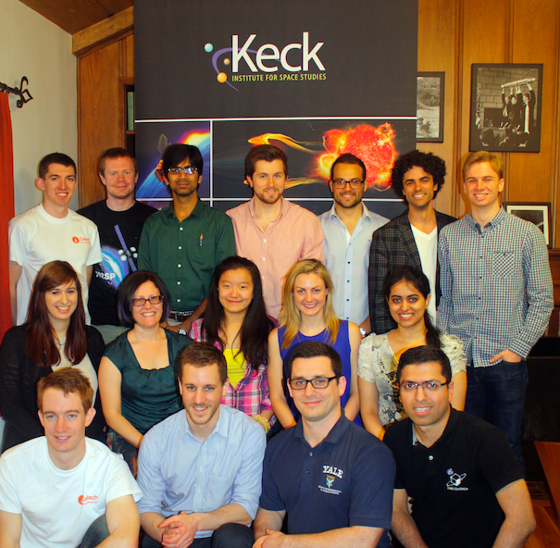
Team Introduction
Introduction
Mission Overview
Science
16 team members:
10 Engineers
  8 Aerospace
  1 Mechanical
  1 Chemical
1 Materials Science
1 Planetary Science
1 Applied Math
1 Architect
2 Physics
Engineering
Human Factors
Program
Conclusion
Notes:
So I’d like to introduce our team
We are a team of 16, and what’s interesting to see is the team breakdown
Firstly: We are all very technically capable to design a mission that will push the design envelope!
Secondly: We are a diverse group of students and the benefits of being so diverse will hopefully become apparent in this presentation

Slide 3
Problem Statement
Introduction
Mission Overview
  Assume that in 2024 the Asteroid Redirect Mission successfully returns
  500 metric tons of
  C-type asteroid material
  to a distant retrograde lunar orbit (DRO)
  with mean radius of 61,500km
  In five days, each team is challenged to design a mission to land humans on an asteroid brought back to lunar orbit, extract the asteroid’s resources and demonstrate their use. The launch date of the mission may be no later than January 1st 2028
Science
Engineering
Human Factors
Program
Conclusion
Notes:
So this is the problem that we were given when we arrived at the Caltech Space Challenge
We only have five days to land humans on this asteroid and to demonstrate use of the asteroid’s resources
The required mission launch dates as seen from the problem statement are constrained between 2024 and 2028

Slide 4
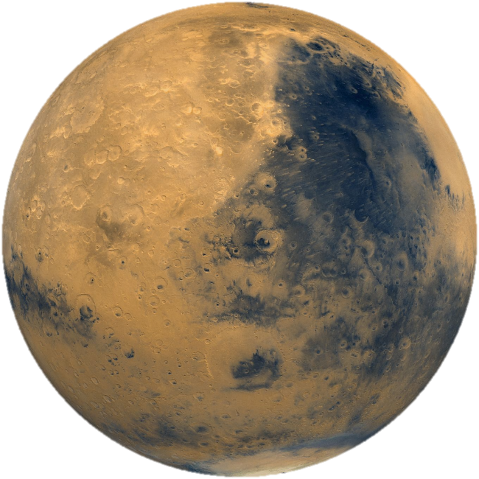
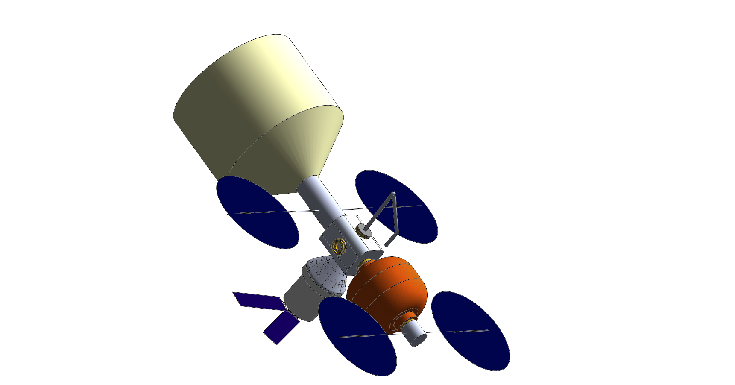
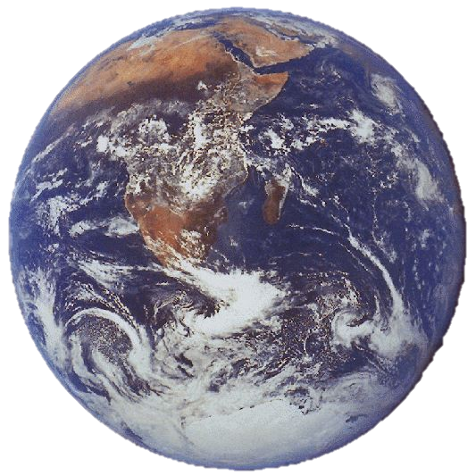
NASA’s Flexible Path
Introduction
Mission Overview
“Steadily advancing… human exploration of space beyond Earth orbit… successively distant or challenging destinations…”
Science
Engineering
Human Factors
Program
Conclusion
OASIS mission is one step towards the long-term goal of a human mission to Mars
Notes:
The ARM, as mentioned in our problem statement forms part of the larger strategic for NASA’s human exploration
The Flexible Path constitutes a
steadily advancing
publicly notable
human exploration of space- past Earth orbit to
enable scientific discoveries
engage the public
ARM is a part of this goal
OASIS is an intermediate step between ARM and the Mars mission

Slide 5
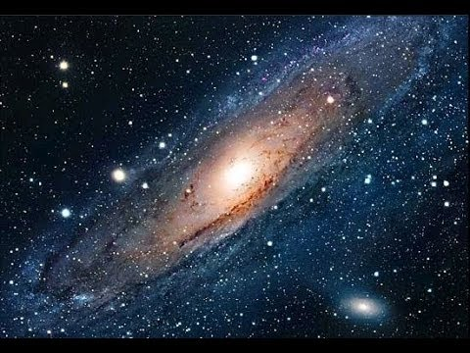
Motivation
Introduction
Mission Overview
Why this mission?
Science
“Demonstrate viability of ISRU via the production of materials beneficial to mankind from asteroid resources for extraterrestrial exploration.”
“Ascertain the content, origin, and evolution of the solar system and the potential for life elsewhere.”
“Discover how the universe works, explore how it began and evolved, and search for life on planets around other stars.”
Engineering
Human Factors
Program
Conclusion
The outcome of this mission will guide the utilization of resources for future space exploration
Notes:
So, our solar system is huge and there is a hugely diverse number of exciting missions that would fit along the flexible path
Why this mission?
Why an asteroid?
There are multiple reasons, the main ones listed here
All of these reasons feed into the fact that the outcome of this mission will guide the utilization of resources for future space exploration!

Slide 6
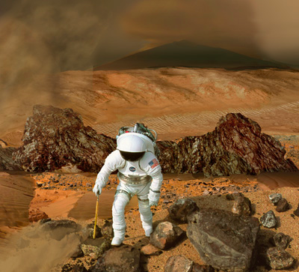
Motivation
Introduction
Mission Overview
Why send humans?
Science
Engineering
“Expand the frontiers of knowledge, capability, and opportunity in space.”
“Expand human presence into the solar system and to the surface of Mars to advance exploration, science, innovation, benefits to humanity, and international collaboration.”
Human Factors
Program
Conclusion
The outcome of this mission will guide the future manned mission to Mars
Notes:
We know the mission
As with anything in space- incredibly difficult (technically, logistically and otherwise
Why not just do a robotic mission and spare the expense and risk of a human mission>
As before- the outcome of this mission will guide the future manned mission to Mars
There is no analog study on earth or possible other way to prepare us for such an event

Slide 7
Voyager Team Assumptions
Introduction
Mission Overview
In addition to the problem statement:
Successful delivery of asteroid to DRO by the ARRM
There exists a docking mechanism to attach to ARRM
Platform can utilize ARRM power generation
Astronauts have access to the asteroid surface
The asteroid is stable
Low-fidelity characterization of the asteroid is complete
Communication between astronauts during EVA is possible throughout all proximity operations
SLS Block 1B is available
Science
Engineering
Human Factors
Program
Conclusion
Notes:
So, here are the assumptions that we have made about the mission to narrow our scope and to guide our objectives and requirements
Distant retrograde orbit

Slide 8
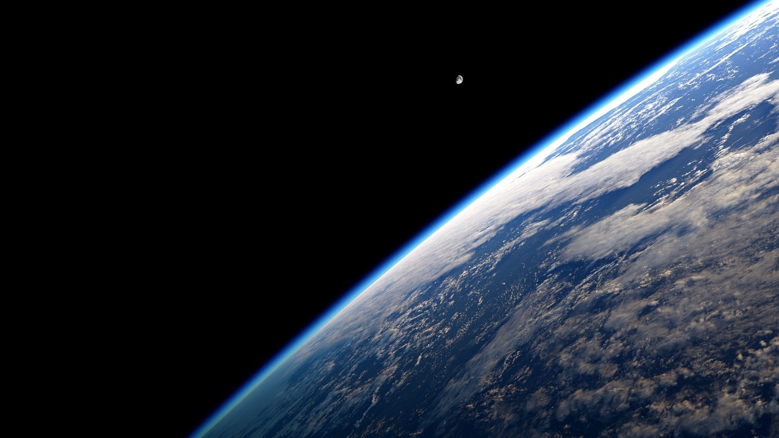
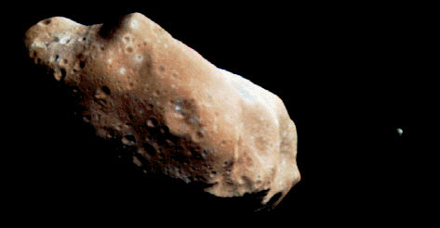
OASIS: Mission Statement
Introduction
Mission Overview
Science
The OASIS mission will demonstrate the capability for humans to live and work independently in deep space through the creation of a long-term platform and in-situ resource utilization of an asteroid.
Engineering
Human Factors
Program
Conclusion
Notes:
So here we have arrived at our mission-

Slide 9
Objectives
Introduction
Mission Overview
The mission will contain science, technological and human factor objectives:
Science
Engineering
Primary Science Objectives
Characterize space environment around asteroid
Extract, process and demonstrate use of resources
Characterize the internal structure and composition of asteroid
Human Factors
Program
Conclusion

Slide 10
Objectives
Introduction
Mission Overview
The mission will contain science, technological and human factor objectives:
Science
Engineering
Primary Technological Objectives
Reach Lunar Distant Retrograde Orbit with manned mission and return crew successfully using Orion capsule
Demonstrate ability of crew to survive in deep space environment for the duration of the mission
Develop platform for deep space exploration
Human Factors
Program
Conclusion

Slide 11
Objectives
Introduction
Mission Overview
The mission will contain science, technological and human factor objectives:
Science
Engineering
Primary Human Factor Objectives
Demonstrate ability of crew to independently perform EVA in deep space environments
Record physiological and psychological data from crew and compare to ISS data
Demonstrate capability of spacesuit designs for exploring a new terrain
Human Factors
Program
Conclusion

Slide 12




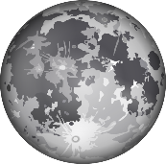


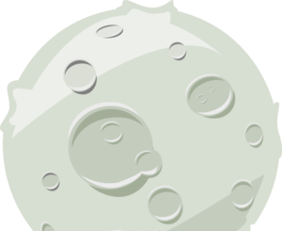







Team Voyager’s Answer: OASIS
Introduction
Mission Overview
Asteroid Redirect Robotic Vehicle
Science
OASIS
Engineering
Habitat
Human Factors
Program
Conclusion
Multi-Purpose Docking Module
Propulsion Module
Orion
  Habitat + Propulsion Module - 17.6 T
  Orion + Multi-Purpose Docking Module - 33.5 T

Slide 13
Mission overview
Introduction
Mission Overview
The science payload will be used to survey the asteroid for structural integrity, environmental safety and determine composition and structure
The astronauts will perform 7 EVAs
  Six for ISRU
  One for independent decision making
Science
Engineering
Human Factors
Program
Conclusion
Notes:
Delta v of 9.3 km/s is required for both launches to enter LEO.
Additional delta v requirements for insertion into proper trajectory are shown, and the sum of the two requirements dictates the launch vehicle mass capability

Slide 14
Science Operations
Introduction
Mission Overview
Objectives | Product | Instrument
Characterize internal structure and composition | 3D geological model | Seismic Monitoring Module
 |  | Subsurface Drill
 |  | Composition Analysis Unit
Characterize space environment | Dust, micrometeroid radiation and plasma outgassing | Space Environment Monitoring Module
Extract, process and demonstrate use of resources | 3kg raw material, water, propellant, radiation shield | Resource Utilization Demonstrator Module
Science
Engineering
Human Factors
Program
Conclusion
Notes:
Robotic or manned?
Convey that characterization is complete before humans

Slide 15
Human Factor Operations
Introduction
Mission Overview
Science
Objective | Product | Instrument
Study human health and psychology in deep space | Radiation Data | Radiation area monitor
 | Health Data | AN/UDR-13 Radiac Set
 | Mood Data | Crew Health Care System (CHeCS)
Demonstrate human independent decision making in deep space | Mission Control Training | Short duration EVA with LABitat acting as Mission Control Simulate communications delay
 | Independent Decision Making | Select Asteroid sample analysis experiment from predetermined list
Engineering
Human Factors
Program
Conclusion

Slide 16
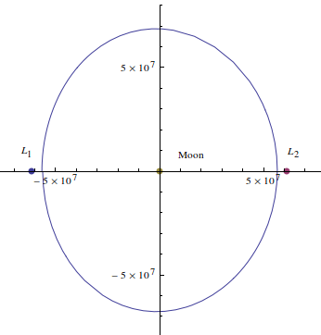
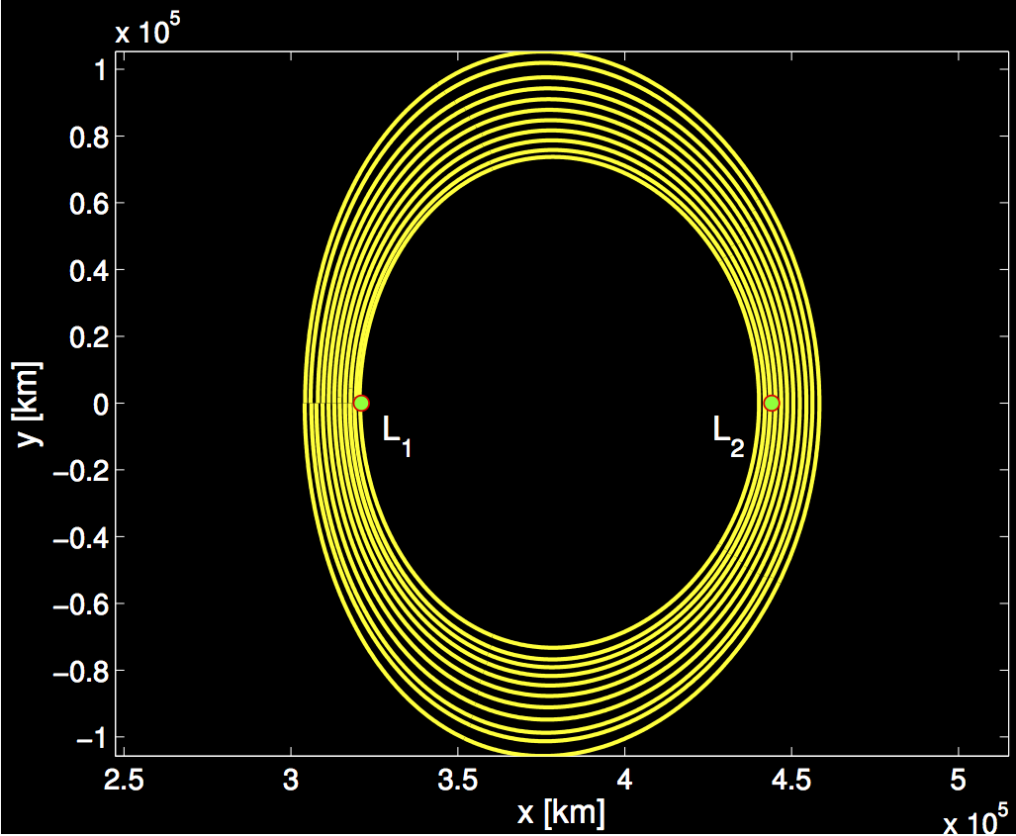
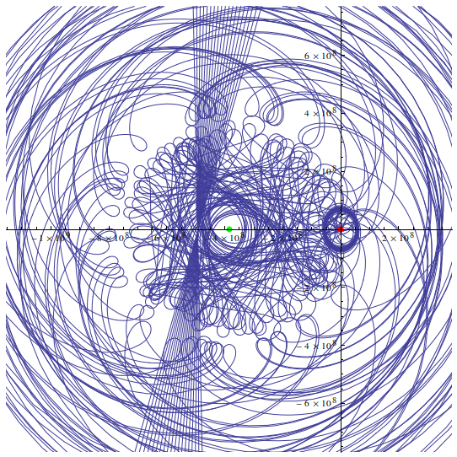
Orbit
Introduction
Mission Overview
  Mean radius: 61,500km
  Orbits found to be stable for over 100 years
Science
Engineering
Human Factors
Program
Conclusion
Notes:
DRO’s are from Parker et. al, 2015

Slide 17
Launch Vehicle Selection
Introduction
Mission Overview
Two launches
  One cargo launch (Habitat + Propulsion Module)
  One crew launch (Orion + Multi-Purpose Docking Module)
Science
Engineering
Human Factors
Launch | Launch Vehicle | Transfer | Mass Cap (T) | Actual Mass (T) | Flight time (days) | Insertion Delta-V (m/s)
Habitat + Propulsion Module | Falcon Heavy | Ballistic | 18.5 | 17.6 | 100 | 3100
Orion + Multi-Purpose Docking Module | SLS Block 1B | Flyby | 37.8 | 33.5 | 8.5 | 3370
Program
Conclusion
Notes:
Delta v of 9.3 km/s is required for both launches to enter LEO.
Additional delta v requirements for insertion into proper trajectory are shown, and the sum of the two requirements dictates the launch vehicle mass capability

Slide 18
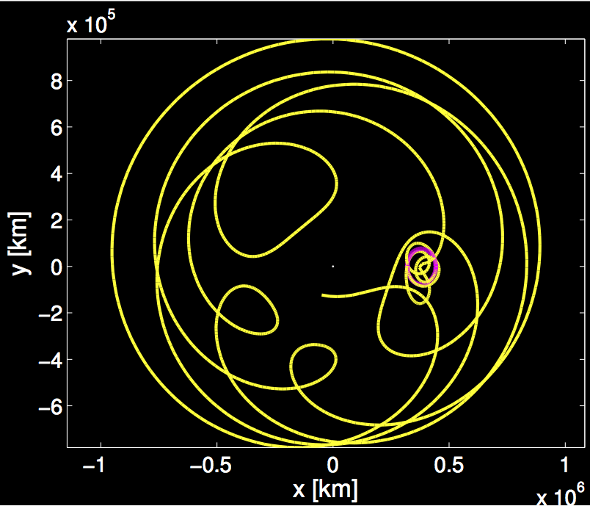
Cargo Approach Trajectories
Introduction
Mission Overview
Cargo
  Ballistic Trajectory
  Cruise time of ~100 days
  Station-keeping (~15 m/s): MMH/N₂O₄
  Zero DRO Insertion Δv
Science
Engineering
Human Factors
Program
Conclusion

Slide 19
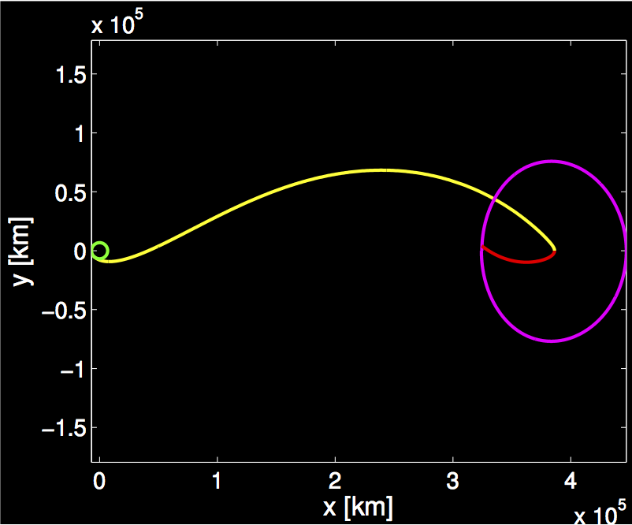
Crew Approach Trajectories
Introduction
Mission Overview
Crew
  Apollo-style rendezvous with additional payload before insertion into fly-by trajectory
  Cruise time of 8.5 days
  Payload Propulsion: Orion, MMH//N₂O₄
  DRO Insertion Δv: 480 m/s
Science
Engineering
Human Factors
Program
Conclusion

Slide 20
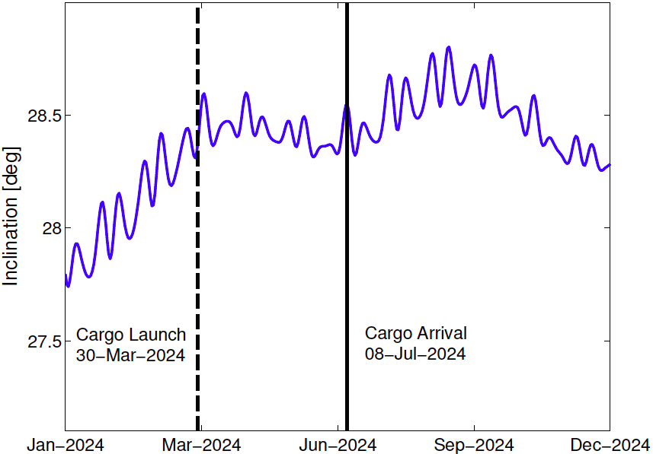
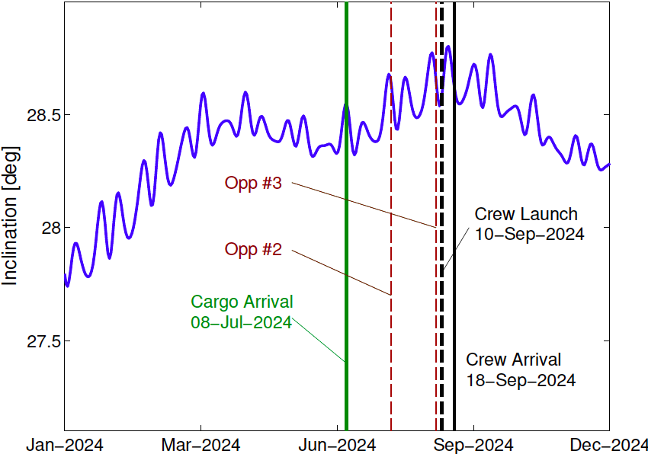
Launch windows
Introduction
Mission Overview
 | Cargo phase | Crewed phase
Driver | Sun-Moon position | Phasing at DRO
Launch opportunity | ~28 days | ~10.5 days
Science
Engineering
Human Factors
Program
Conclusion
Notes:
For the direct transfer orbit (Crewed phase) the main concern is the position of the asteroid in the DRO. Being its period 10.5 days, there is one optimum opportunity every 10.5 days. Delays of +-1days in the launch date may be adjusted during the transfer orbit. That is, if you launched one day late, then you will adjust the delta V to reduce the flight time by one day. The figures show the inclination of the Moon for the considered launch period. The crewed mission will arrive 10.5 days after the habitat, leaving a one period gap with the habitat.

Slide 21
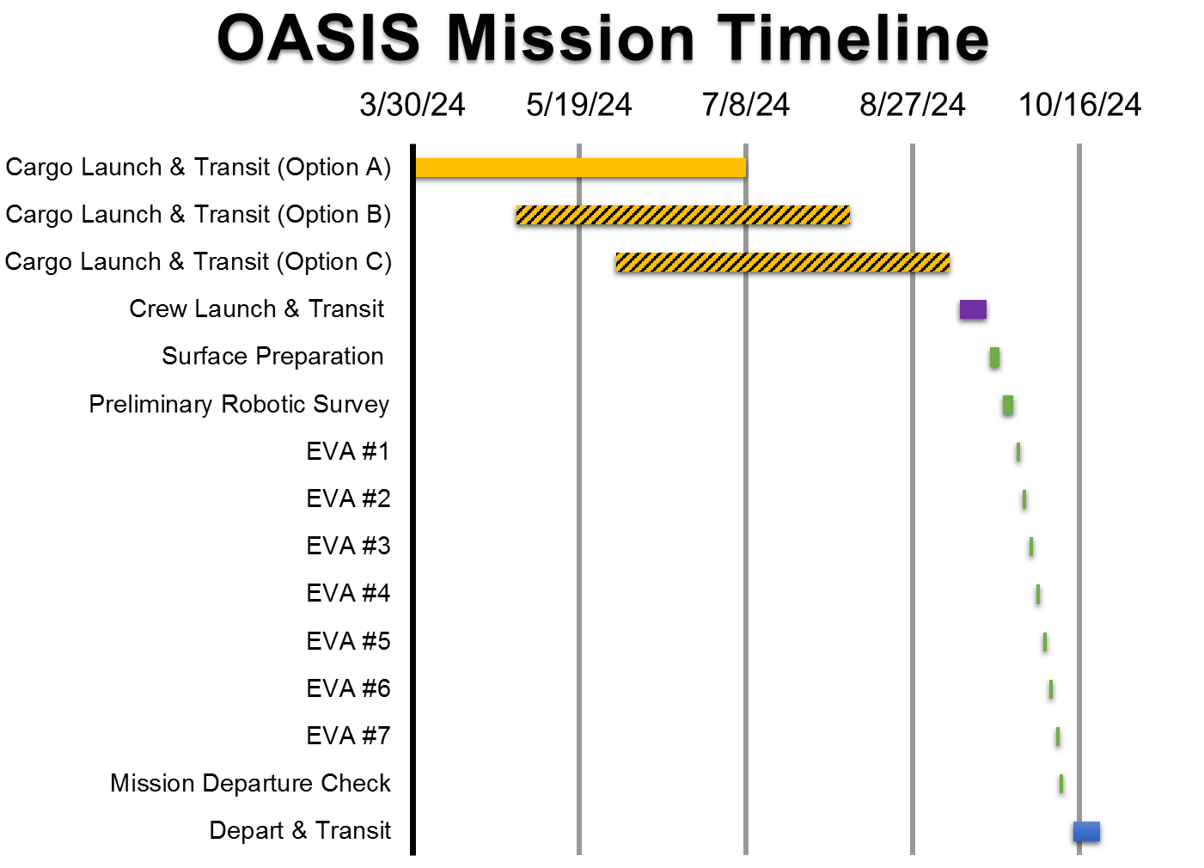
Introduction
Mission Overview
Science
Engineering
Human Factors
Program
Conclusion
Notes:
Now let’s clarify exactly what makes up a space system architecture
This chart is from NASA’s most recent Design Reference Architecture study and shows one potential architecture concept
In this chart we see the vehicles used in the mission, a timeline showing transit times and times between key events and the number of earth launches required for the mission
Essentially, this is a good illustration of what an architecture is; an attempt to capture the mission as a whole

Slide 22
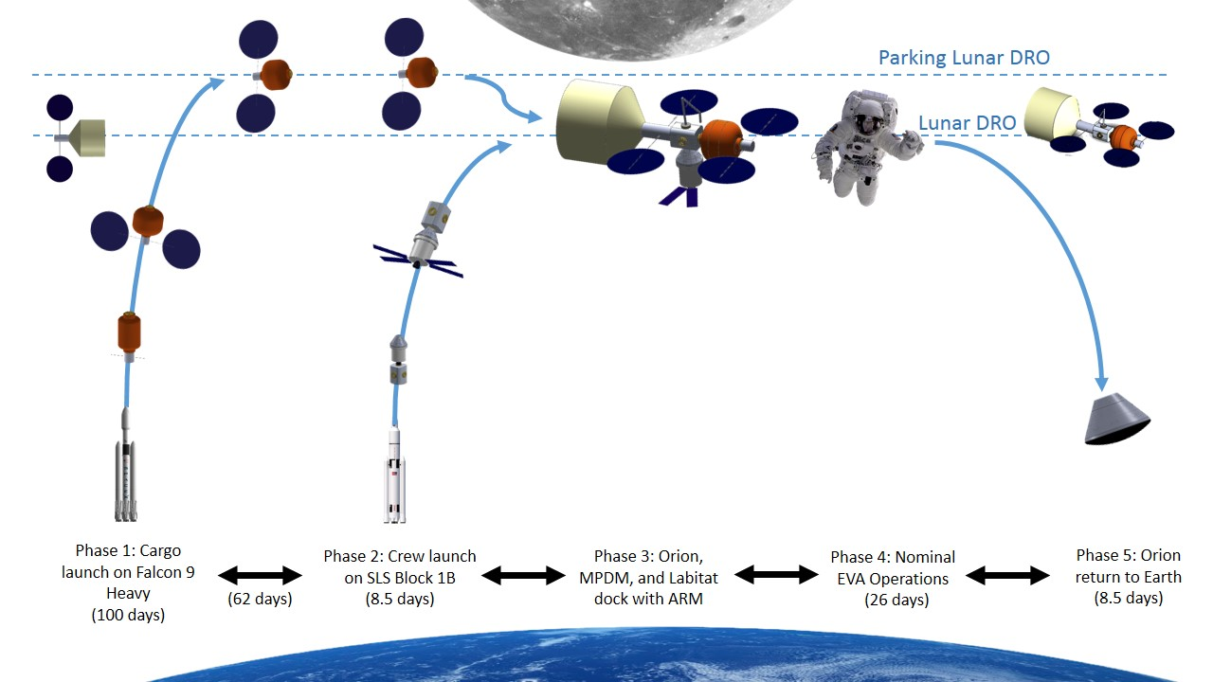
Mission Architecture
Introduction
Mission Overview
Science
Engineering
Human Factors
Program
Conclusion

Slide 23
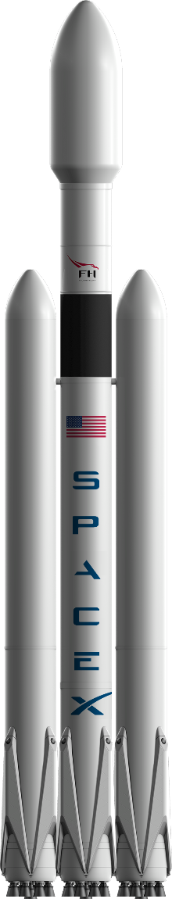
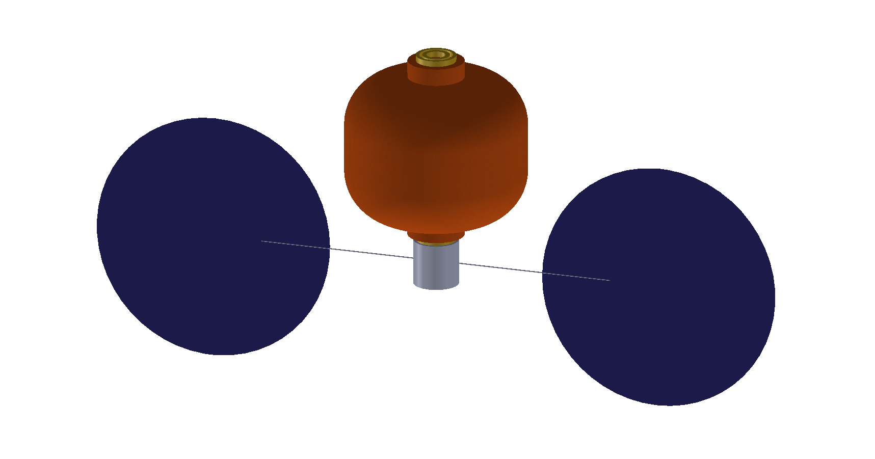
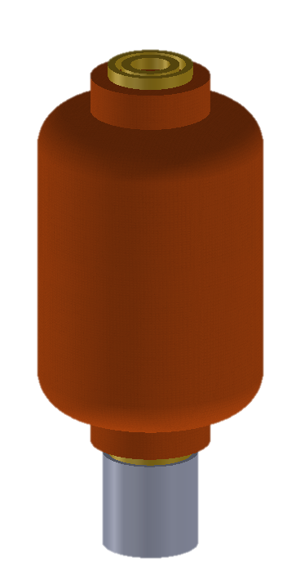
Mission Architecture
Introduction
Mission Overview
Phase 1
Launch of Labitat & Propulsion module
Trans-lunar injection in a ballistic (low-energy) trajectory
Inflate Labitat
Insert into a parking Lunar Distant Retrograde Orbit (DRO)
Science
Engineering
Human Factors
Program
Conclusion
Falcon Heavy
Launch configuration
Inflated Labitat
Deployed solar array
+

Slide 24
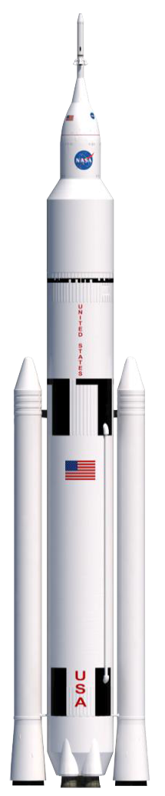
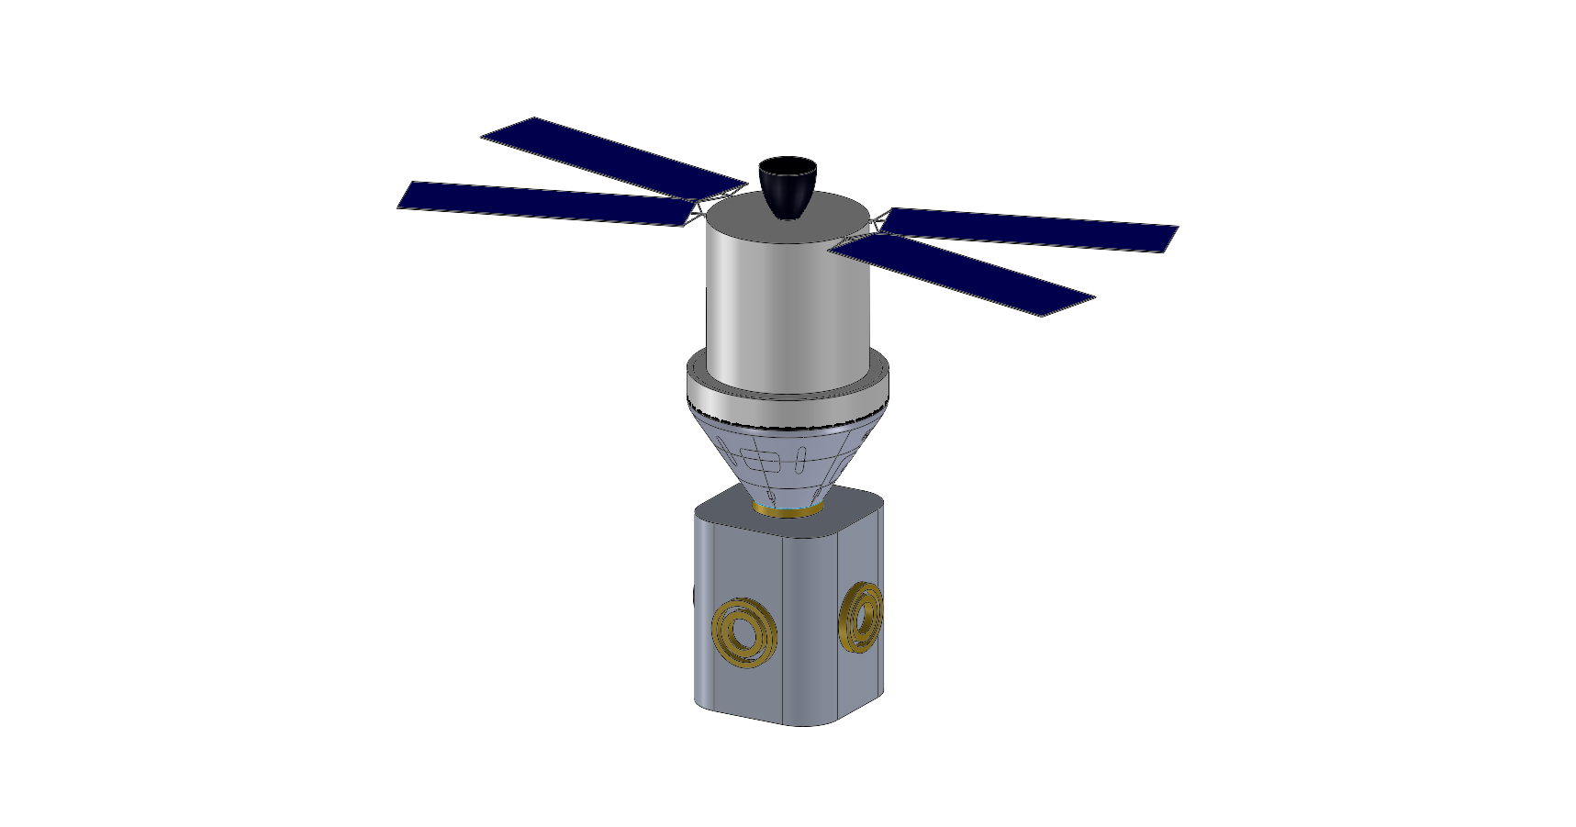
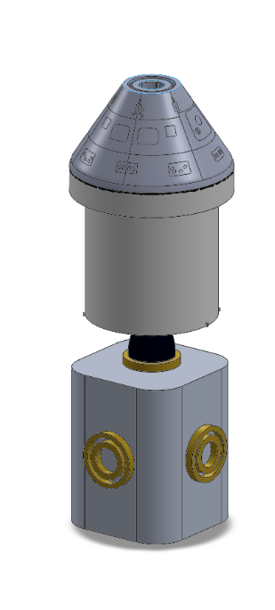
Mission Architecture
Introduction
Mission Overview
Phase 2
Launch of Orion & Multi-Purpose Docking Module (MPDM)
Trans-lunar injection (TLI) in a flyby outbound trajectory
Transposition, docking, and extraction (TD&E) maneuver to dock Orion to MPDM
Insertion into DRO
Dock with ARRM
Science
Engineering
Human Factors
Program
Conclusion
SLS Block 1B
Launch configuration
After TD&E maneuver

Slide 25
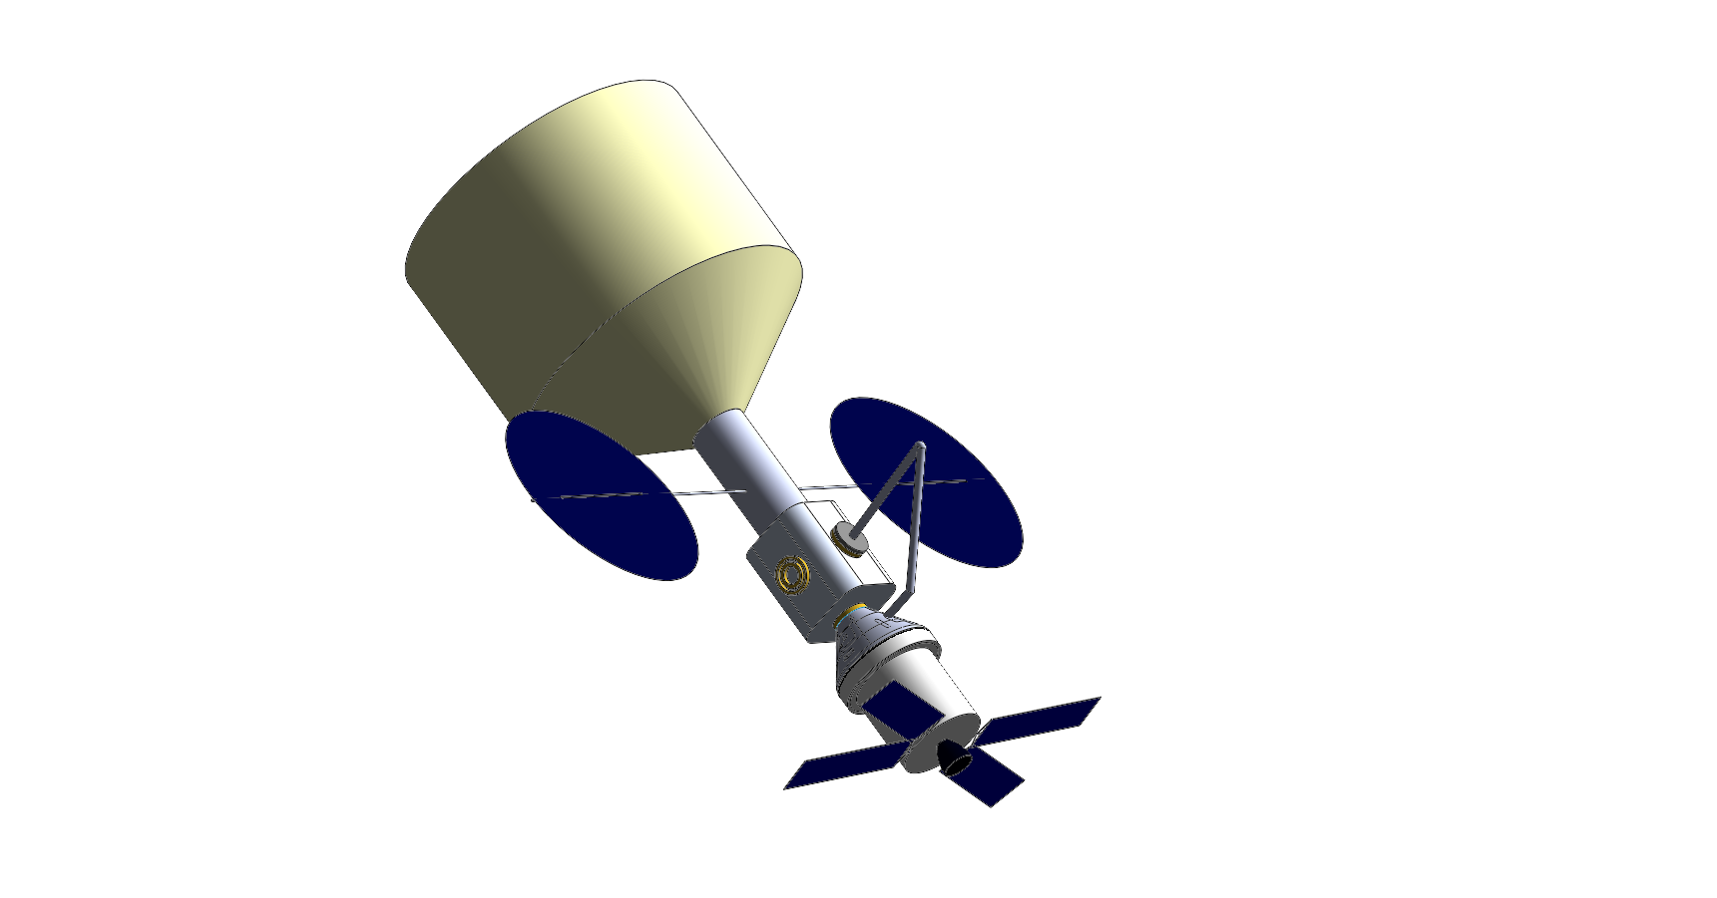
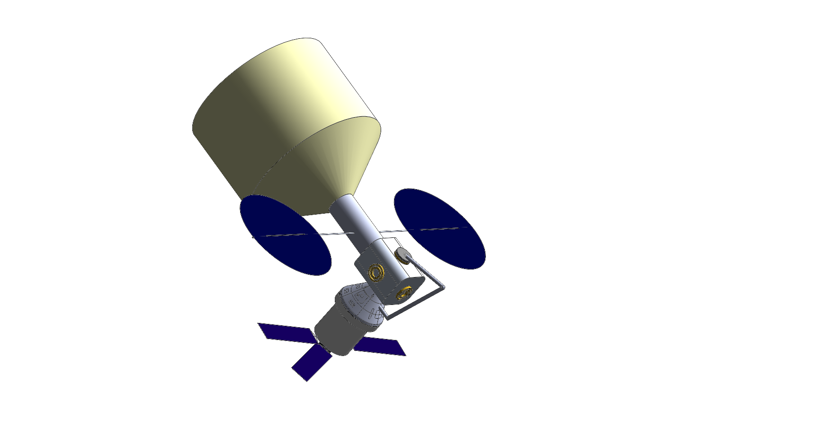
Mission Architecture
Introduction
Mission Overview
Phase 3
  Use Canadarm3 to undock Orion from the side of the MPDM and dock it to the bottom of the MPDM, making way for Labitat.
  Labitat & Propulsion module approaches for docking
  Docking of Labitat with MPDM
Science
Engineering
Human Factors
Program
Conclusion

Slide 26
Mission Architecture
Introduction
Mission Overview
Phase 4 (Nominal operations)
  Summary of nominal operations
  Start of science experiments
  7 Extra-Vehicular Activities
  Mission duration
    Minimum: 39 days (22 days for science, 17 days for travel)
    Nominal: 3 months
  Note: At the end of mission and in case of emergency, move to Phase 5.
Science
Engineering
Human Factors
Program
Conclusion

Slide 27
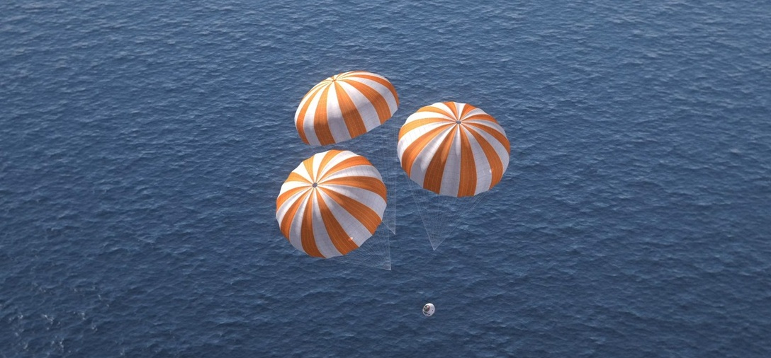
Mission Architecture
Introduction
Mission Overview
Phase 5
  Undock Orion from the bottom of the MPDM.
  Trans-Earth injection (TEI)
  Entry, descent and splashdown in the Pacific ocean
Science
Engineering
Human Factors
Program
Conclusion
Orion EFT-1 Splashdown (Photo Credit NASA)

Slide 28
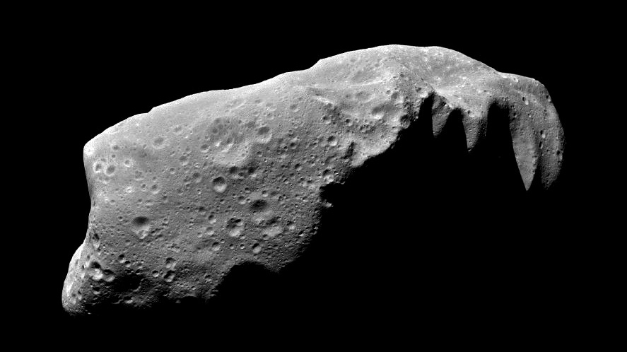
Science Overview
Introduction
Mission Overview
Space Environment
Total Dose Radiation
Plasma
Outgassing
Dust
Composition
Water content
Water form
Chemical analysis
Elemental analysis
Science
Ensure the safety of the crew and equipment
Integrity
Drilling, sampling
Seismic survey, monitoring
Engineering
Determine subsurface composition and identify resources
Human Factors
Program
Conclusion
Extract, process, and demonstrate utilization of the identified resources
ISRU
Deep drill
Resource Utilization Demonstrator
Notes:
[What is Space Environment] http://www.esa.int/Our_Activities/Space_Engineering/Space_Environment/Introduction_to_space_environment
-- Script yourself with Tribble’s book on The space Environment
<What is Space Environment>
-- Space Environment = the physical environment in outer space
-- What s space ?
Def Space = Definition of Space for both international or domestics : There is no formal definition of where space begins. International law, based on a review of current treaties, conventions, agreements and tradition, defines the lower boundary of space as the lowest perigee attainable by an orbiting space vehicle. A specific altitude is not mentioned. By international law standards aircraft, missiles and rockets flying over a country are considered to be in its national airspace, regardless of altitude. Orbiting spacecraft are considered to be in space, regardless of altitude.
The Fédération Aéronautique Internationale has established the Kármán line at an altitude of 100 km (62 mi) as a working definition for the boundary between aeronautics and astronautics. This is used because at an altitude of about 100 km (62 mi), as Theodore von Kármáncalculated, a vehicle would have to travel faster than orbital velocity in order to derive sufficient aerodynamic lift from the atmosphere to support itself.^{[7]}
The United States designates people who travel above an altitude of 50 miles (80 km) as astronauts.^{[70]}
NASA's mission control uses 76 mi (122 km) as their re-entry altitude (termed the Entry Interface), which roughly marks the boundary where atmospheric drag becomes noticeable (depending on the ballistic coefficient of the vehicle), thus leading shuttles to switch from steering with thrusters to maneuvering with air surfaces.^{[71]}
<Why Are we Studying Space Environement>
Understanding the basic nature of the environment and of the potential interactions(effects) between the environment and spacecraft engineering subsystems
Understand and address conditions existing in space that affect the operation of spacecraft
<ESA Definition>
The Space Environments and Effects section is the Agency's focal point for analyses of the physical environment in space and its effects on space systems and astronauts.
The space environments considered include energetic particle radiation, plasmas, atmospheres, micro-particles, and contamination. They can all cause serious problems for space systems and experts need to carefully take them into account during the development of spacecraft and space missions.

Slide 29
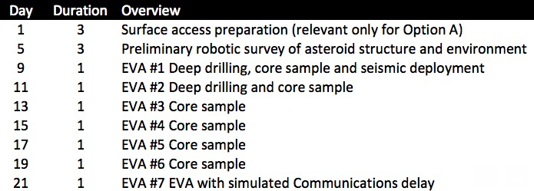
Science Operations Overview
Introduction
Mission Overview
Science
Engineering
Human Factors
Program
Conclusion

Slide 30
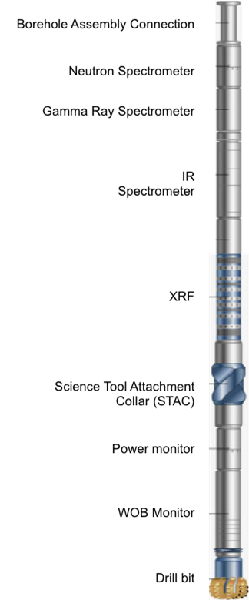
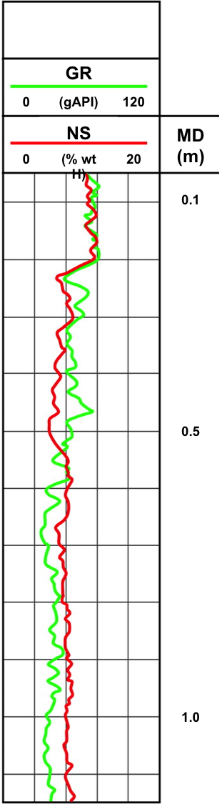
Subsurface Drill Composition Analysis Unit
Introduction
Mission Overview
Deep drill: correlation of geological information to geophysical (seismic) data
Near-IR Spectrometer: chemical analysis and water presence (and form)
X-Ray Fluorescence: detailed elemental analysis
Gamma Ray Spectrometer: lithology determination
Neutron Spectrometer: water content
Science
Engineering
Human Factors
Program
Conclusion

Slide 31
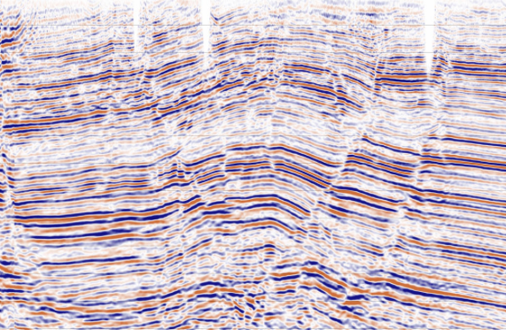
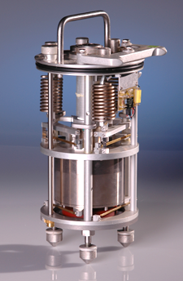
Seismic Monitoring Module
Introduction
Mission Overview
Internal Structure
Seismic array: detailed 3D geophysical image of the asteroid interior
Continuous monitoring of internal changes due to excavation/manipulation
Science
Engineering
Human Factors
Program
Conclusion

Slide 32
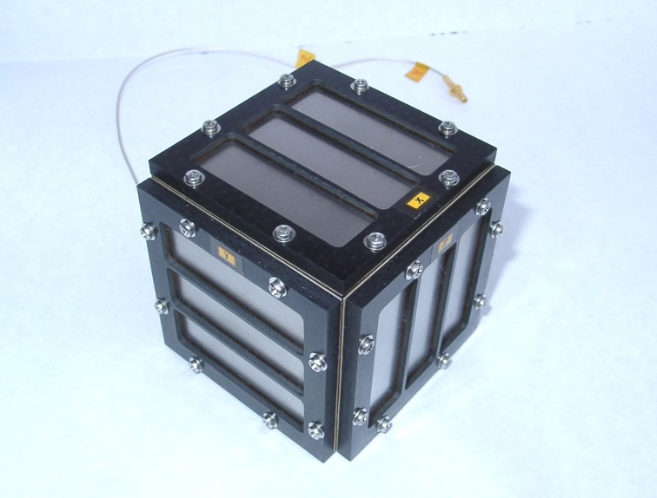
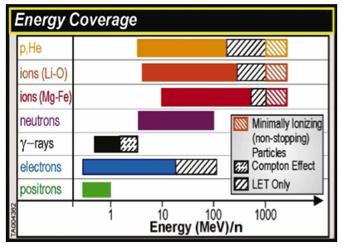
Space Environment Monitoring Module
Introduction
Mission Overview
Surface Dust Impact Monitor
Provide continuous dust velocity and mass measurement
DIM senses the falling particles by an arrangement based on the acoustic impact monitoring principle
Surface Radiation Access Detector
Provide surface galactic cosmic rays (GCR) and solar energetic particles (SEP) continuous measurement
Surface Magnetometer and Plasma Monitor
Study the local magnetic field and the interaction between the asteroid and the solar wind by measuring magnetic moment and plasma spectrum
Science
Engineering
Human Factors
Program
Conclusion
Energy Coverage Range of MSL-RAD
Notes:
Dust Detector
Active regions of the comet P/Wirtanen are thought to emit particles of different sizes. As a result of the gas drag and gravity force, some part of the particles will be ejected to interplanetary space, some part will fall back onto the nucleus. A dust impact monitor (DIM), placed on the ROSETTA Lander will observe those particles on the surface of the comet which temporarily leave the surface but fall back due to insufficient velocity. The DIM senses the falling particles by an arrangement based on the acoustic impact monitoring principle.

Slide 33
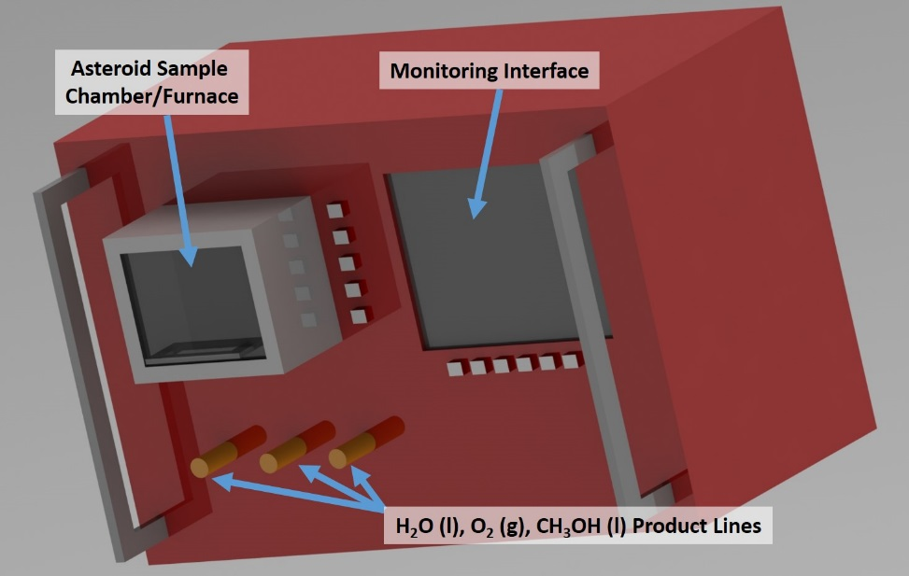
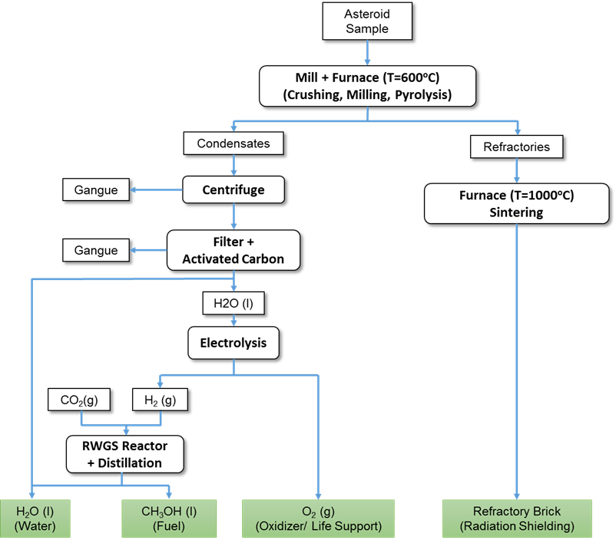
Resource Utilization Demonstrator Module
Introduction
Mission Overview
Science
Engineering
Human Factors
Program
Conclusion
Contains:
Pyrolysis furnace
Volatile processing cell
Oxygen Generation System (OGS)
Reverse Water Gas Shift (RWGS) reactor

Slide 34
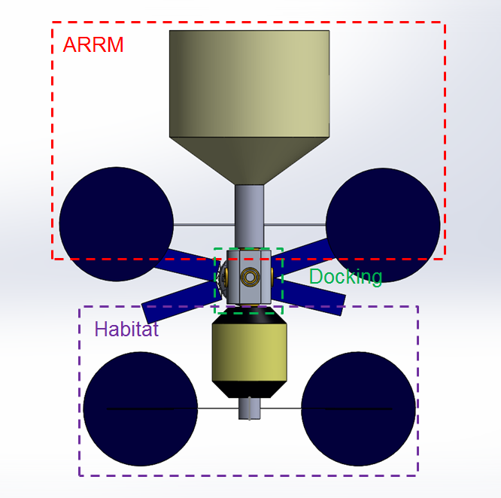
Structural Components: Mass and Volume
Introduction
Mission Overview
Equipment | Launch 1 Mass/ t | Launch 2 Mass/ t
Orion | - | 26
Science | - | 1
Habitat | 12 | -
Docking Module | - | 6
Power | 0.25 | -
Propulsion + GNC | 2.1 (0.5+1.6) | -
Avionics | 0.5 | -
Thermal | 0.5 | 1.5
Communications | 0.2 | -
Spares | 0.25 | 0.25
ECLSS | 1.1 | -
Robotic Arm | 0.4 | -
Airlock | 0.4 | -
Science
Engineering
Human Factors
Program
Conclusion
Component | Volume/ m³
Habitat | 201.8
Docking Module | 77.83
Notes:
(Shanti)

Slide 35
Docking and Propulsion Modules
Introduction
Mission Overview
Multi-Purpose Docking Module
  Launches with the SLS 1B and Orion
  6 docking ports for Orion, airlock, ARV, Labitat, CanadarmX/Experiment Rack, and one empty
Propulsion Module
  Launches with Habitat module
  Houses communications, radiators and heat exchangers, solar arrays, GNC, and propulsion/ACS
  Guides Habitat during ballistic transfer
  Provides station keeping and attitude control
Science
Asteroid Redirect Robotic Vehicle
Engineering
CandarmX
Habitat
Human Factors
Program
Conclusion
Docking Module
Propulsion Module
Orion
Component | Volume m³ | Mass mT
Docking Module | 78 | 7.2
Propulsion | 77.83 | 3.6
Notes:
(Shanti) The multi-purpose docking module is launched with the astronauts on the SLS and provides a backbone for the entire station. A rack for housing all of the science tools is placed here, as well as the airlock and robotic arm. Docked to the fore port is the asteroid redirect robotic mission vehicle, and docked to the aft is the habitat module. Orion is docked to one of the side ports, and another side port is left open for potential resupply, or station expansion.
The propulsion module is attached to the aft of the habitat. It houses all of the hardware for maneuvering and pointing, guidance, navigation and control, power generation, and heat radiation.

Slide 36
Protection from Deep Space: Thermal, ECLSS, Space Environment
Introduction
Mission Overview
Active Heating Systems with radiators
Open-Loop ECLSS System
Consumable launched in habitat on Falcon Heavy
Inflatable shell provides improved impact protection over aluminum
Central core uses consumables and waste as additional protection in the event of large radiation event
  Calculations show 15 cm material in core and 0.5 m outer wall provide sufficient shielding to meet NASA exposure standards during CME
Science
Engineering
Human Factors
Program
Conclusion
Component | Mass [kg] | Power [W] | Volume [m^3]
ECLSS Storage and Systems | 400 | 154 | 1.6
ECLSS Consumables | 700 | [-] | 2.1
Thermal System | 1326 | 184 | 7.7
Larson, Wiley J., and Linda K. Pranke. Human Spaceflight: Mission Analysis and Design. New York: McGraw-Hill, 2000. Print.
Notes:
(Shanti) In the extreme thermal environment of a distant retrograde orbit, a combination of an active thermal system and substantive insulation is used to maintain ambient temperature on station. For the defined mission length, an open-loop ECLSS system makes the most sense, with the possibility for recharge by visiting commercial resupply vehicles. For the first deployment, all ECLSS consumables are launched packed inside of the habitat. The habitat shell itself is based upon concepts developed by NASA for its transhab concept, and further by Bigelow aerospace. This shell technology is shown to provide much better shielding from micrometeroids as compared to aluminum structures, and is about to get flight time as part of the BEAM experiment on ISS. Finally, for radiation protection, our calculations show that for the lunar environment of this mission, background levels are acceptable, and for additional shielding in the event of a Coronal Mass Ejection, the central core of the habitat is design with 15 cm of shielding in addition to the half meter thick inflatable walls. Consumables and waste are strategically placed around this storm shelter to provide maximal protection.

Slide 37
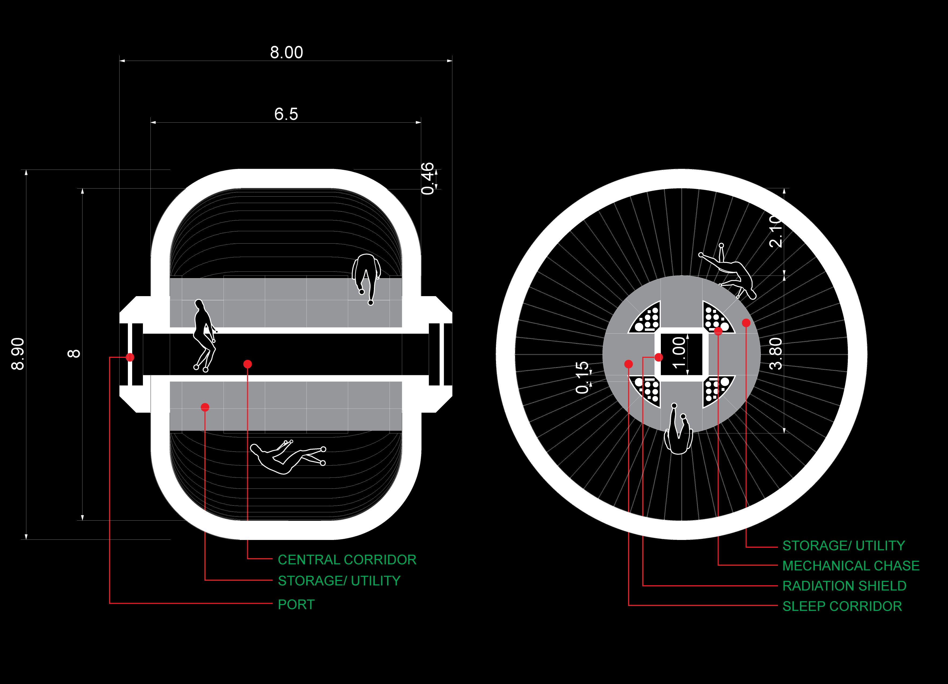
Labitat Module
Introduction
Mission Overview
1st habitat in deep space as a stepping stone
Science
Engineering
Human Factors
Program
Conclusion
Notes:
(Ryan) The previous slide determines the habitat in numerical terms of provided adequate capability for survival, and functionally for the scope of our mission, it is required to provide safe haven to the crew for a long enough duration to complete the science objectives. However, if we are ultimately to fulfill the vision of living and working far beyond Earth’s surface, and accomplish one of our stated goal of demonstrating this vision, we need a place that is not just a shelter for the astronauts, but a proper home and workspace. The official name, Labitat, reflects this dual purpose. Based on a modified Bigelow BA 330, it consists of a central structural core, which provides a backbone both structurally and functionally for the crew. A central tunnel runs the length of the core, and intersecting tunnels at right angles form passage to the opposite side of the station, nooks for sleeping quarters at night, and strategically placed radiation shelters in the event of a storm.

Slide 38
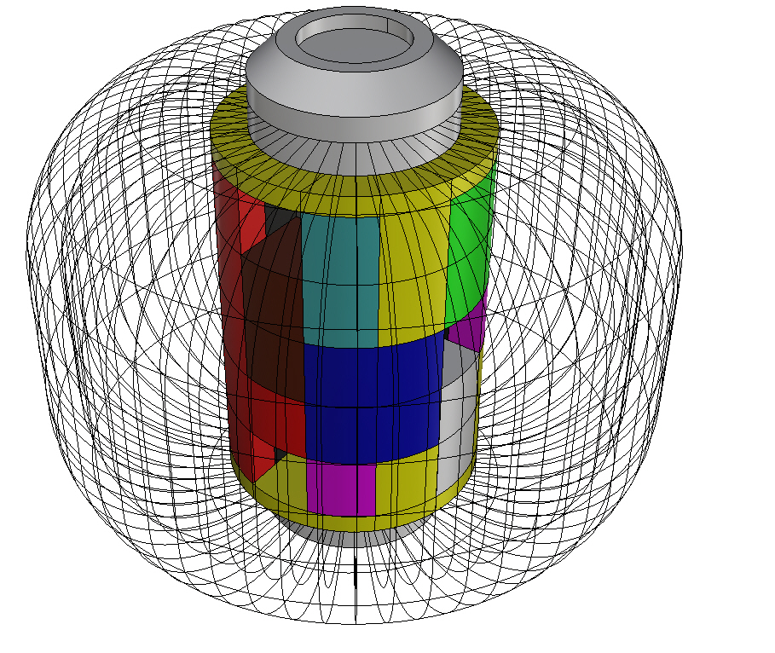
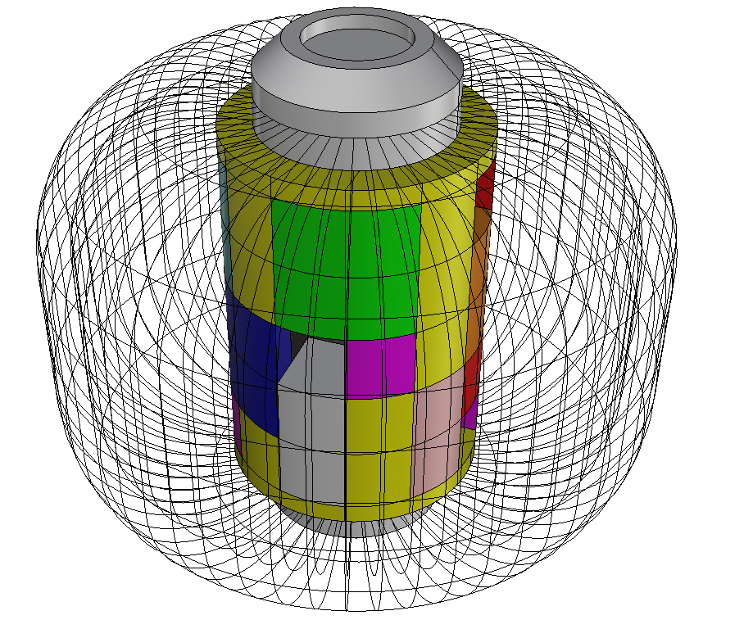
Labitat Functional Areas
Introduction
Mission Overview
Science
Engineering
Human Factors
Program
Conclusion
Core serves as backbone for structure and human functionality
Water: orange, Food: teal, Waste: brown, EVA: light gray, Science: red, Workstation: green, Personal effects: magenta, Entertainment: pink, Toilet: black, Pantry: lavender, Exercise: blue, Flexible/open: yellow
Notes:
(Ryan) Around the perimeter of the core, there are racks and voids for carrying out scientific experiments, and for storage. By taking advantage of microgravity to allow 360 degree access to any point of the toroidal living and working space, we are designing to the environment and using the precious volume to maximize both form and functionality in a way that can be easily extrapolated to have implications for long term presence of human’s in space.

Slide 39
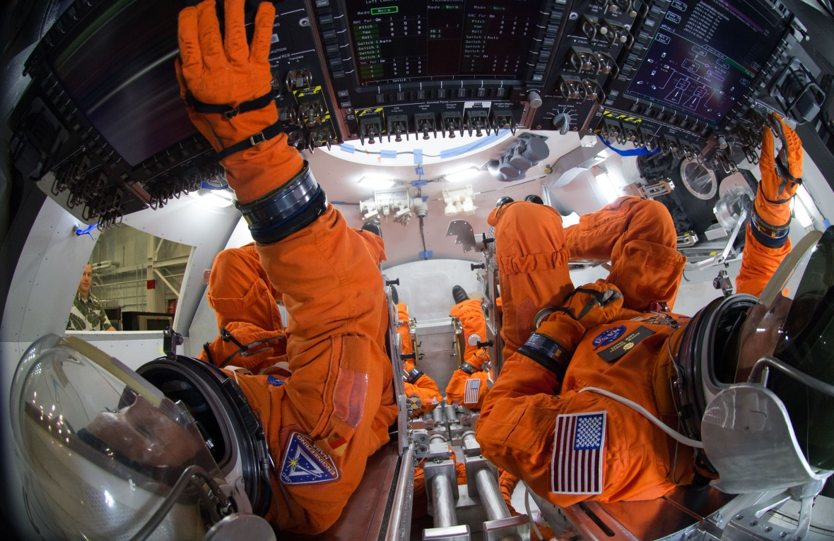
Crew Selection
Introduction
Mission Overview
Crew of three astronauts
  EVAs require two astronauts
  Geologist, pilot/robotic mission specialist, engineer
  Allows larger sample mass return in Orion
Representative of international partners
  Proportional to member state contributions
Science
Engineering
Human Factors
Program
Conclusion
Photo credit: NASA
Notes:
(Ryan)

Slide 40
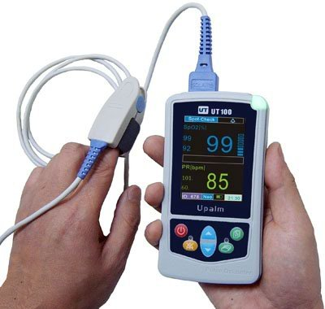

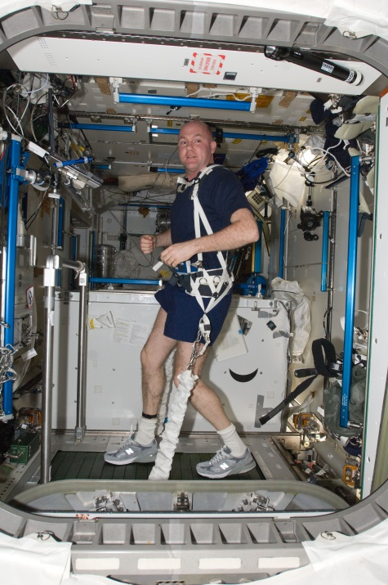

Crew Health Beyond Low Earth Orbit
Introduction
Mission Overview
Monitoring
  Twice daily record pulse-oximeter and blood pressure reading
  Weekly blood and urine samples
  Measurements will be compared to recorded data from LEO missions
Maintenance
  Exercise equipment: 2 hours cardio and resistive training per day
  Daily private conversations with ground physicians to monitor mental and physiological health
Science
Engineering
Human Factors
Program
Conclusion
Notes:
(Ryan) Part of this mission’s science objectives

Slide 41
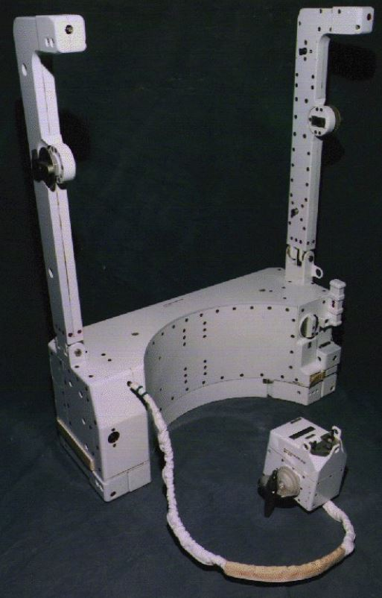
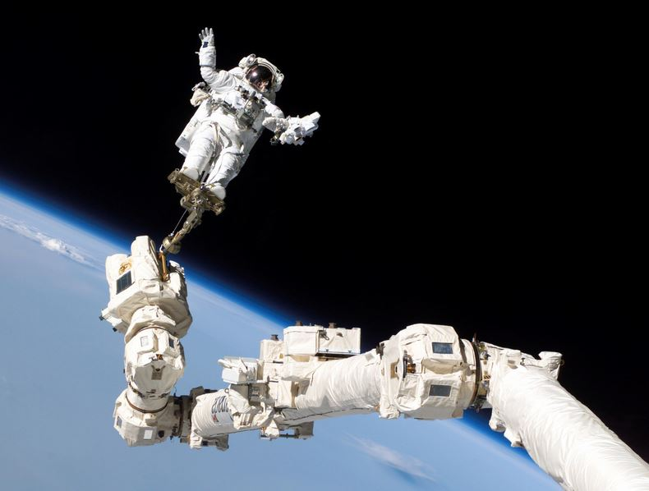
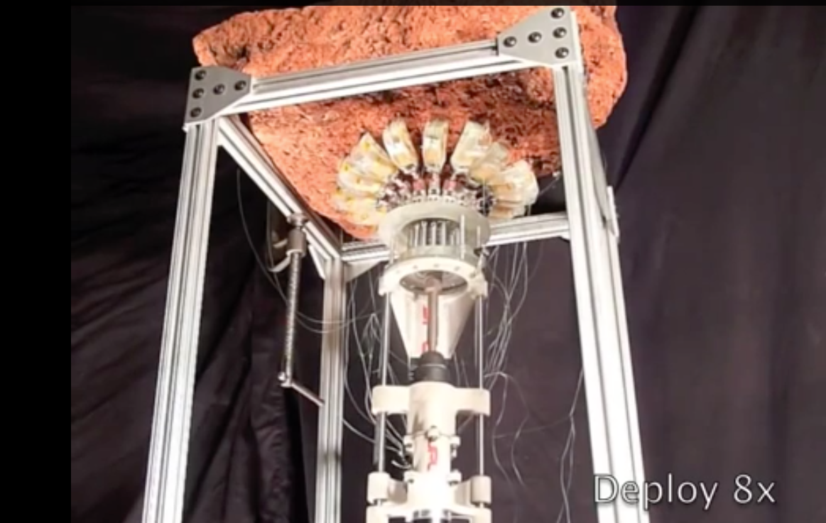
Space Suit Design/EVA Ergonomics
Introduction
Mission Overview
Operations use heritage ISS-derived EVA suits
Robotic arm can be used as platform and for movement
Use of Simplified Aid for EVA Rescue (SAFER) system
Science
Engineering
Human Factors
(Left) Contingency SAFER jet-pack for use in the event of tether failure
(Middle) Canadarm2 provides a platform for an astronaut on EVA to assist in mobility (Right) Drill with
microspines for surface coupling. Photo credit: NASA and JPL
Program
Conclusion
Notes:
(Ryan)

Slide 42

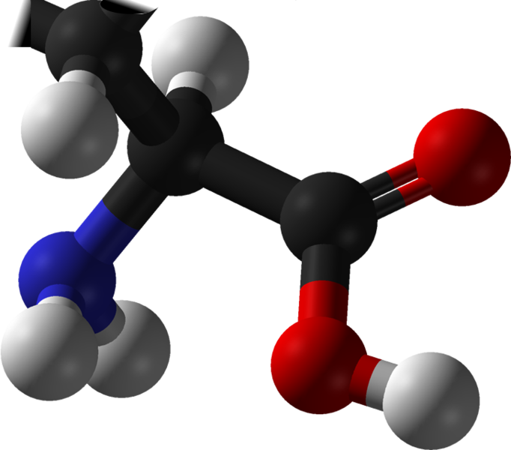
Contamination Protection
Introduction
Mission Overview
Do not want to cross-contaminate asteroid and Earth
Do not want to expose crew to harmful materials
Use of three key technologies to do this
  Aseptic spacecraft assembly
  Aseptic Robotic Arms and Equipment
  Sample Return Containment
Strict Planetary Protection Protocol to ensure safety
Science
Engineering
Human Factors
Program
Conclusion
Notes:
(Ryan) When investigating the asteroid, there are three basic rules when it comes to planetary protection. We don’t want to inadvertently deposit organic
Aseptic spacecraft assembly : The use of aseptic spacecraft assembly for any segment that can potentially have contact with the asteroid
2) Aseptic Robotic Arms and Equipment : stringent cleanliness sterilization required on all parts that has potential direct contact with the asteroid or parts of asteroid
3) Sample Return Containment : Sterilized and robotic operable storage containers
4) Curation planning and protocol

Slide 43

Policy and Outreach
Introduction
Mission Overview
Broad international cooperation on mission objectives, vehicles, science instruments
  Orion Service Module (ESA)
  Robotic Arm (MDA, Canada)
  Neutron Spectrometer & Gamma Ray Spectrometer (Schlumberger, Worldwide)
  XRF (FUB, Germany)
  Pervaporation Test Cell (Pervatech BV, Netherlands)
  Seismic Array (Sensor Geophysical, Canada)
Public-Private Initiatives and educational programs to engage public
Asteroid mining for science/exploration legal with broad legal consensus, as specified in UN Outer Space Treaty
@CSC2015_Voyager is tweeting!
Science
Engineering
Human Factors
Program
Conclusion
43
Notes:
Public-Private Initiatives on mining, ISRU, launch to encourage private development of space

Slide 44
Cost
Introduction
Mission Overview
Subsystem | Cost (FY 2004 Billion Dollars)
Launch 1 – Falcon Heavy | $0.14
Launch 2 – SLS | $1.5
Science Payload | $0.2
Habitat* | $2.6
Multi-Purpose Docking Module* | $0.6
Orion* | $3.2
Propulsion | $0.06
Communications | $0.15
Guidance, Navigation and Control | $0.1
Power | $0.4
Total | $8.95
Science
Engineering
Human Factors
Program
Conclusion
* Estimated using Advanced Missions Cost Model

Slide 45
Risks and Mitigation Strategies
Introduction
Mission Overview
Likelihood | Consequences
 |  | Very Minor | Minor | Moderate | Major | Severe
 | Almost Certain |  | Musculoskeletal Degradation
 | Likely |  | Unconsolidated asteroid
 | Possible |  |  |  | Failure of asteroid’s structural integrity | Coronal Mass Ejections
 | Unlikely |  | Drill Failure |  | Separation of EVA Tether | Launch vehicle failure
 | Rare |  |  |  | Failure of RUD | Large meteor impact
Science
Engineering
Human Factors
Program
Conclusion
Notes:
Based on Goddard Space Flight Center paper
Technical, human, and scientific objective risks
Some examples of risk in this slide, major risks drive technical designs.

Slide 46
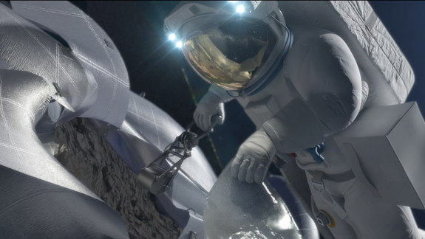

How will the results change the future?
Introduction
Mission Overview
Understanding of internal structure of celestial bodies
Preparation for future missions to Mars
Study of human long term duration spaceflight
Understand physical and psychological degradation
Advancement for human deep space exploration
Inspire the next generation of scientists
Science
Engineering
Human Factors
Program
Conclusion

Slide 47
Conclusion
Introduction
Mission Overview
OASIS:
Science
Demonstrates the capability for humans to live and work independently
Engineering
Creates a long-term platform in support of NASA’s Flexible Pathway to a manned Mars mission
Human Factors
Demonstrates in-situ resource utilization of an asteroid
Program
Conclusion

Slide 48

Acknowledgements
CSC
Hayden
Niko
Jay
Dimity
Mentors
Steve Edberg (Asteroid Scientist)
John Elliott (Systems Engineer/ISRU)
Damon Landau (Mission Design/Trajectory Planning)
Charles Dandido (Mechanical)
Paul Woodmansee (Propulsion)
Jackie Green (Planetary Scientist/A Team Lead)
Randii Wessen (Astronautics System Engineer)
Michele Judd (Keck Institute for Space Studies)

Slide 49
Questions?
Thank-you for listening!

Slide 50
Backup Slides

Slide 51


Slide 52


Policy and Outreach
Introduction
Mission Overview
Continuous deliverables, ISS-based testing to show development progress
Innovative new science outreach, including live HD, 3D, 360°broadcast of spacewalks from helmet-mounted cameras
Objectives
Engineering
Engineering
Policy
Program
Conclusion

Slide 53
Mass and Volume
Equipment | Launch 1 Mass (T) | Launch 2 Mass/ t
Orion | - | 26
Science | - | 1
Habitat | 12 | -
Docking Module | - | 6
Power | 0.25 | -
Propulsion + GNC | 2.1 (0.5+1.6) | -
Avionics | 0.5 | -
Thermal | 0.5 | 1.5
Communications | 0.2 | -
Spares | 0.25 | 0.25
ECLSS | 1.1 | -
Robotic Arm | 0.4 | -
Airlock | 0.4 | -
Component | Volume/ m³
Habitat | 201.8
Docking Module | 77.83

Slide 54
Mission Architecture
Phase 1
  Launch of Labitat & Propulsion module with a Falcon Heavy
  Place in 300 km circular parking orbit
  Verify readiness of spacecraft systems (1-2 orbits)
  Trans-lunar injection in a ballistic (low-energy) trajectory
  Inflate Labitat
  Verify readiness of spacecraft systems
  Insert into a parking Lunar Distant Retrograde Orbit (DRO)
  Verify readiness of spacecraft systems
  Proceed to Phase 2

Slide 55
Detailed Mission Architecture
Phase 2
  Launch of Orion & Multi-Purpose Docking Module (MPDM) with a SLS Block 1B
  Place in 1806 km by 185 km elliptical parking orbit
  Verify readiness of spacecraft systems (1-2 orbits)
  Trans-lunar injection (TLI) in a flyby outbound trajectory
  Transposition, docking, and extraction (TD&E) maneuver to dock Orion to MPDM
  Verify readiness of spacecraft systems
  Insertion into DRO
  Dock with ARM
  Verify readiness of spacecraft systems
  Proceed to Phase 3

Slide 56
Detailed Mission Architecture
Phase 3
  Use Canadarm3 to undock Orion from the side of the MPDM and dock it to the bottom of the MPDM, making way for Labitat.
  Verify readiness of spacecraft systems
  Labitat & Propulsion module approaches for docking
  Docking of Labitat with MPDM
  Verify readiness of spacecraft systems
  Start nominal operations, phase 4.
  Note: At the end of mission and in case of emergency, move to Phase 5.

Slide 57
OASIS Final Configuration
Asteroid Redirect Mission (ARM)
Multi-Purpose Docking Module
z
x
y
Labitat with its propulsion module
Orion and Orion Service Module

Slide 58
ΔV destribution
 | Falcon Heavy | SLS
Earth to LEO (LV) | 9.3 km/s | 9.3 km/s
LEO to DRO transfer (LV) | 3.1 km/s | 3.37 km/s
Total LV Δv | 12.4 km/s | 12.67 km/s
Payload Propulsion | MMH/N₂O₄ | Orion & Draco system: MMH/N₂O₄
Payload Prop. Max Δv | .150 km/s | Orion: 1.1 km/s Draco: .252 km/s
Payload Insertion correction | 0.02 km/s | 0.02 km/s
Targeting, Rendezvous, Orbit trim maneuvers | 0.015 km/s | 0.015 km/s
Insertion | 0 km/s | .480 km/s
Phasing | 0.05 km/s | 0.05 km/s
DRO Orbit Corrections | 0 km/s | 0 km/s
Departure | 0 km/s | .750 km/s
Total Payload Δv Required | 0.04 km/s | 1.270 km/s

Slide 59

Abort scenarios
Introduction
Mission Overview
Objectives
Engineering
Engineering
Policy
Program
Conclusion

Slide 60

Return trajectories in a non-rotating frame

Slide 61

Poincare phase recurrence diagram

Slide 62

Reentry

Slide 63

ΔV and time of flight for orbit abort trajectories

Slide 64

Free return trajectory

Slide 65

Planetary Protection
Planetary Protection Provisions for Robotic Extraterrestrial Missions
NASA Policy on Planetary Protection Requirements for Human Extraterrestrial Missions
Extract, Process and Utilization
Storage/transport
Curation
Courtesy of HoneyBee Robotics
Notes:
• Safeguarding the Earth from potential back contamination is the highest planetary protection priority in Mars exploration.
• The greater capability of human explorers can contribute to the astrobiological exploration of Mars only if human-associated contamination is controlled and understood.
• For a landed mission conducting surface operations, it will not be possible for all human-associated processes and mission operations to be conducted within entirely closed systems.
• Crewmembers exploring Mars, or their support systems, will inevitably be exposed to martian materials.
input to determine the topics that should be studied; for example:
Developing capabilities to comprehensively monitor the microbial communities associated
with human systems and evaluate changes over time;
2) Developing technologies for minimizing/mitigating contamination release, including but not limited to closed-loop systems; cleaning/re-cleaning capabilities; support systems that minimize contact of humans with the environment of Mars and other solar system destinations;
3) Understanding environmental processes on Mars and other solar system destinations that would contribute to transport and sterilization of organisms released by human activity.

Slide 66
Science and Overall Mission
Study human health and psychology in deep space
Characterize the internal structure /composition and space environment around
The mission will demonstrate the capability for humans to live and work independently in deep space through the creation of a long-term platform and in-situ resource utilization of an asteroid.
Demonstrate human independent decision making in deep space.
Extract, process and demonstrate use of resources

Slide 67
Science Con-Op
Science Objectives
Science Product
Instrument
3D Geological Model
Composition & Strength
Internal Structure
Thermal & Radiation
OASIS-SMM
(Seismic Monitoring Module)
OASIS- SDCAU
(Subsurface Drill & Composition Analysis Unit)
Characterize the internal structure and composition
Characterize the space environment around
- Dust, Micrometeoroid
- Radiation & Plasma
- Outgassing
OASIS- SEnV
(Space Environment Monitoring Module)
- 3 kg Raw Material
- Water
- Propellant – methanol
- Radiation Shield
Extract, process and demonstrate use of resources
OASIS-RUD
(Resource Utilization Demonstrator Module)

Slide 68
Planetary Protection
An overall

Slide 69

Science Directives

Slide 71


Slide 73



Slide 74


Slide 75



ARM EVA Crew Deployed Drill
ARM EVA Crew Deployed Sample Cache

Slide 76


Slide 78


Slide 79


Slide 80


Slide 81


Slide 82


Slide 83


Slide 84


Slide 85


Slide 86


Slide 87


Slide 88

Borehole Assembly Connection
Neutron Spectrometer
Gamma Ray Spectrometer
IR Spectrometer
XRF
Science Tool Attachment Collar (STAC)
Power monitor
WOB Monitor
Drill bit
Notes:
http://publications.iodp.org/proceedings/332/102/images/02_F01.jpg

