Slide 1
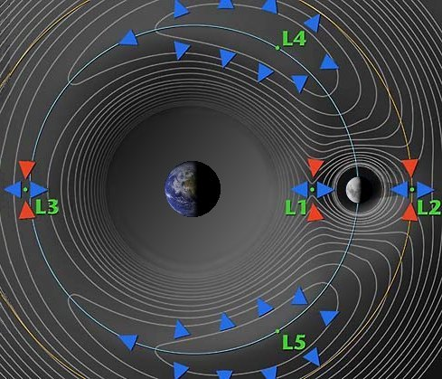
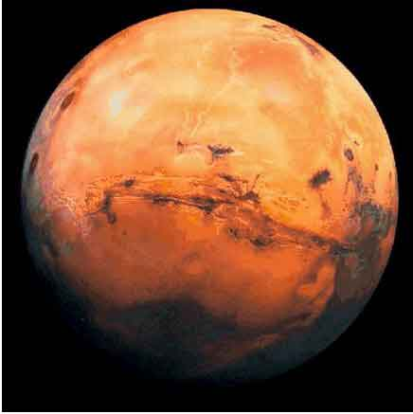
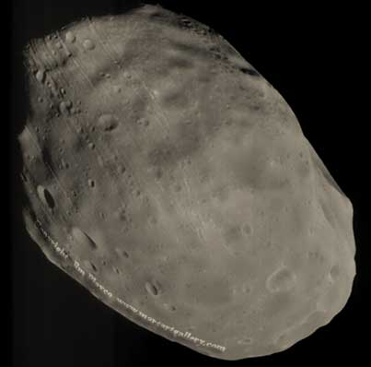
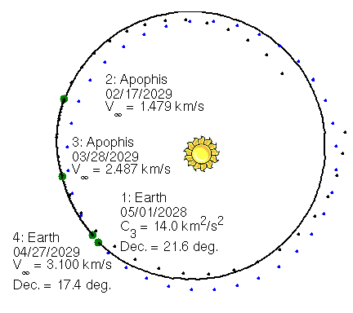
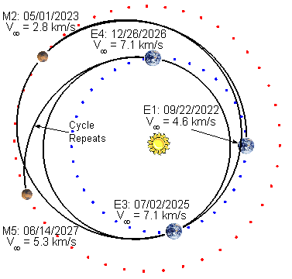
Trajectory Design Techniques for Human Missions to Mars Damon Landau and Nathan Strange Jet Propulsion Laboratory, California Institute of Technology
Cislunar Missions
Asteroid Missions
Mars Moons
Mars Surface
Low-Perigee HEO
Moon
Phobos capture
Earth
High-Perigee HEO
Deimos escape
Moon’s Orbit
© 2013 California Institute of Technology. Government sponsorship acknowledged.

Slide 2
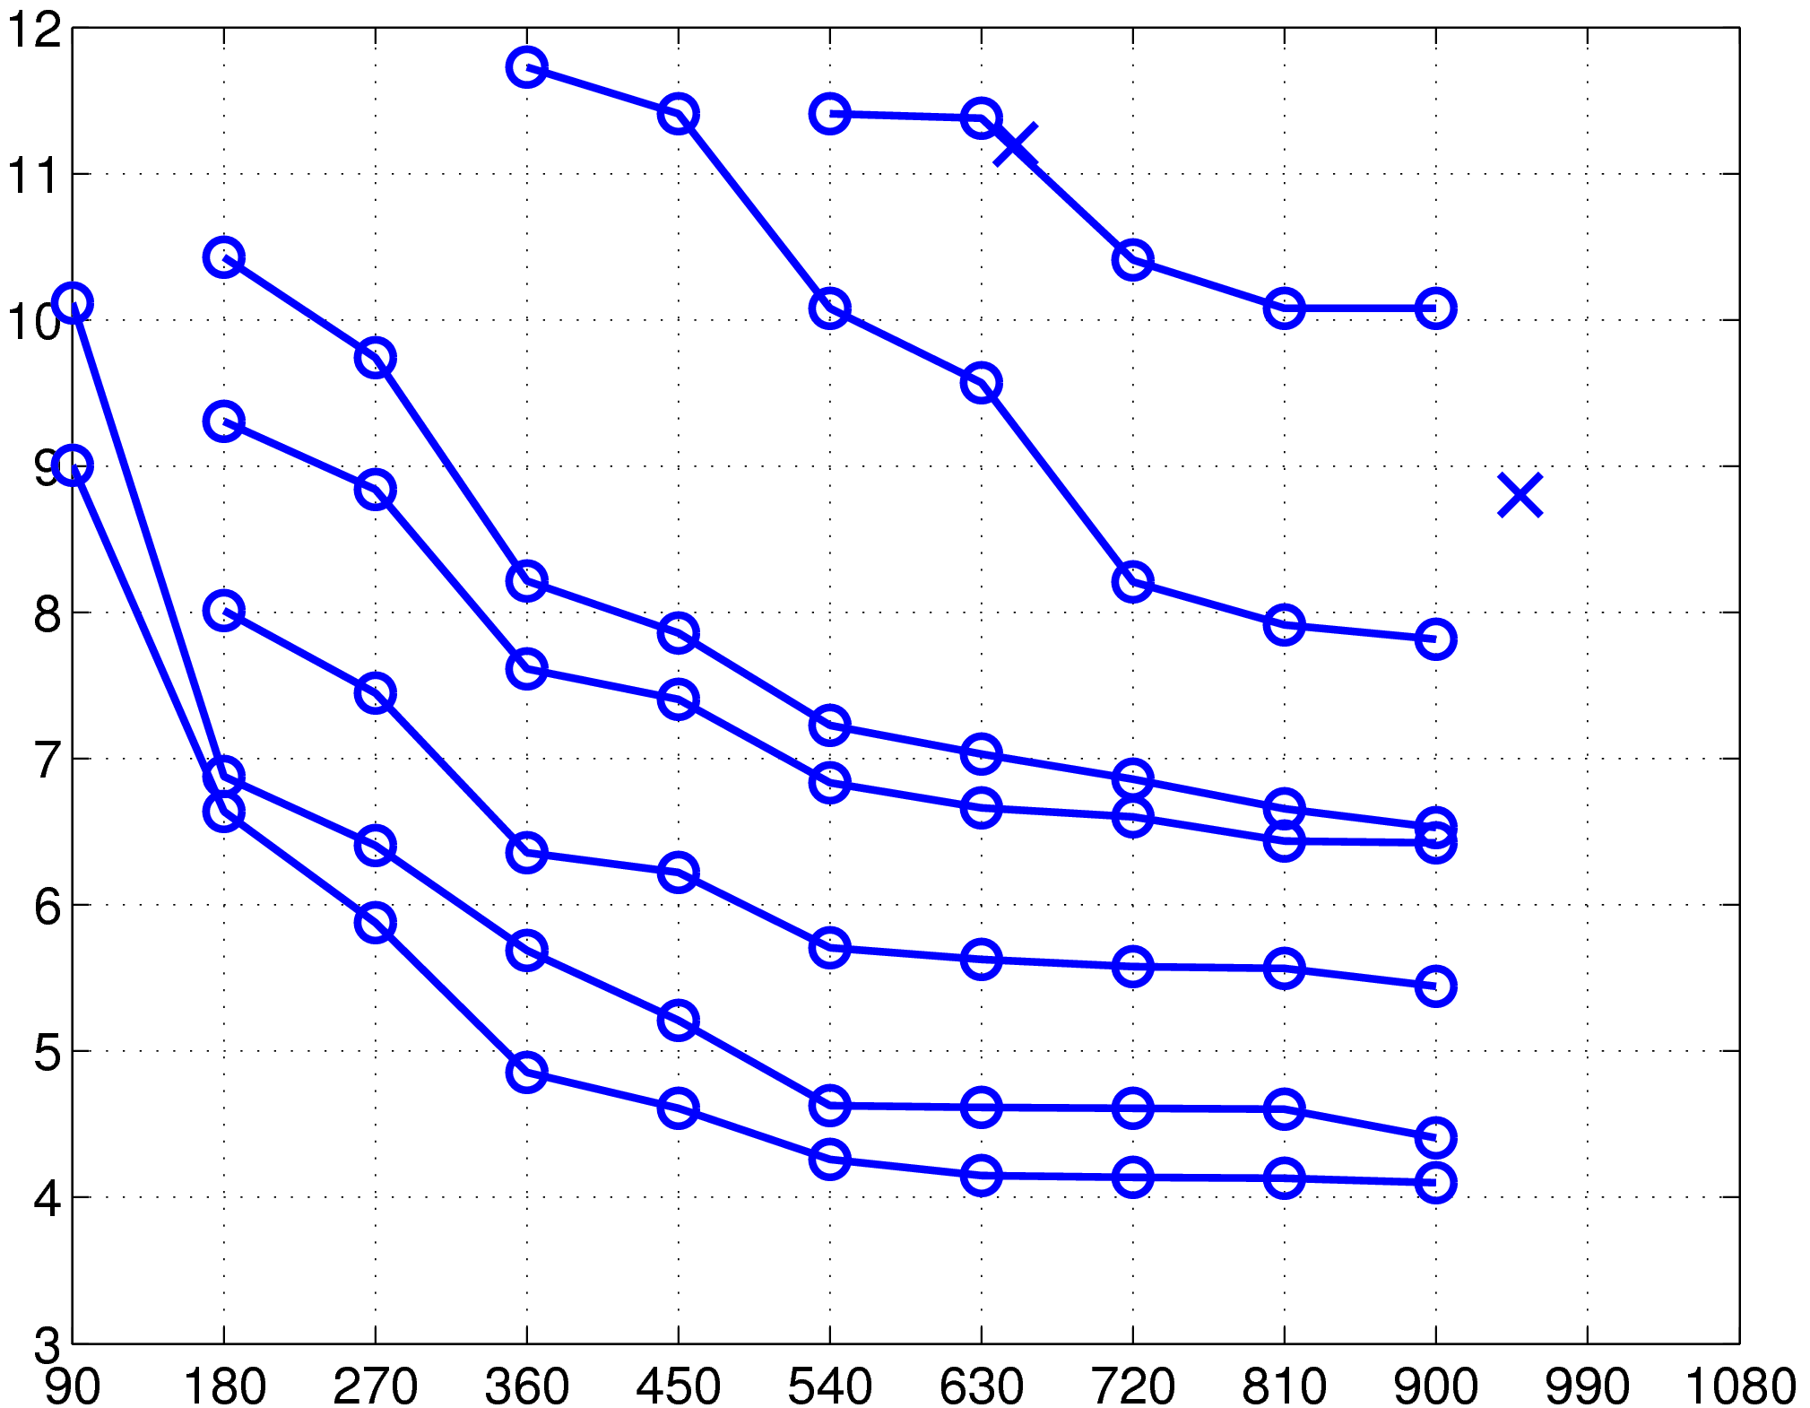
Delta-V for Deep Space Missions
This plot shows the ΔV required to allow at least one mission every Earth-Mars synodic period (2.14 years)
Phobos / Deimos
1 km NEAs
Phobos / Deimos
Total ΔV [km/s]
600 m NEAs
300 m NEAs
100 m NEAs
60 m NEAs
Lunar orbit
30 m NEAs
Cislunar missions
10 m NEAs
diameter estimates assume 15% albedo
Crew Flight Time [days]

Slide 3
Mean-old Mr. Rocket Equation
For lunar mission (DV ~4.5 m/s), 50 metric ton
vehicle requires a 130 t launcher
For a six-month mission to a 10 m NEA (DV ~6.5 m/s),
a 50 metric ton vehicle requires a 220 t launcher
Storable (325 sec)

Slide 4
The Electric Path
Hall Thruster (2000 sec)
Storable (325 sec)

Slide 5
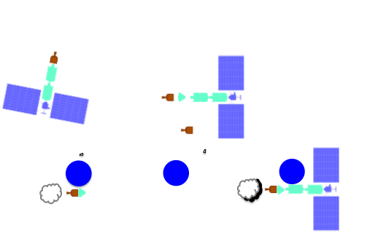
Indirect Escape from Elliptical HEO
Basic Strategy:
1. Use high Isp propulsion for the majority of the ΔV to get to Mars and the majority of the mass sent to Mars
2. Use high thrust propulsion for the crew
3.4 km/s
0.57 km/s
Payload Mass Fraction to HEO

Slide 6
Benefits of HEO Staging Node
This plot shows the ΔV required to allow at least one mission every Earth-Mars synodic period (2.14 years)
Target Accessibility (CP-Crew)
HEO staging with indirect escape lowers the effective mission ΔV by roughly 3 km/s
180-day missions to 10-60 m asteroids are then available every ~2 years with an effective ΔV comparable to lunar missions
With 1-year missions, the DSV could get to 100 m objects with similar effective ΔV to lunar missions
Progressively larger objects are accessible as flight time and ΔV capability approach the levels needed for Phobos / Deimos and Mars surface missions
Phobos / Deimos
1 km NEAs
Total ΔV [km/s]
Phobos / Deimos
HEO staging with indirect escape can lower effective mission ΔV by
~3 km/s
600 m NEAs
300 m NEAs
100 m NEAs
60 m NEAs
Lunar orbit
30 m NEAs
Cislunar missions
10 m NEAs
diameter estimates assume 15% albedo
Crew Flight Time [days]

Slide 7
SEP Spiral
Spiral Cheatsheet for mass and time :
SEP inert mass
30 kg/kW array
15% Xe
Array to Jet efficiency
50% @ 1600 s
60% @ 2500 s
68% @ 6000 s
add margin (~10%) for radiation and shadowing

Slide 8
Cargo pre-placement at Deimos
The SEPC can get 54% of the IMLEO to Deimos
Deimos
Cargo:
2 SEV
2 SCPS
4-year
SEP trajectory
From LEO
Single 130 t Launcher
Earth

Slide 9
Earth Departure Strategies
Human missions to Mars require several vehicle elements with multiple launches
Elements could be aggregated at Earth-Moon L₂, high-lunar orbit, high-Earth orbit, or low-Earth orbit
High level comparison of overall ΔV, departure windows, backup opportunities, and contingency options
Feeds into assessments of vehicle sizing, cost, and risk

Slide 10
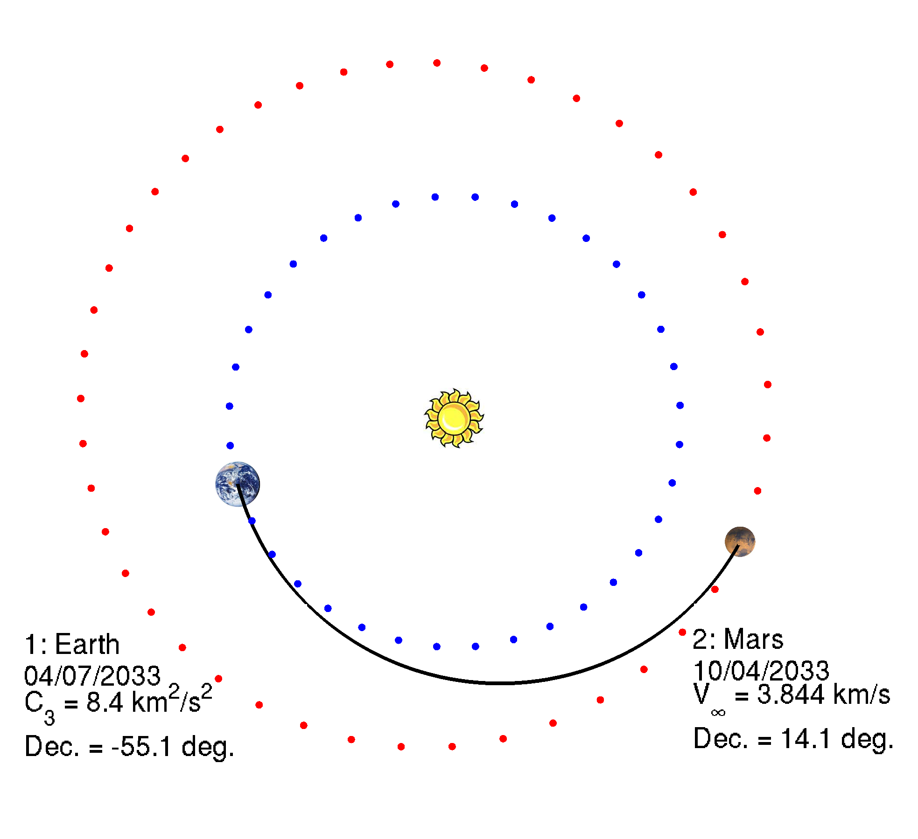
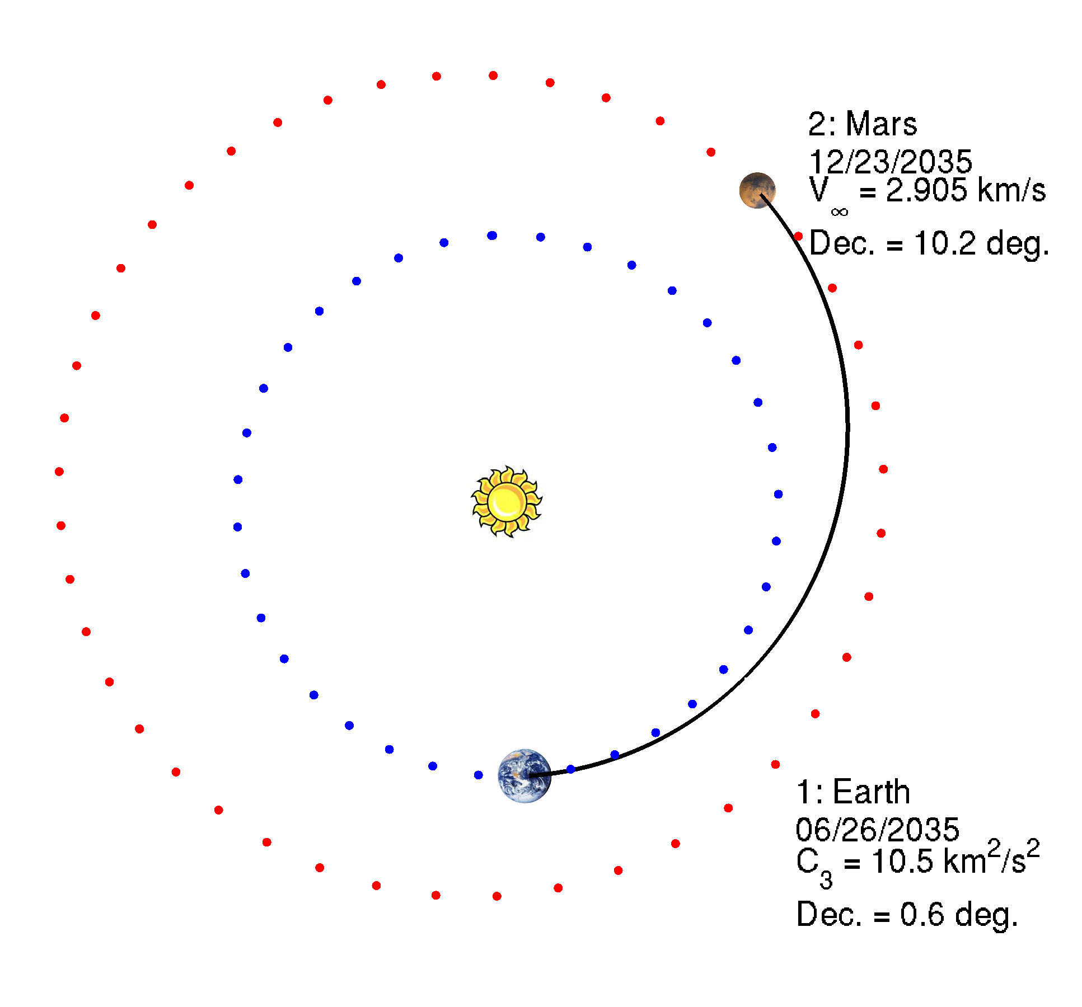
Example Outbound Transfers
2033
High declination, lower C₃
2035
Low declination, higher C₃
180-d Earth-Mars transfers

Slide 11
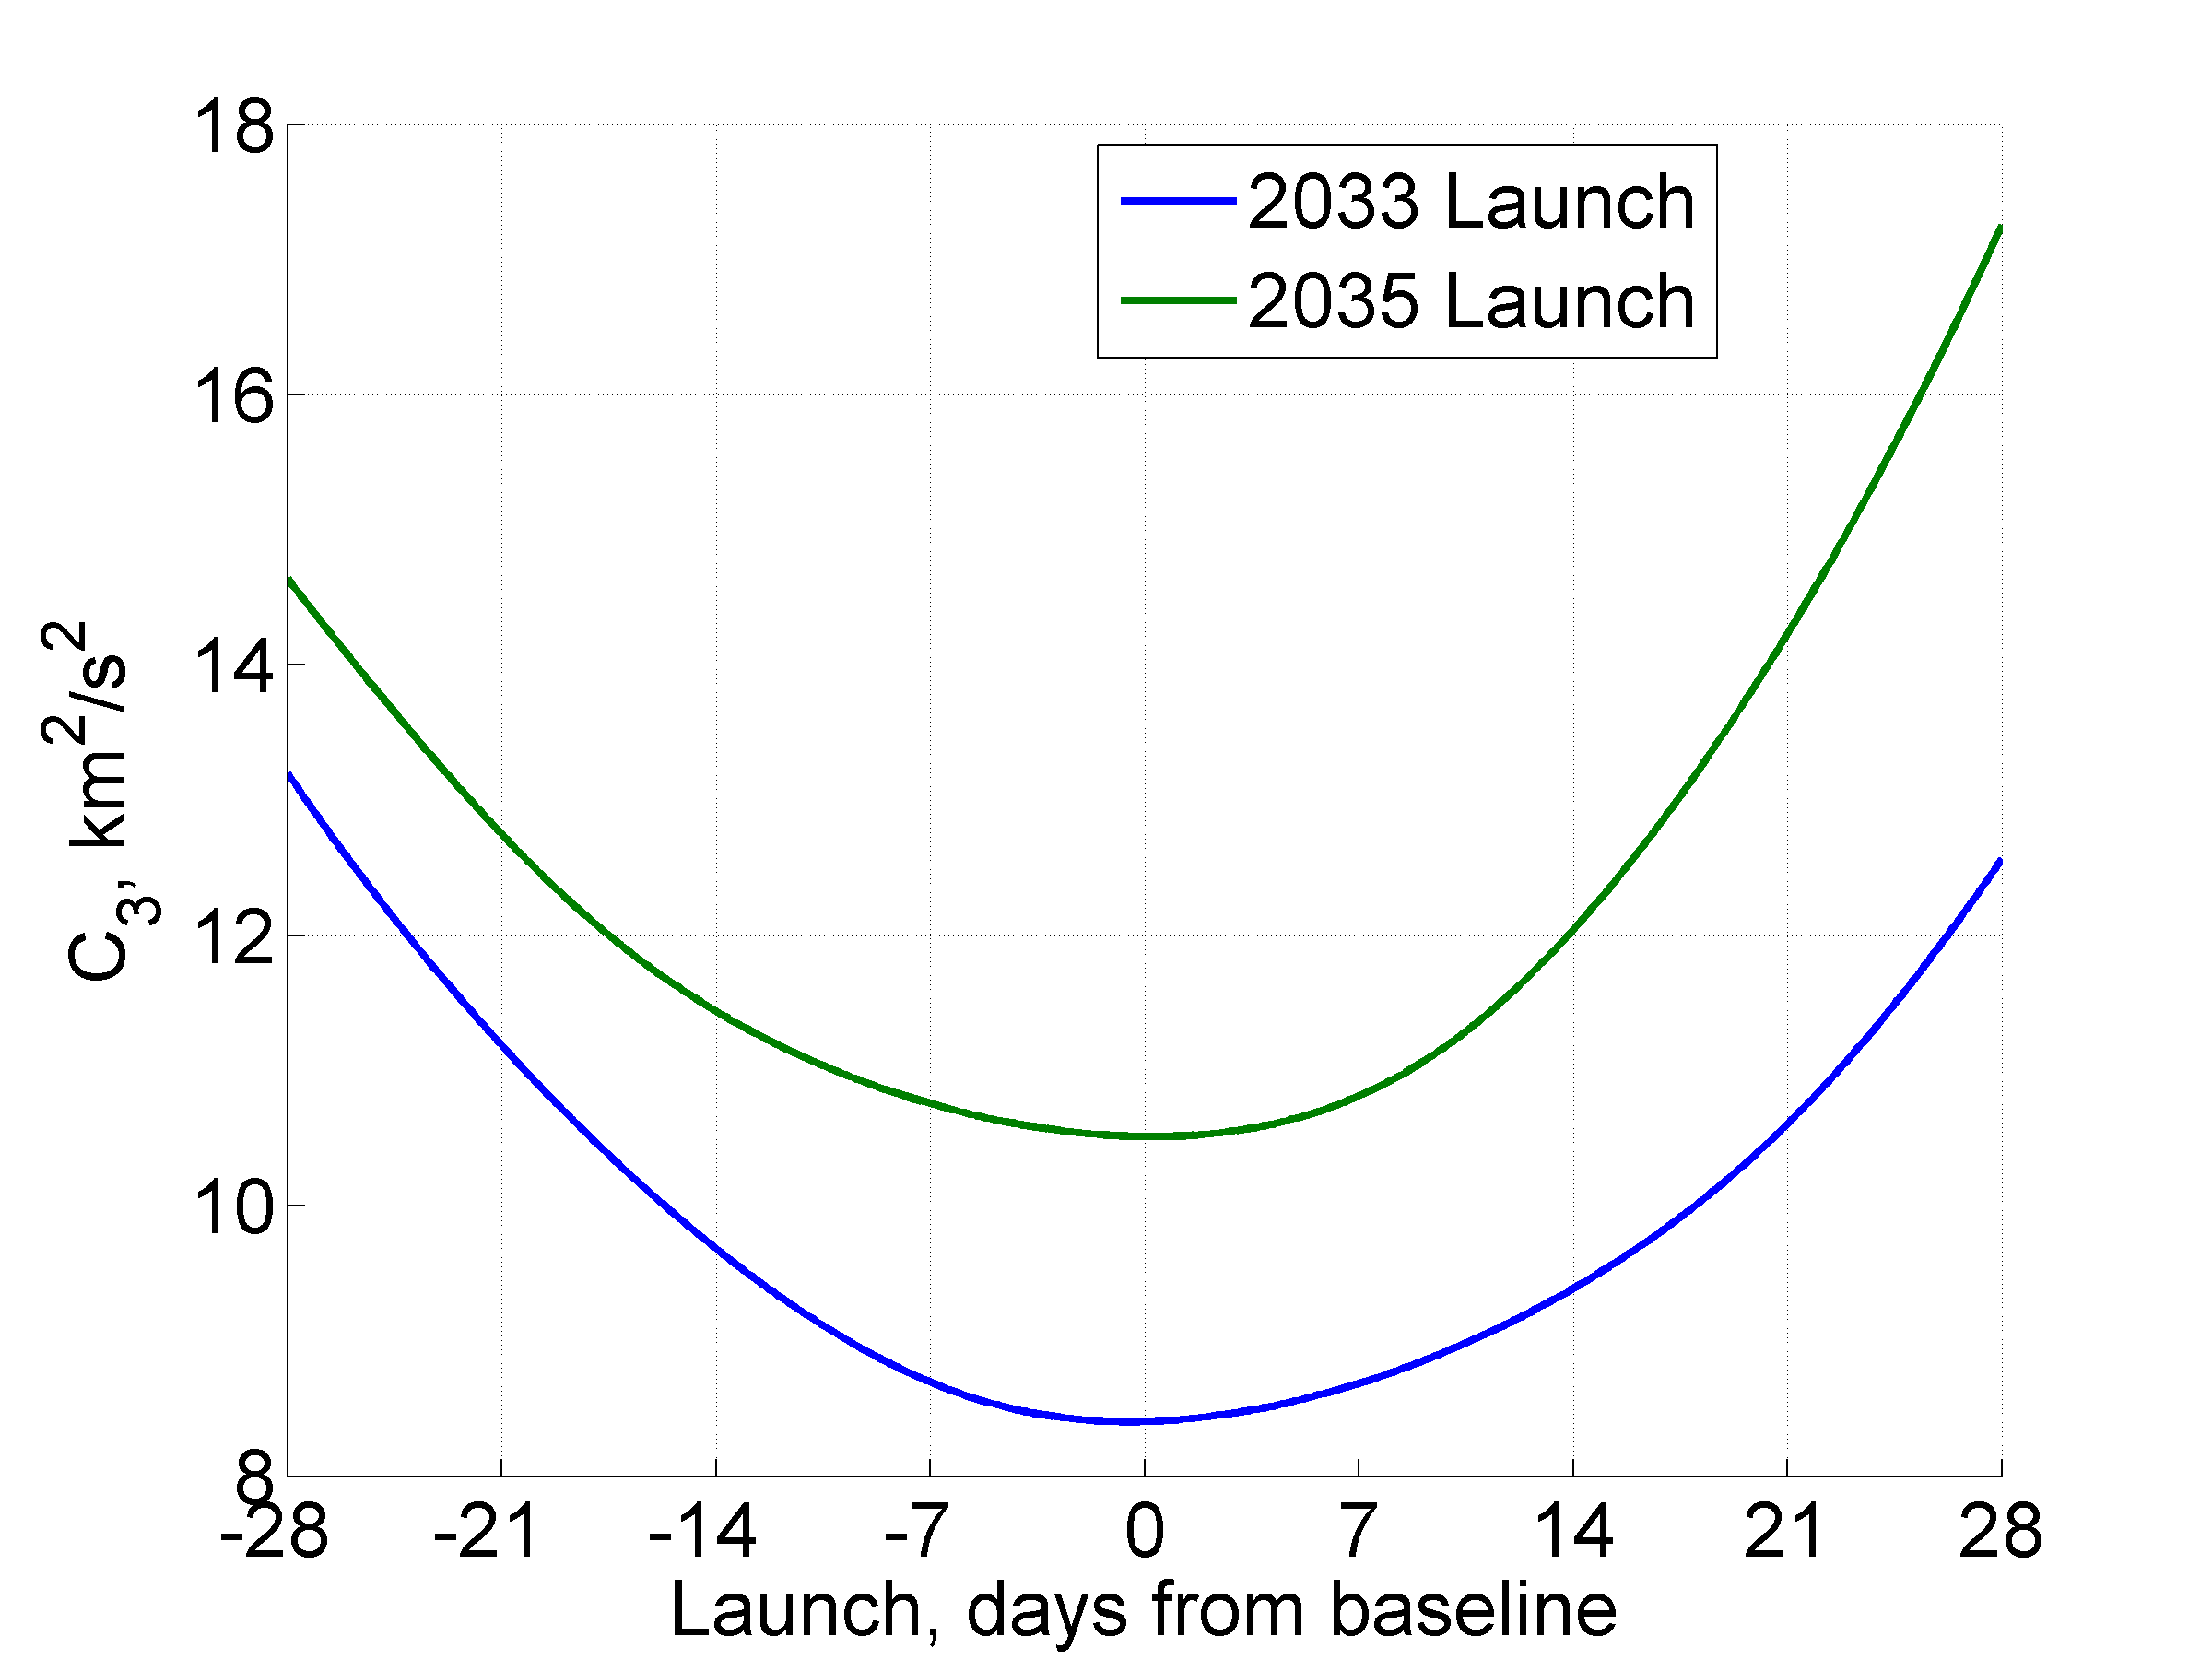
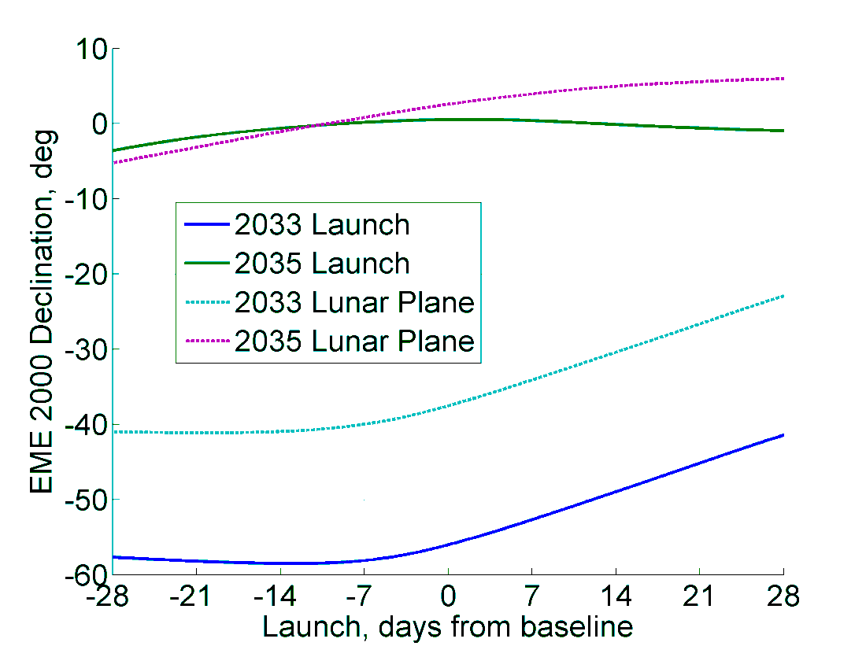
Earth Departure Asymptote

Slide 12
Earth-Moon Lagrange Points
Moon-Fixed Rotating Perspective
Inertial Perspective
view from Earth
to Earth
L₂ orbit
to Earth
Moon’s orbit

Slide 13
Departures from L₂

Slide 14
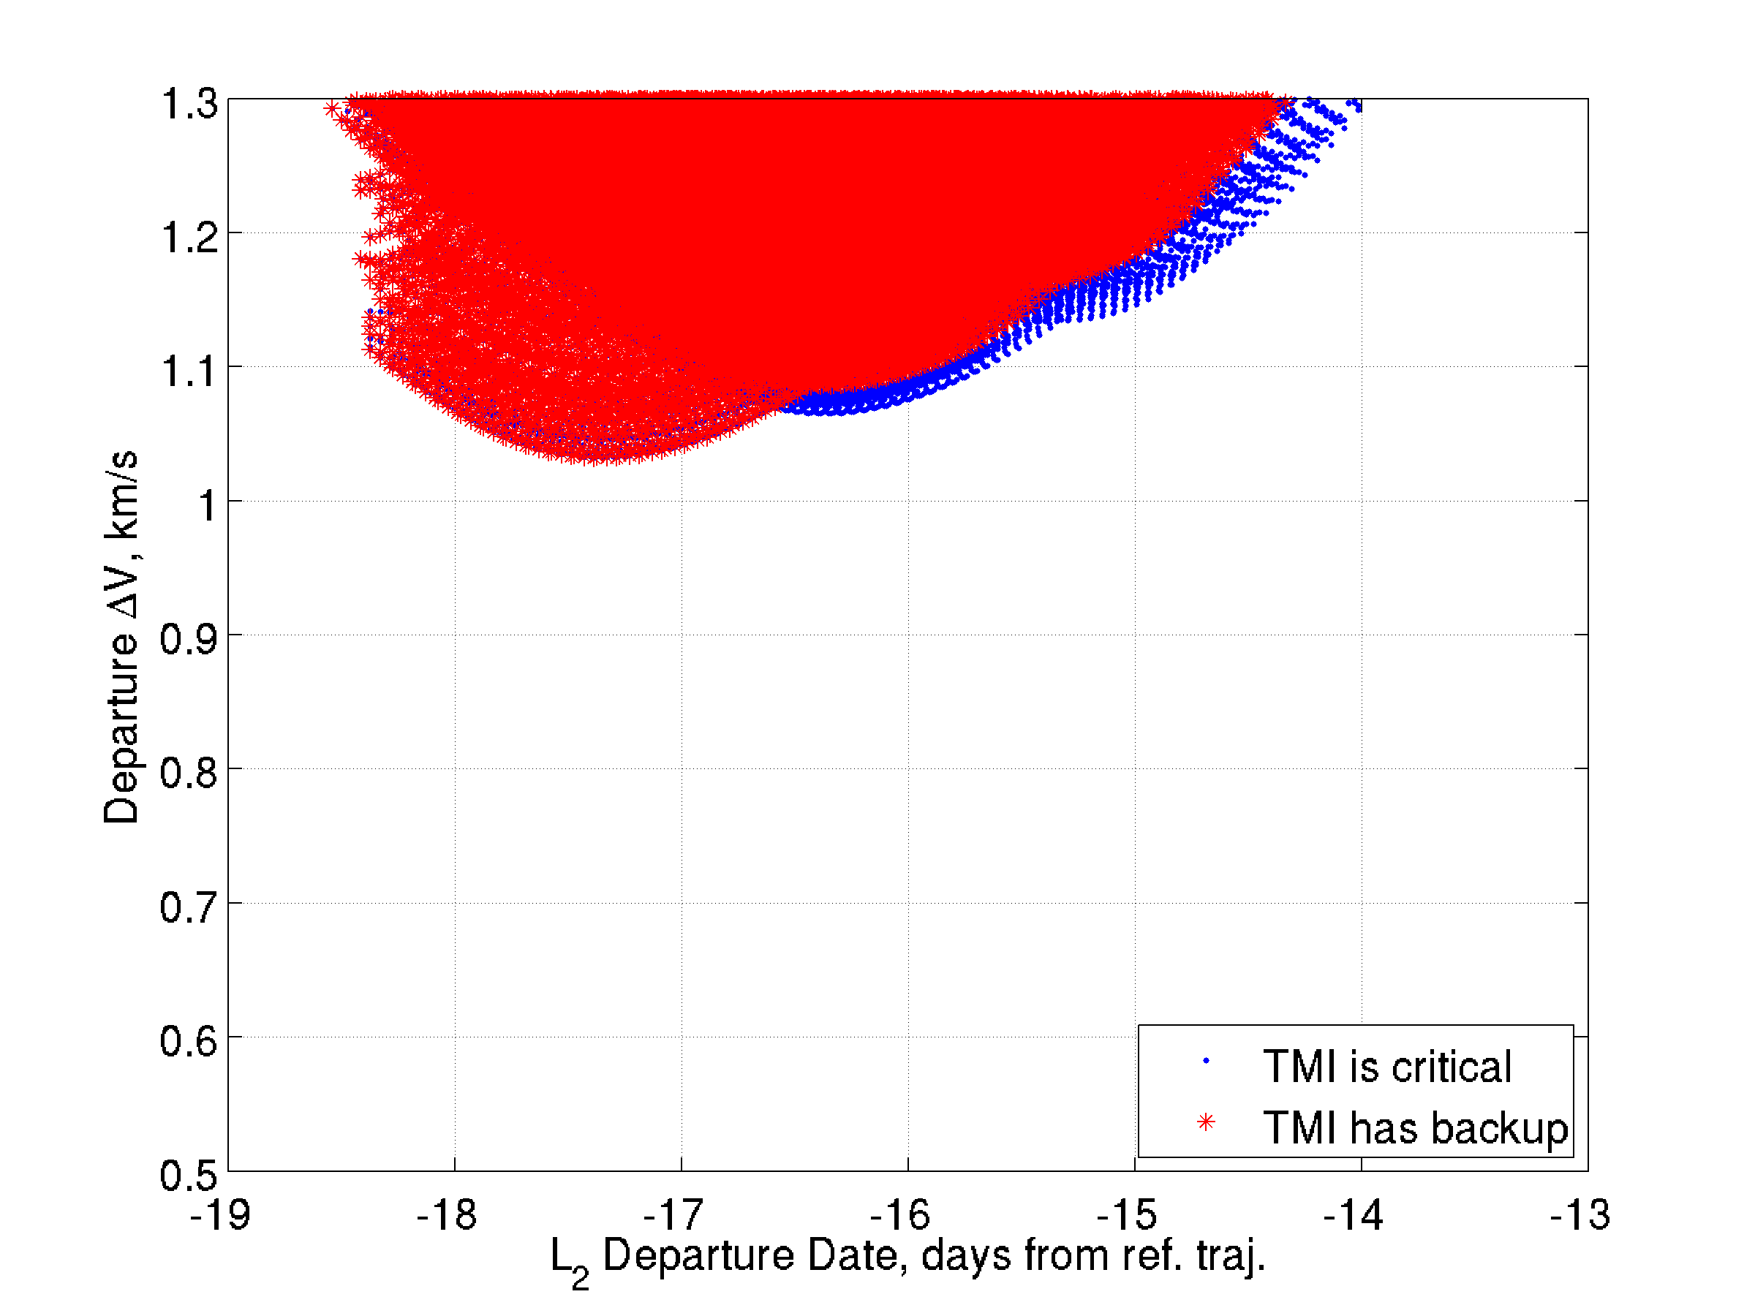
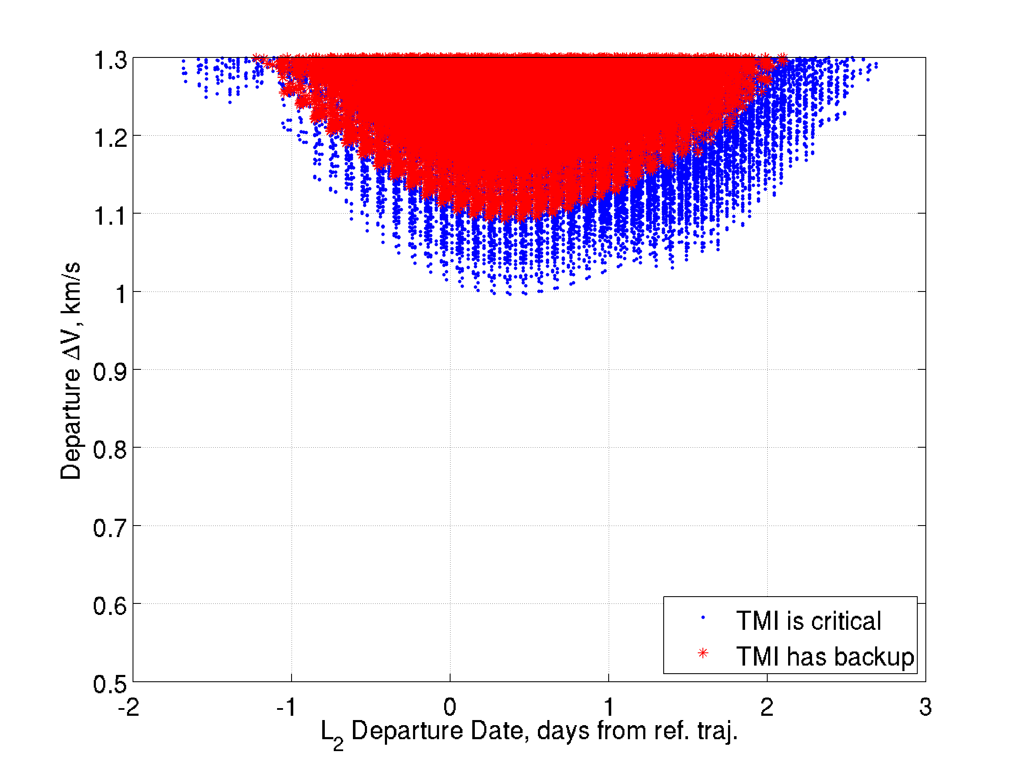
L₂ Departure Dates Free Choice Once in L₂
2033
2035
Backup departure declinations are closer to lunar plane & require less ΔV
3-day departure window
Backup departures require significant plane change and increase ΔV
Departures from L₂ span approximately three days
and have an opportunity to retry Trans-Mars Injection

Slide 15
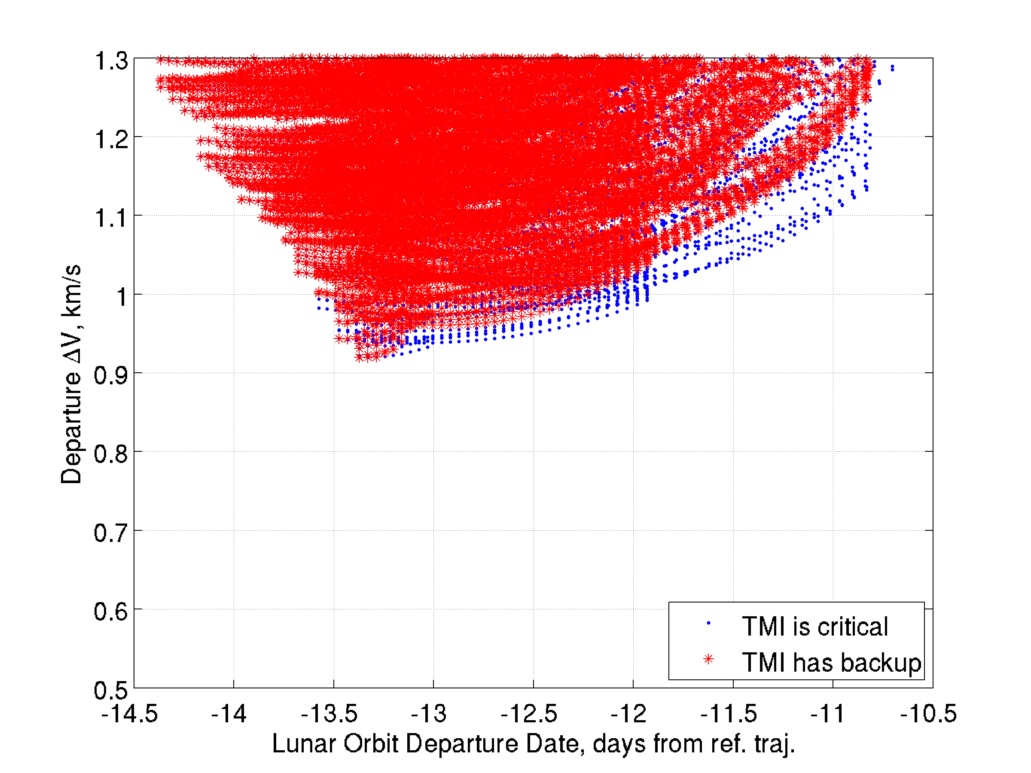
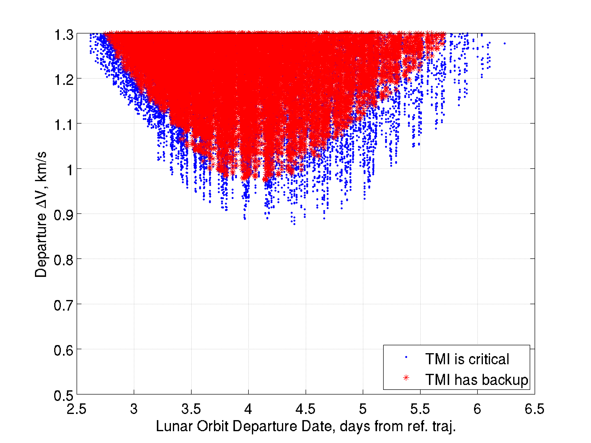
High Lunar Orbit
Low perilune and long period (100 km x 2 days) with stable orientation
2033
2035
TMI backup opportunities occur on subsequent perigee passages
2.5-day departure window
Departure characteristics from high-lunar orbit are similar to L₂

Slide 16
High Earth Orbits
Lunar gravity assists and maneuvers near apogee shape HEO for efficient departures
Lunar gravity assist
TMI ~600 m/s
High inclination departure orbit
High perigee parking HEO
Low perigee, 28.5 degree rendezvous HEO
to Mars
(large declination)
Apogee maneuver rotates to departure plane. ~150 m/s
Lunar gravity assists change inclination and raise perigee ~0 m/s

Slide 17
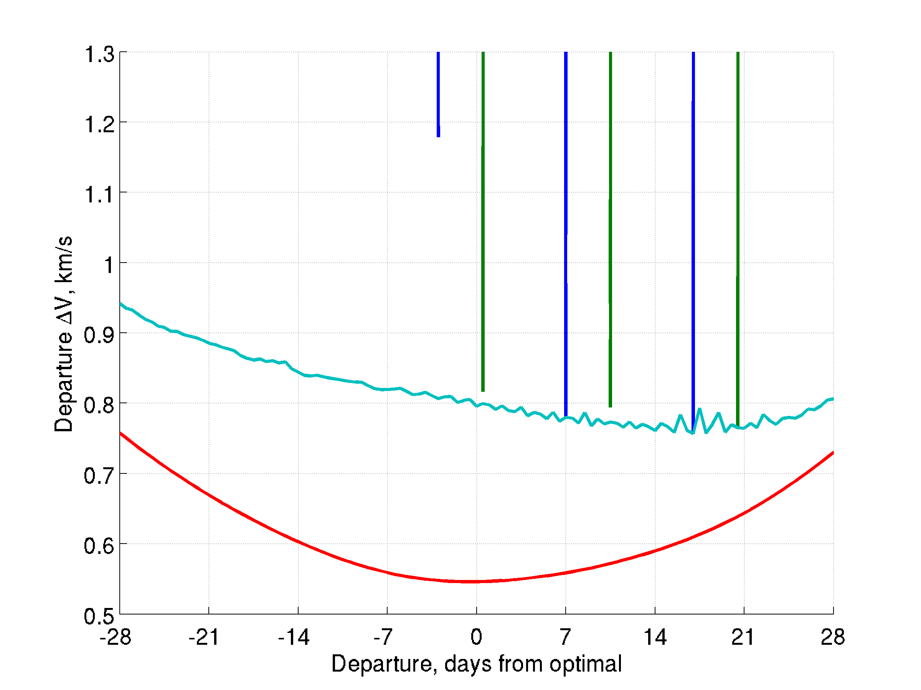
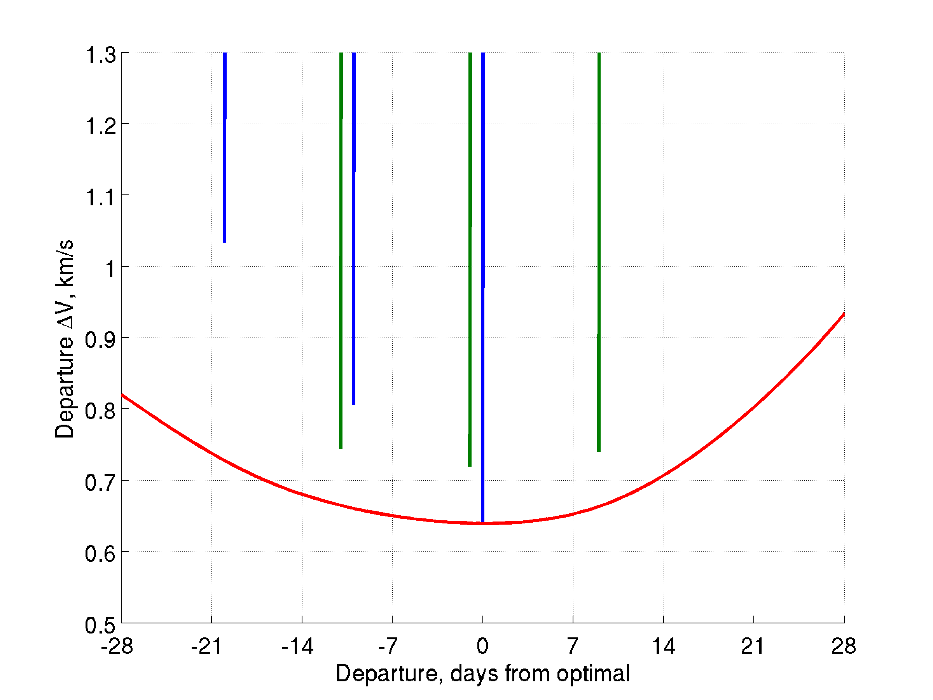
10-day HEO, 28.5 deg inclination
2033 Opportunity
2035 Opportunity
Optimal
1-departure orbit
Optimal
3-departure
orbit
Optimal without backups
Optimal 28.5 deg inc. (no backups)
1
2
3
Optimal 1- departure orbit
Optimal free inc. (no backups)
Optimal 3-departure orbit
Departure opportunities from HEO occur for short durations near perigee passages

Slide 18
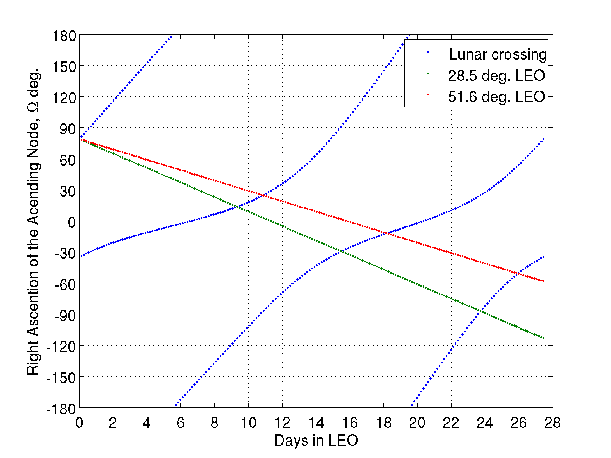
LEO departure constraints
A transfer to the Moon is possible every 6–10 days for given RAAN
Transfers to HEO are available about once a month for a given RAAN (HEO nodal regression is slow)
Crew can launch to desired RAAN on any day due to Earth’s rotation

Slide 19
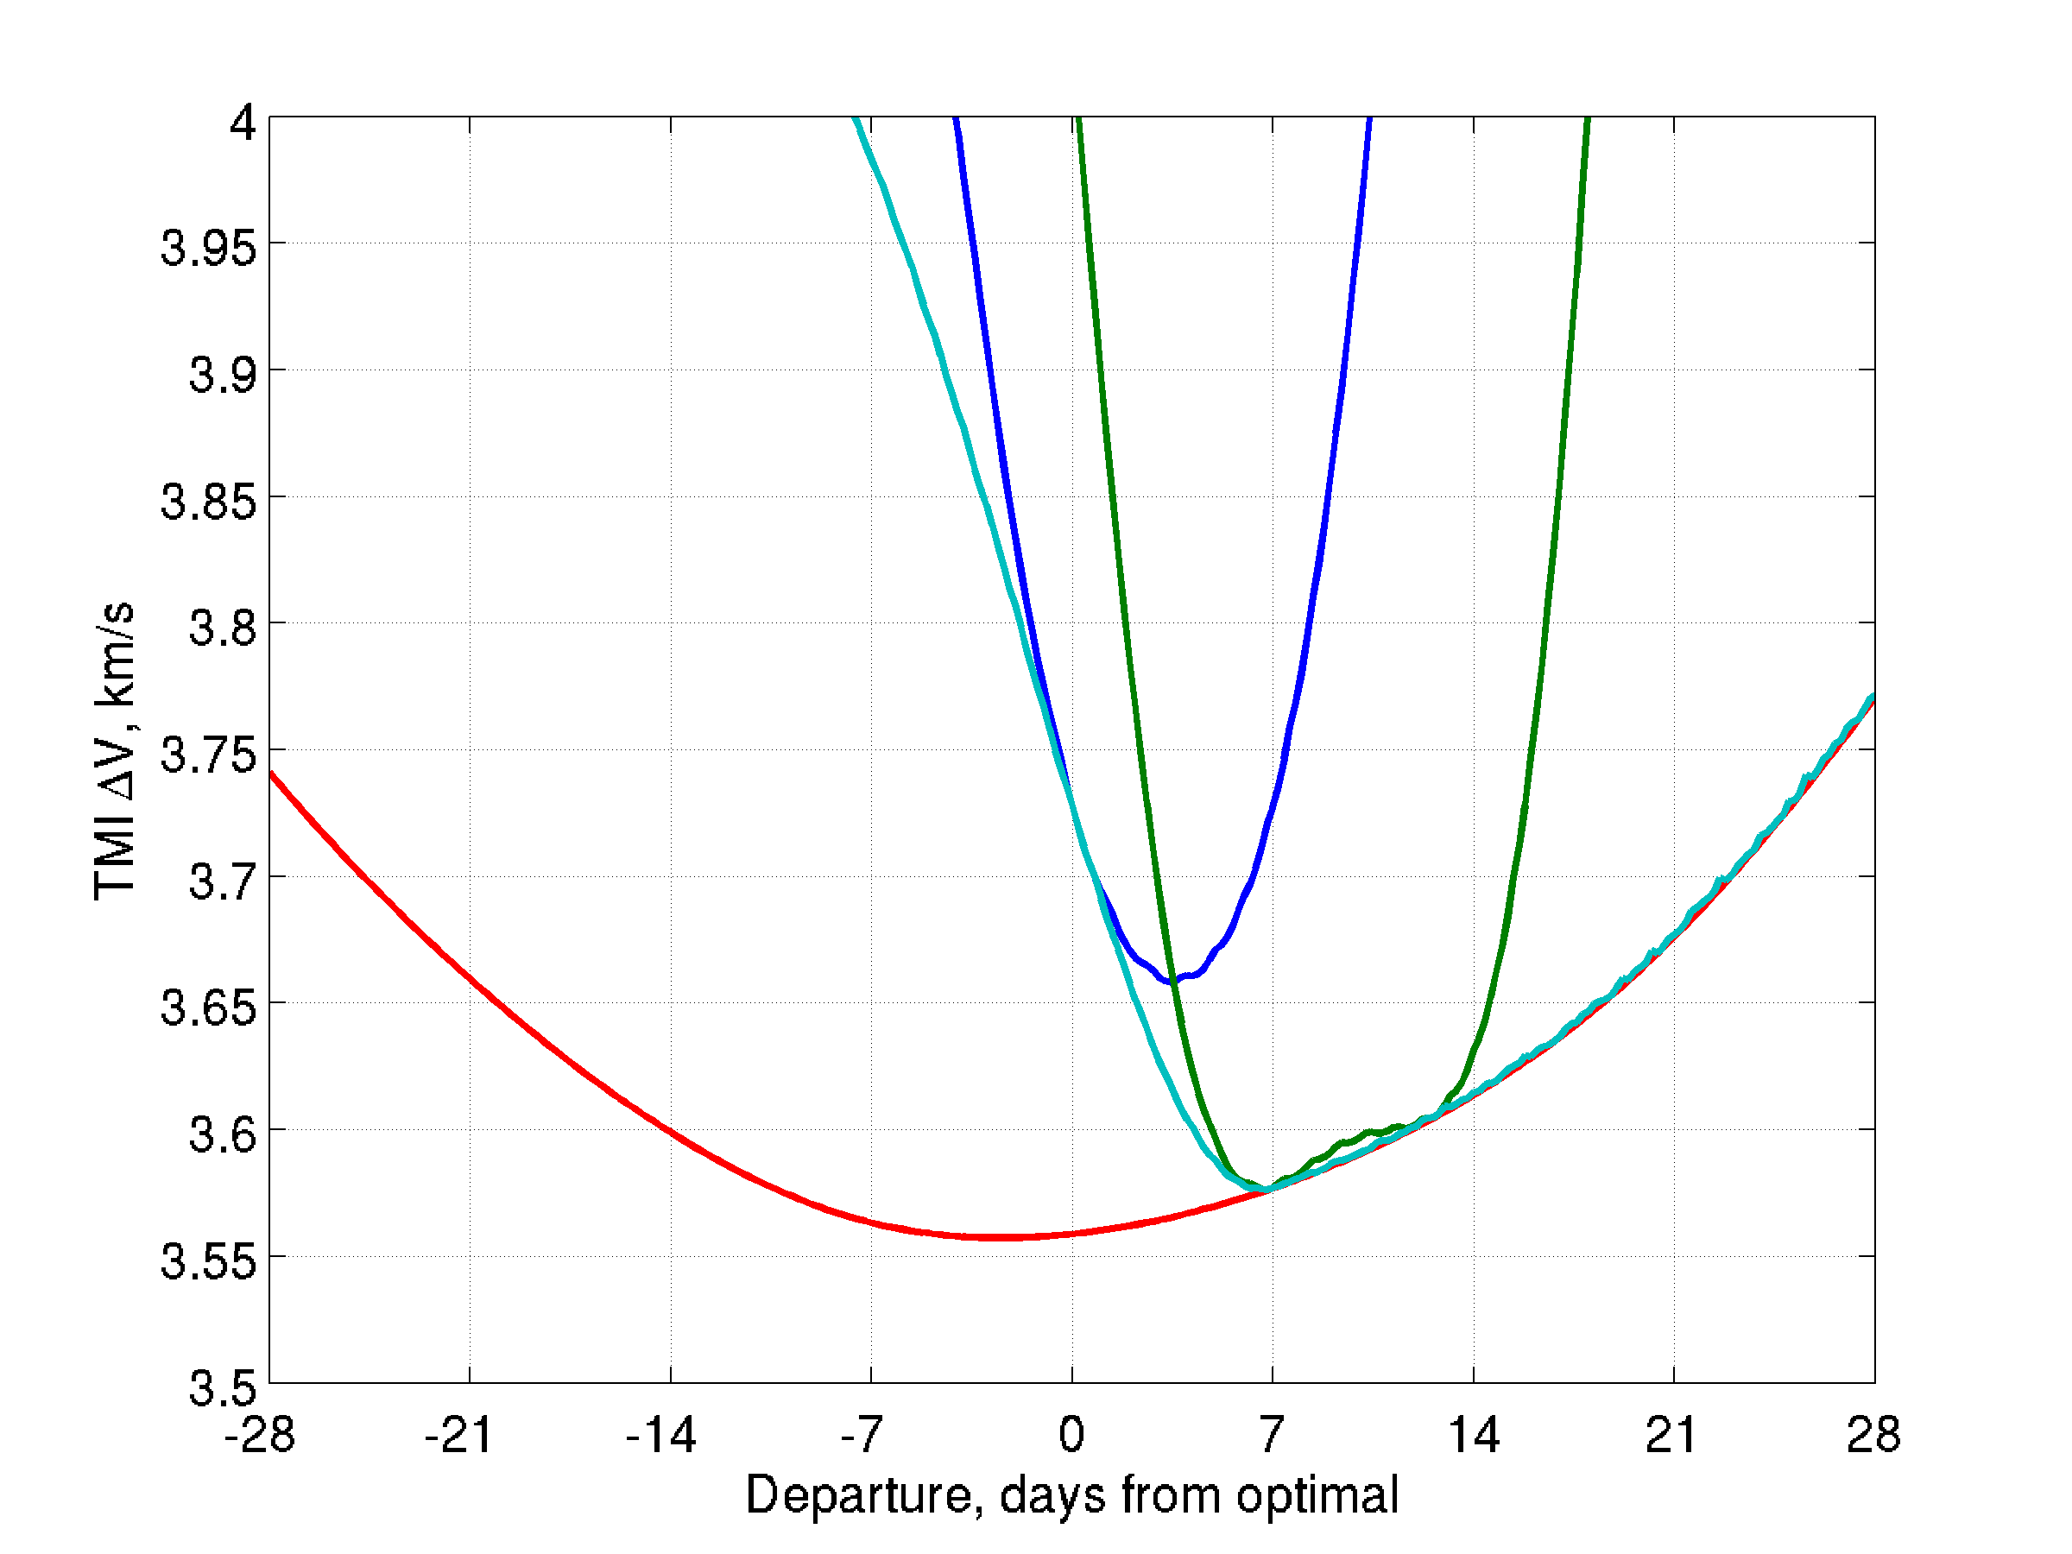
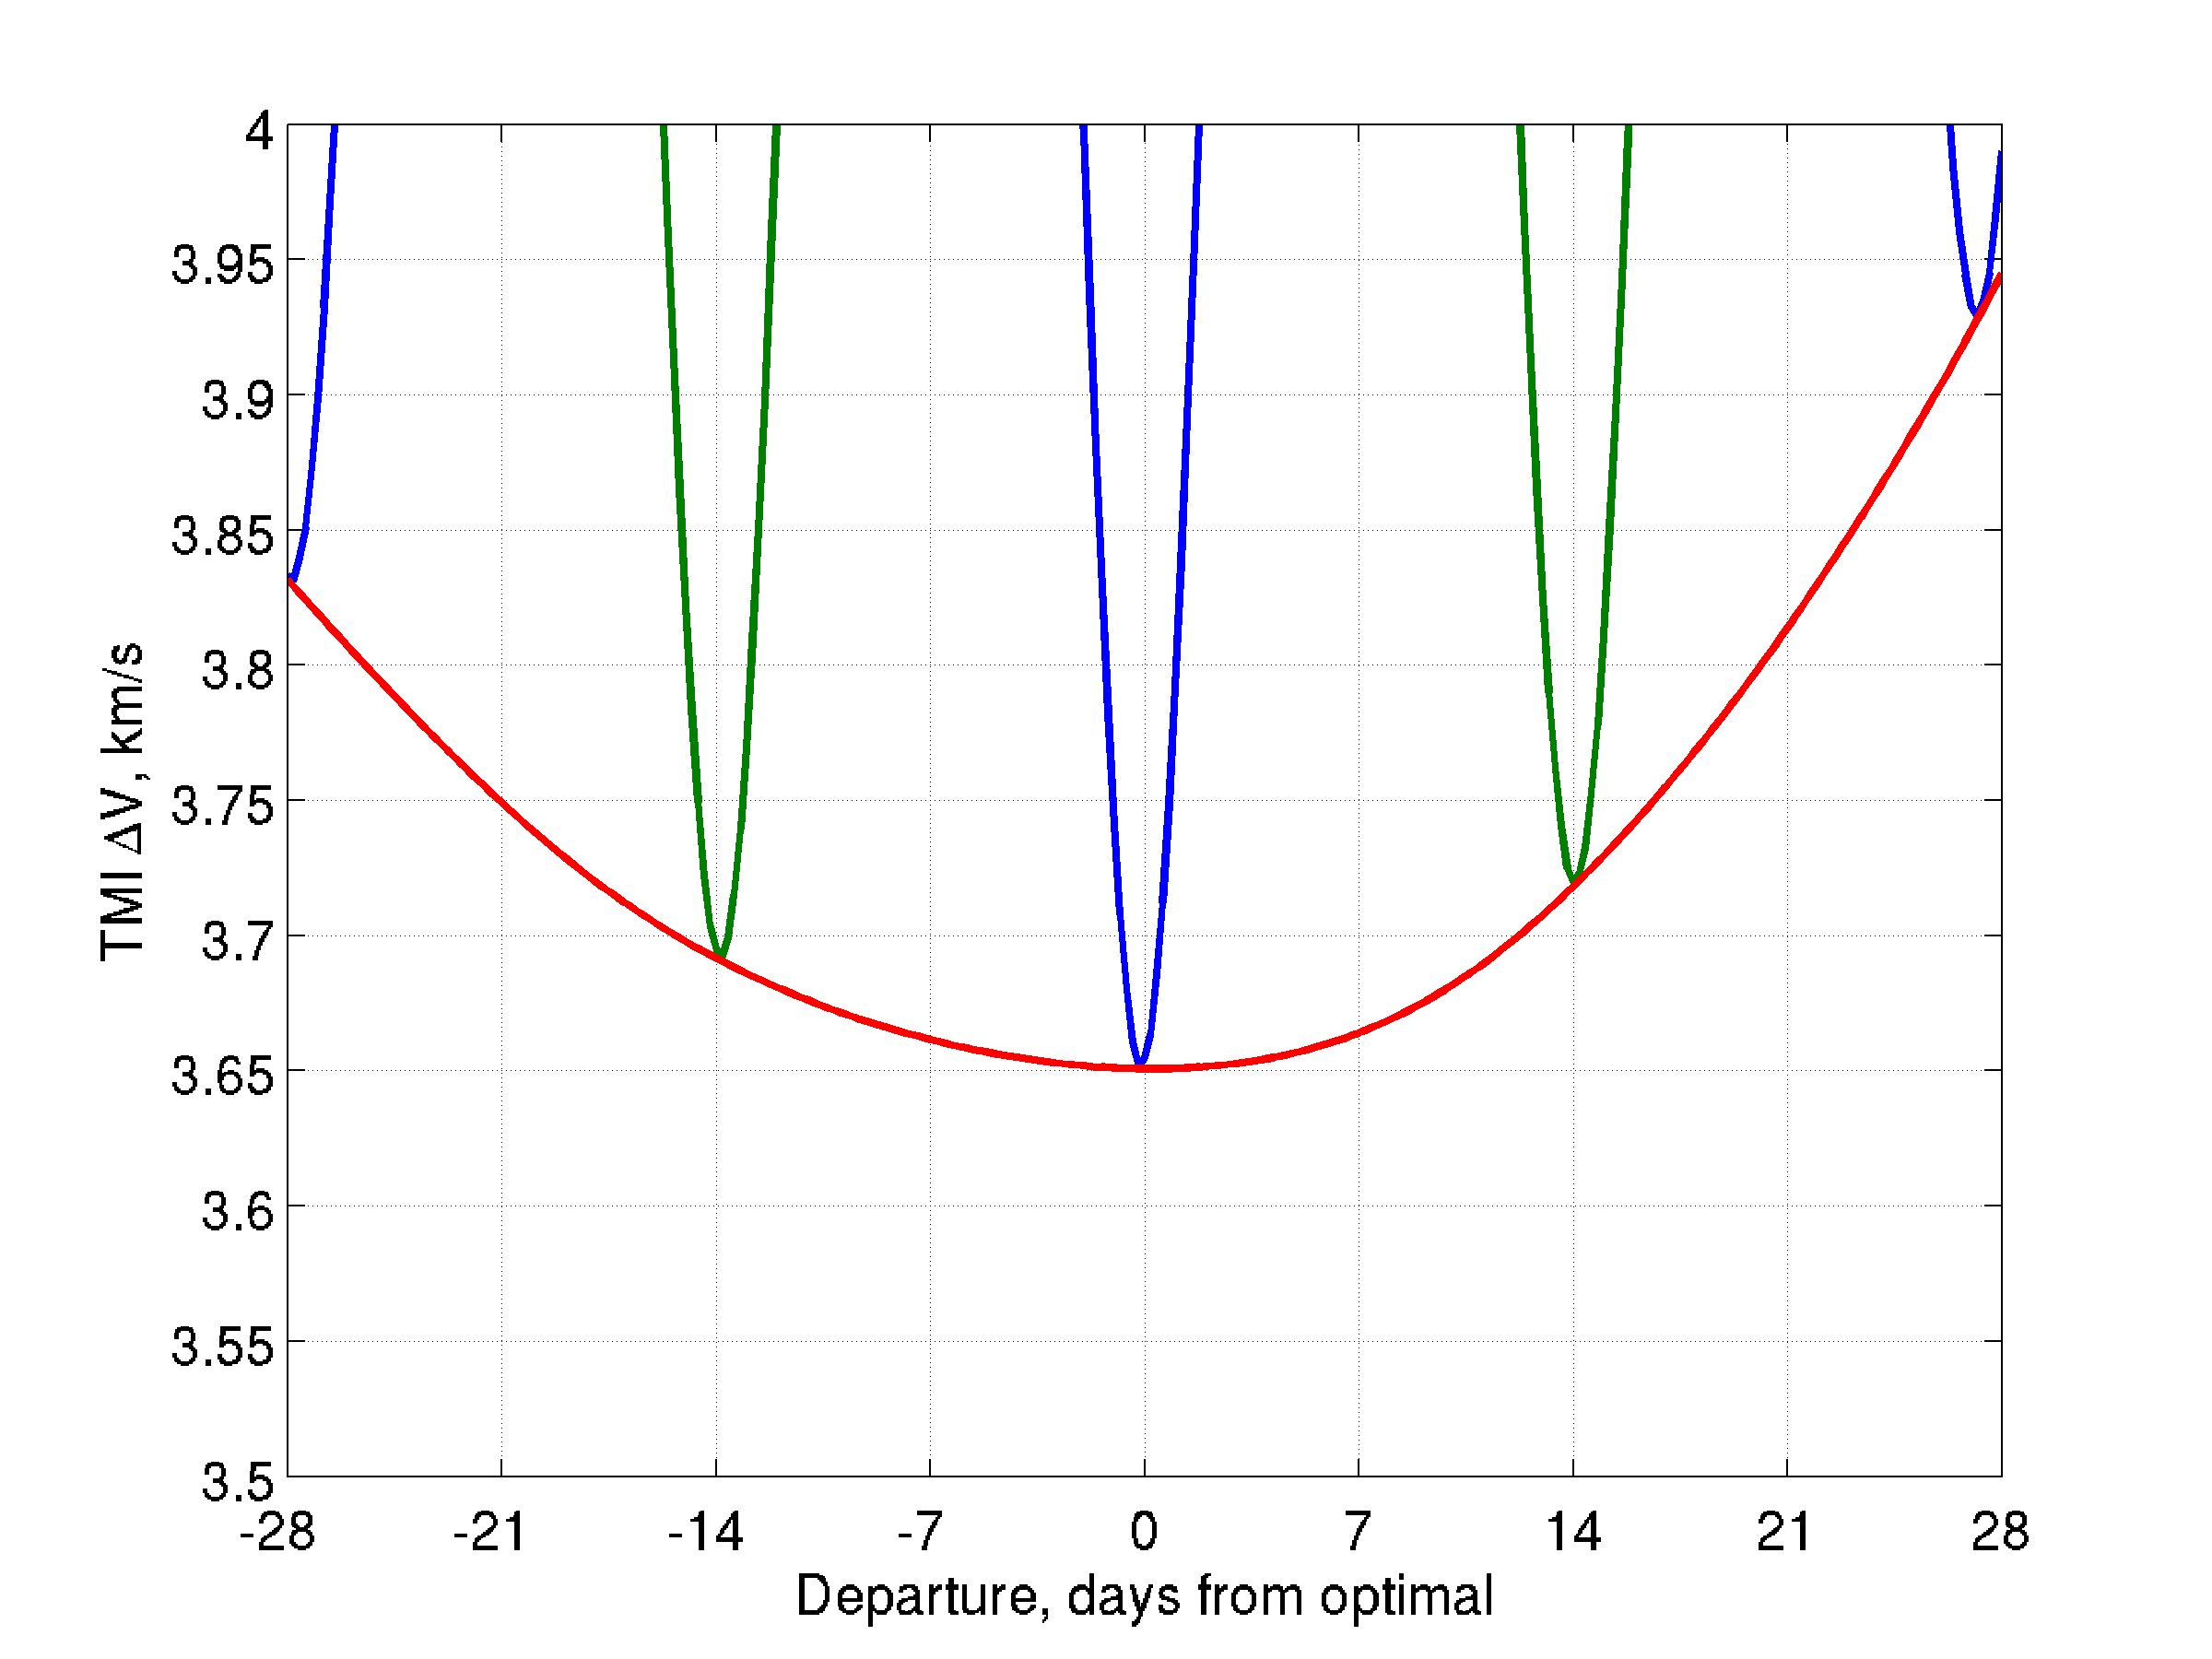
Low-Earth Orbit Departures Single Impulse Mode
2033, 51.6 deg inclination
2035, 28.5 deg inclination
Declination < 51.6 deg before optimal TMI date increases ΔV
ΔV as two different
orbits precess
Dec. near -51.6 deg for several days. Optimal LEO stays in departure plane.
Min. ΔV for free choice of orbit on any day
Launch characteristics depend on launch declination

Slide 20
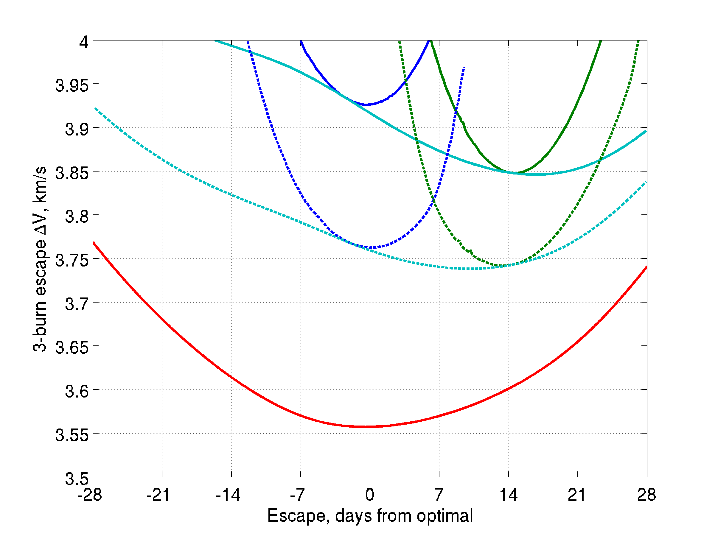
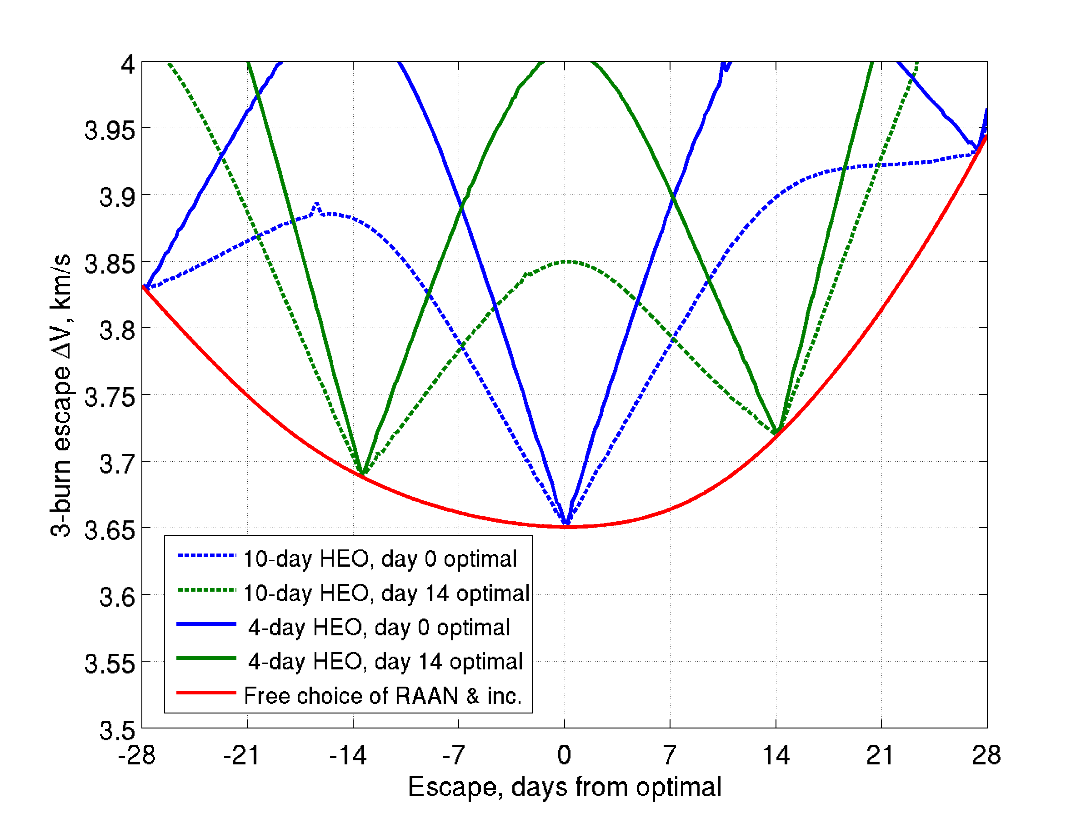
3-Burn with High-Earth Orbit
Three-burn sequence with intermediate HEO enables out-of-plane departures
2033, 28.5 deg inclination
2035, 28.5 deg inclination
4-d HEO
(solid)
10-d HEO
(dashed)
Min. ΔV for 28.5 deg
free choice of RAAN
Min. ΔV for free inclination
Blue and green curves are different choice of LEO with different right ascension of the ascending node (RAAN)
10-d HEO has lower speed at apogee, which lowers reorientation ΔV

Slide 21
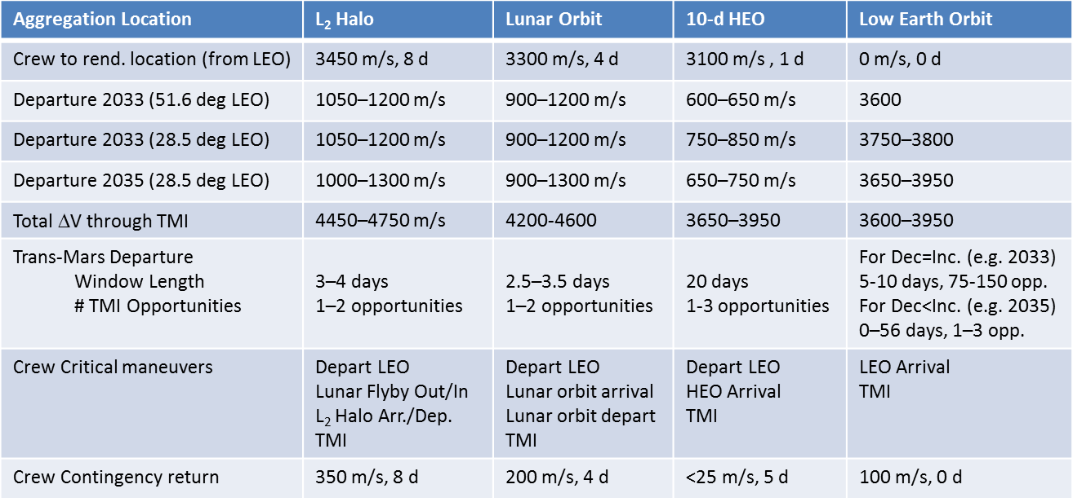
Departure Scenario Considerations for Human Missions to Mars
*
*
*For a 3–4 month cargo transfer, the ΔV reduces to 3100 m/s for L₂ and to 3150 m/s for lunar orbit

Slide 22
Example Mars Orbital Mission
600-day Mars mission with 60 days at Mars
Crew travels to Phobos (or any target orbit)
60-t Deep Space Vehicle
(NASA HEFT II Configuration)
10-t Space Exploration Vehicle
DSV remains in loose orbit while crew travels to target orbit in SEV
Storable Chemical Propulsion
Stage, 325 s Isp

Slide 23
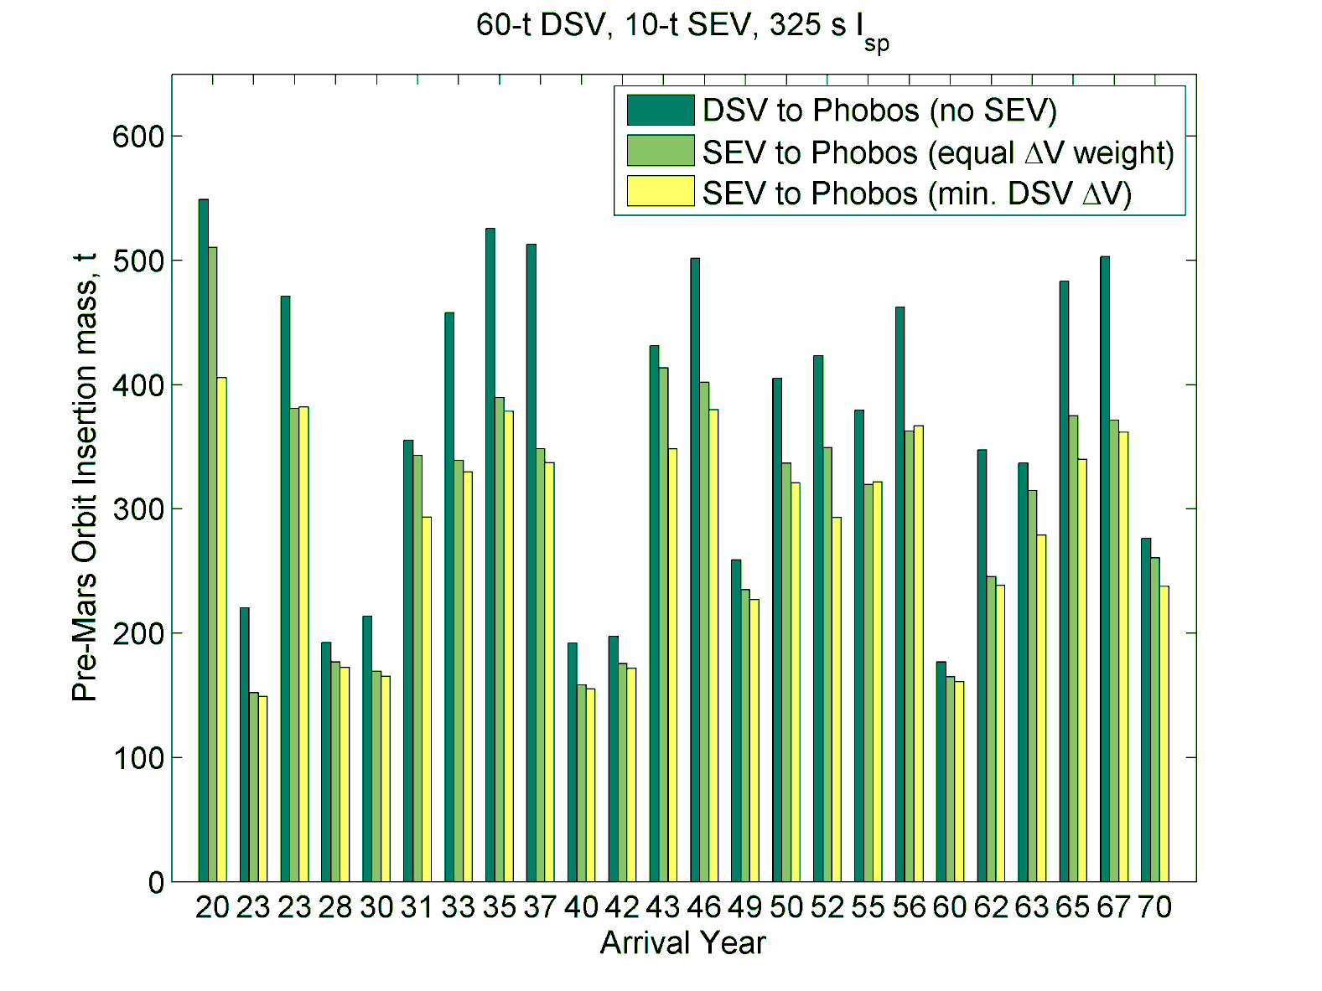
SEV Reduces Mass for Phobos Missions

Slide 24
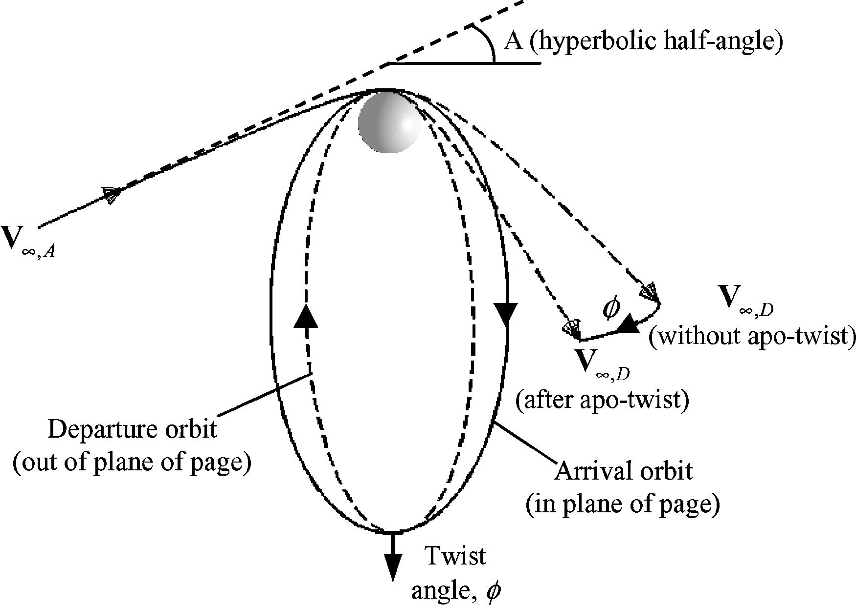
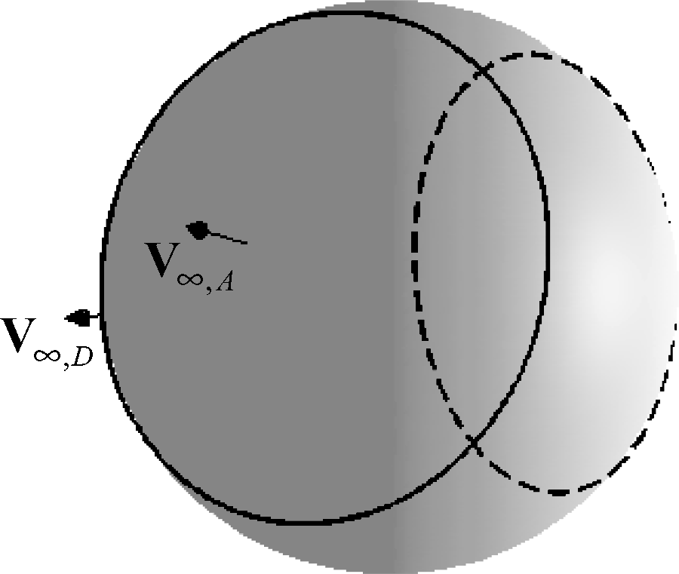
The Old Problem
Connect arrival and departure interplanetary trajectories via maneuver at apoapsis

Slide 25
The Current Problem
Target orbit plane could be mismatched with interplanetary orbits
target orbit
target orbit

Slide 26
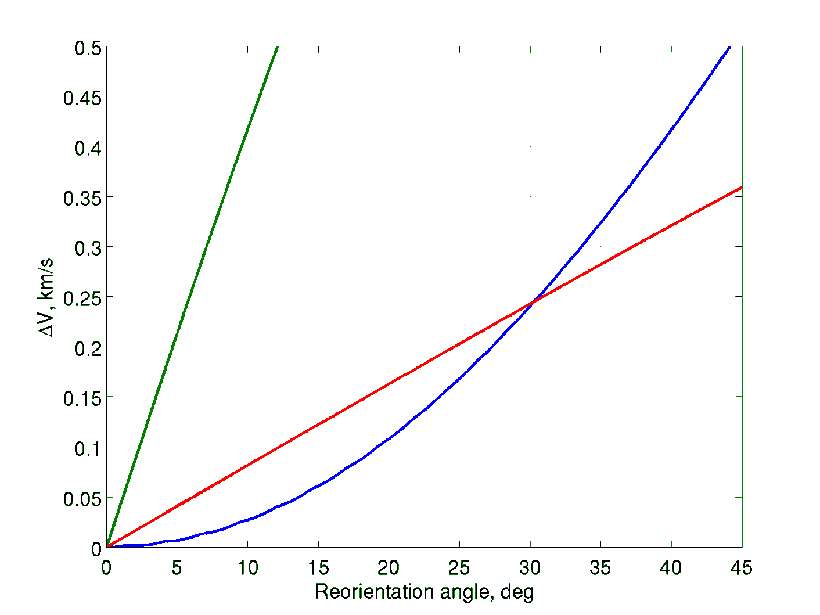
Relative cost of orbit reorientation techniques
Change line of apsides
(argument of periapsis)
in orbit
Mars orbit
250 km altitude periapsis
1 sol period
5 km/s V∞
Rotate orbit along line of apsides
Change line of apsides during arrival/departure maneuver

Slide 27
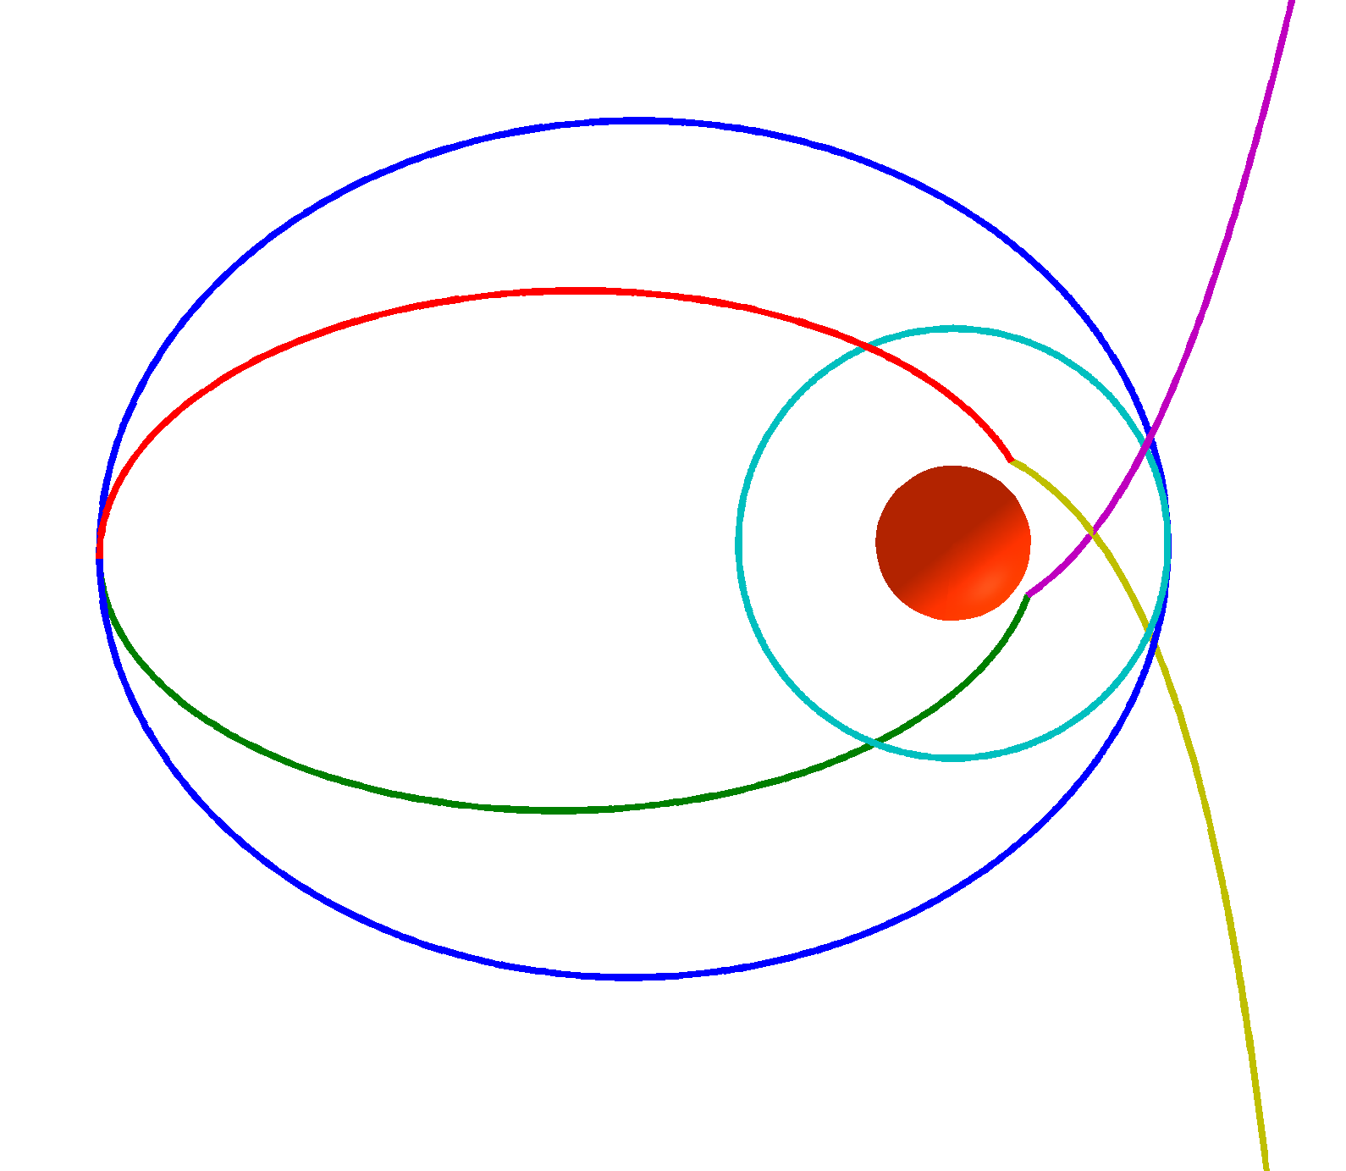
Transfer to Phobos
Transfer
to Phobos
Rotate along
line of apsides
Apoapsis in plane with Phobos
Maneuver sequence:
DSV capture into parking orbit from arrival traj.
DSV rotate from arrival to departure plane
SEV rotate to target plane and raise periapsis
SEV lower apoapsis to circular target orbit
SEV raise apoapsis to elliptical parking orbit
SEV rotate to departure plane and lower periapsis
DSV escape from parking orbit to departure traj.
1
2,3,6
Phobos Orbit
4,5
7
Off-periapsis
arrival/departure

Slide 28
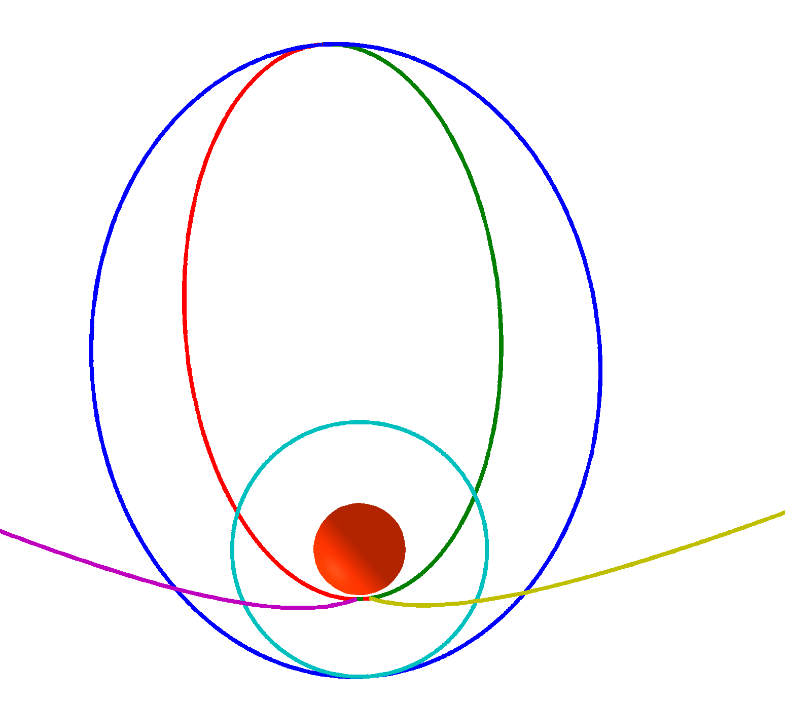
Same Mission, Different Transfers
The optimal orbit orientation can change dramatically based on relative mass of the DSV and SEV
Departure
Arrival
Retrograde
Parking Orbit
with
plane flip
at apoapsis
Direct
Parking Orbit
Arrival
Departure
Equal ΔV weight on SEV and DSV
Full ΔV weight on DSV

Slide 29
Phobos/Deimos Proximity Orbits*
Phobos is a complex dynamical region with significant perturbations from Mars and the irregular shape of Phobos
We present orbit options first in an idealized force model and then propagate these orbits in a full-force model
Orbits at the L1/L2 Lagrange points are unstable and require control (i.e. station keeping maneuvers)
The key questions for flying these orbits is how often a maneuver needs to be done and how quickly something goes wrong if a maneuver is missed
Distant Retrograde Orbits (DROs) are stable orbits that exist around secondary bodies (e.g. Moon, Phobos, Deimos).
Most stable when they remain within in the plane of the target or are further from the target
It is a relatively simple matter to transfer between DROs at different altitudes and also other orbits at the L1/L2 Lagrange points
*Proximity orbit analysis from Mark Wallace, Jeff Parker, and Dan Grebow

Slide 30
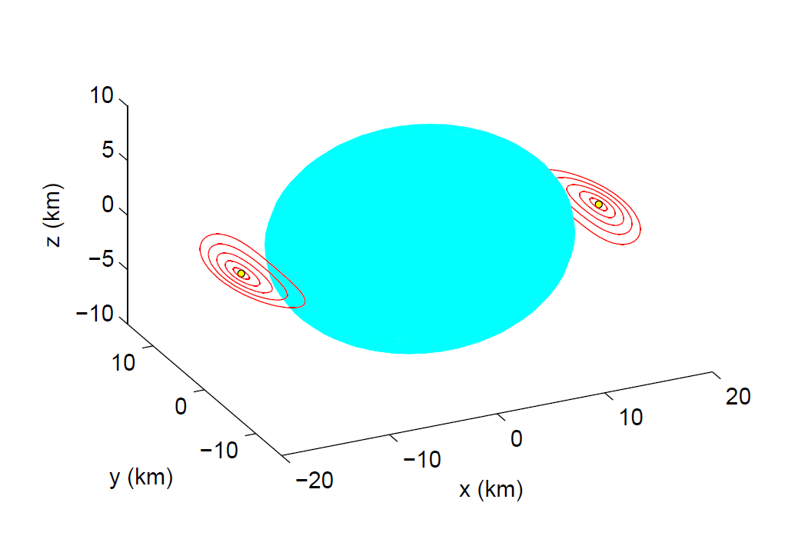
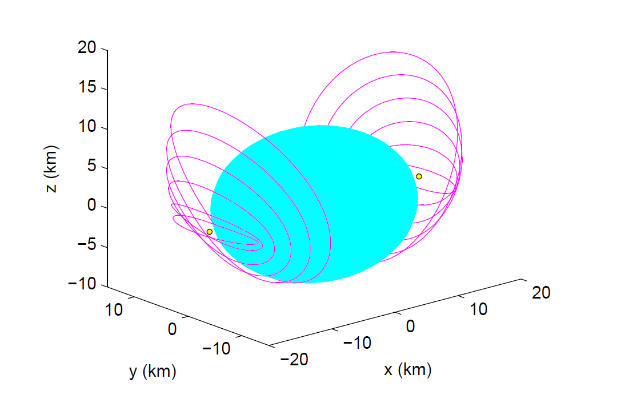
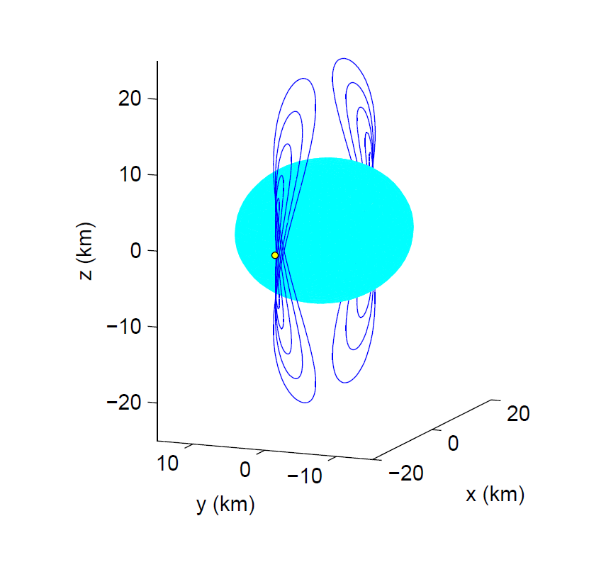
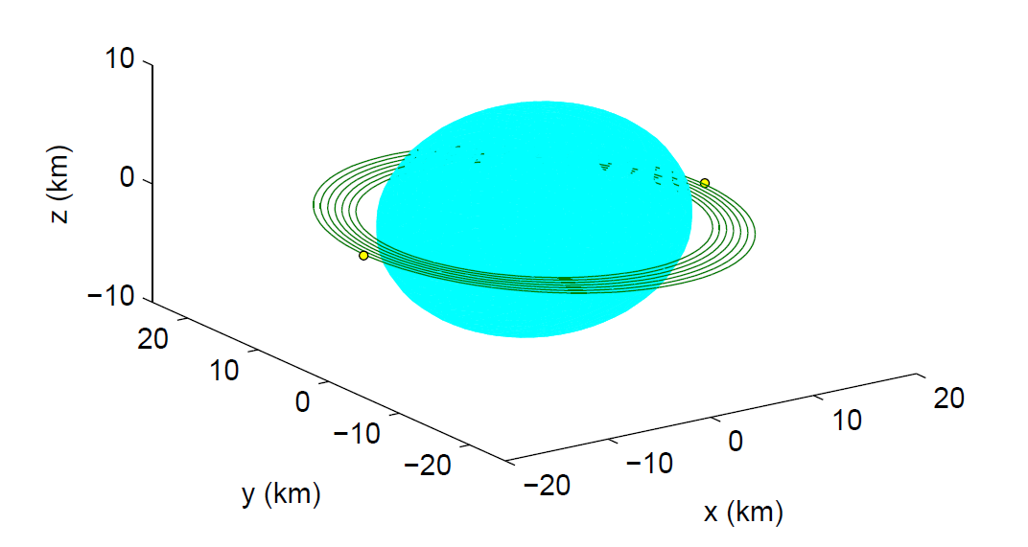
Periodic Orbits in “Ideal” Model (Circular Restricted 3-Body Problem)
Lyapunov Orbits
unstable
Halo Orbits
unstable
L₂
L₁
L₁
Phobos
L₂
To Mars
Vertical Orbits
unstable
“Distant” Retrograde Orbits
stable
L₂
L₁
L₁

Slide 31
Phobos Instability and Orbit Period vs. Closest Approach Alt.
(Circular Restricted 3-Body Problem)
Vertical and Lyapunov Orbits are the highest altitude “Lagrange” point orbits
Highest Halo
Retrograde Orbits are Stable
longer period → more time for maneuvers
Note: Altitude is geodetic altitude relative to Phobos ellipsoid

Slide 32
Flying an Unstable Orbit
Libration orbits (Halo, Vertical, etc) are unstable by nature
Navigating an unstable orbit:
Accurate maneuvers (mm/s precision or better)
Shouldn’t be too hard given large mass of spacecraft
A bigger challenge will be to minimize “noise” DV
Frequent station keeping maneuvers (SKMs)
SKM every 2 hours preferred
SKM every 3-4 hours tolerated
Small maneuvers – on the order of mm/s
Low fuel budget if maneuvers are performed frequently and accurately: ~ 1 m/s per month (est.)
Frequent tracking and/or on-board navigation at Phobos
We can collect navigation data using craters, limb observations, laser/radar ranging, or with navigation beacons
Orbits can be biased to escape (instead of impacting) when control is lost; orbits that escape should return to the vicinity of Phobos every 8 hours or so.

Slide 33
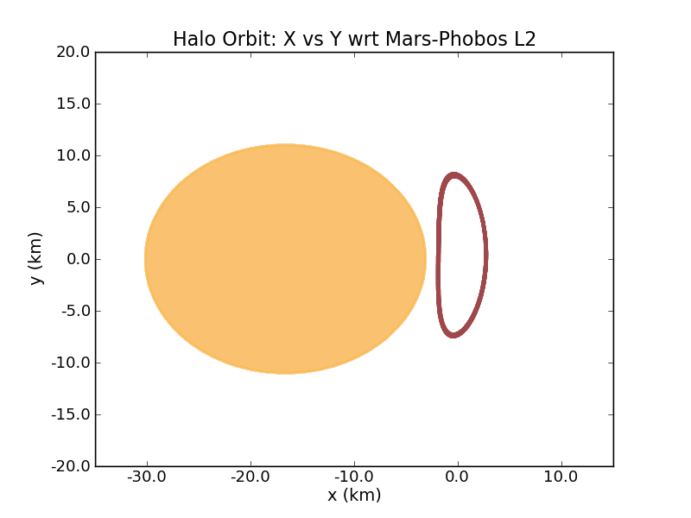
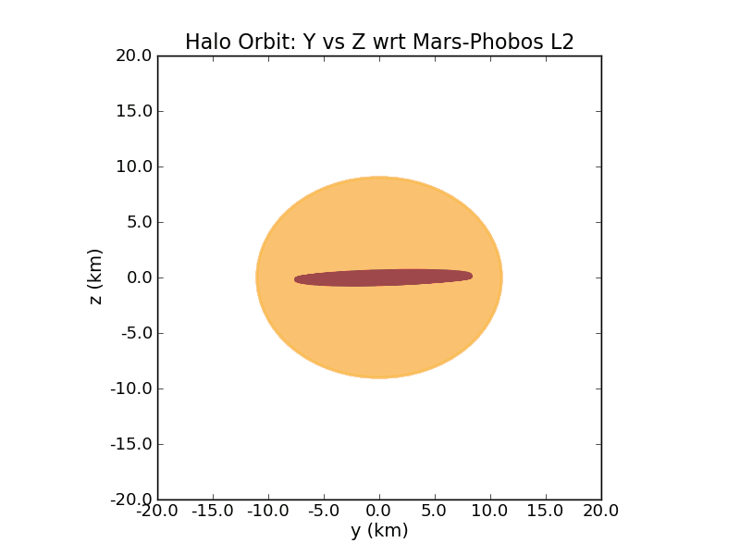
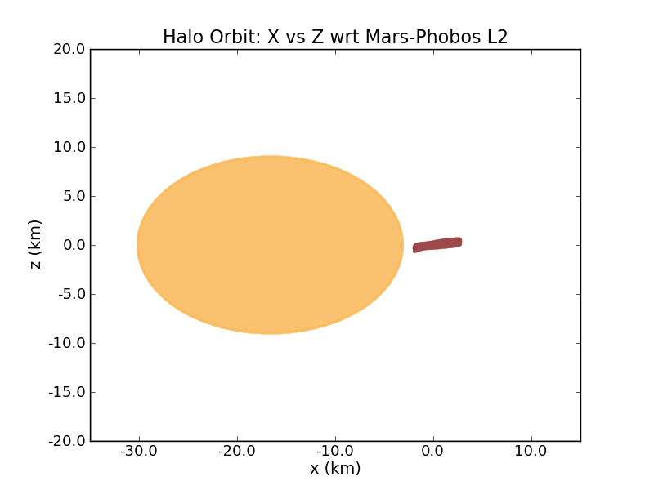
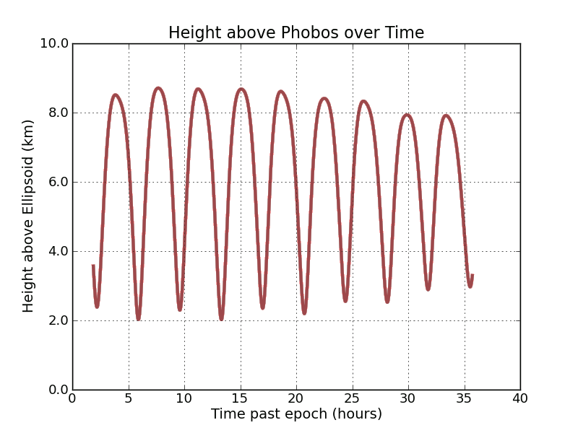
Phobos L2 Halo orbit in Full-Force Model (with control)
Viewed from above
Viewed from Mars (orbit is behind Phobos)
Phobos
L₂
Mars
L1 orbits are similar
Viewed from the side
Altitude shown relative to Phobos ellipsoid
2 km minimum altitude

Slide 34
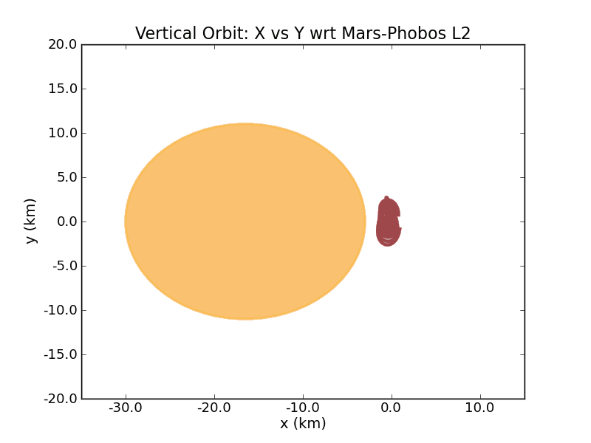
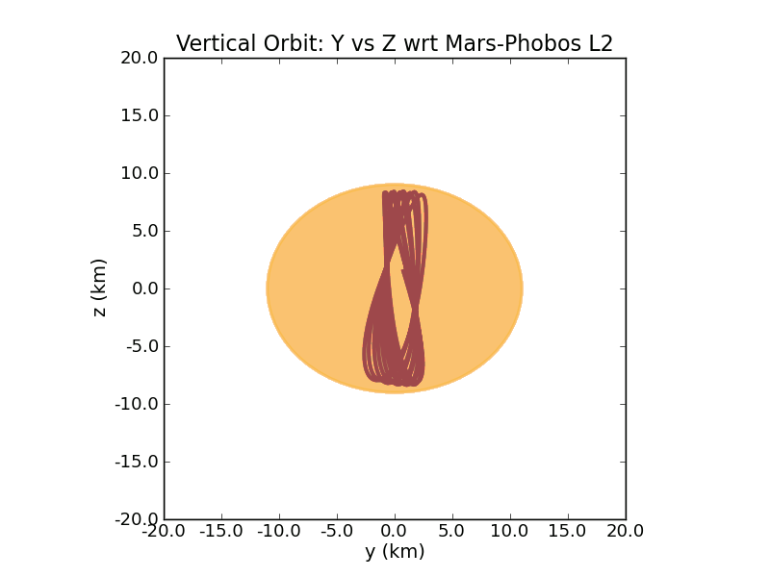
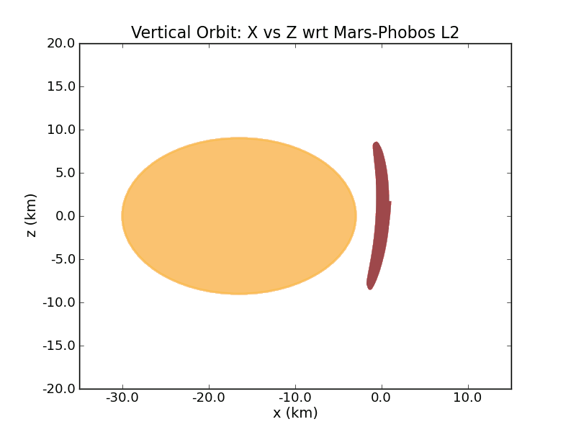
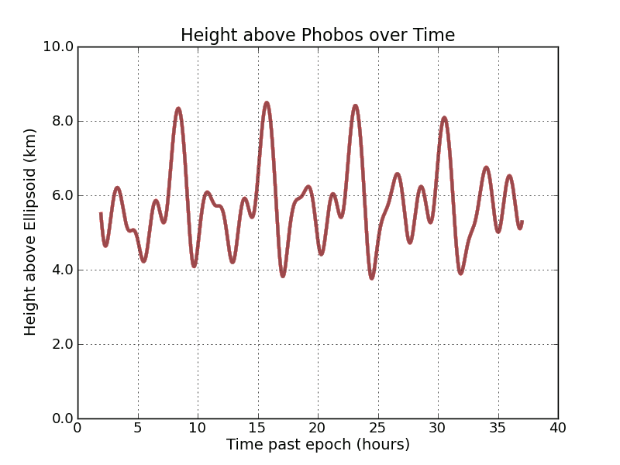
Phobos Vertical Orbit in Full-Force Model (with control)
Viewed from above
Viewed from Mars (orbit is behind Phobos)
Phobos
L₂
Mars
L1 orbits are similar
Viewed from the side
Altitude shown relative to Phobos ellipsoid
3.8 km minimum altitude

Slide 35
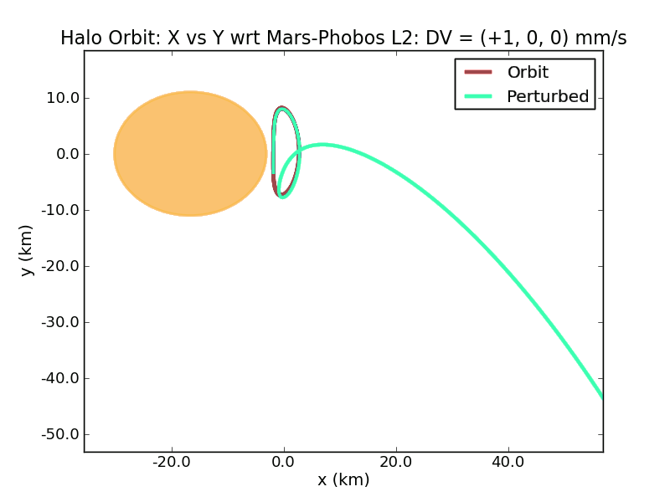
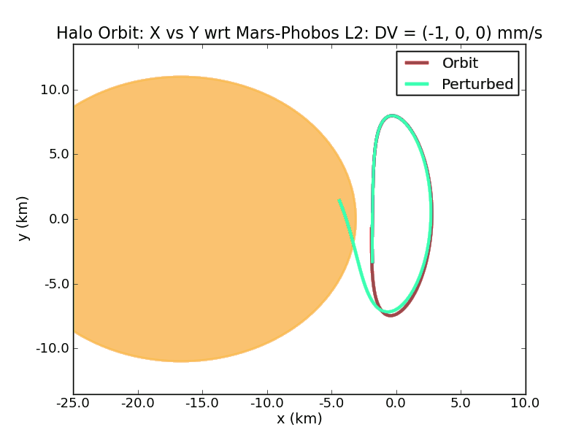
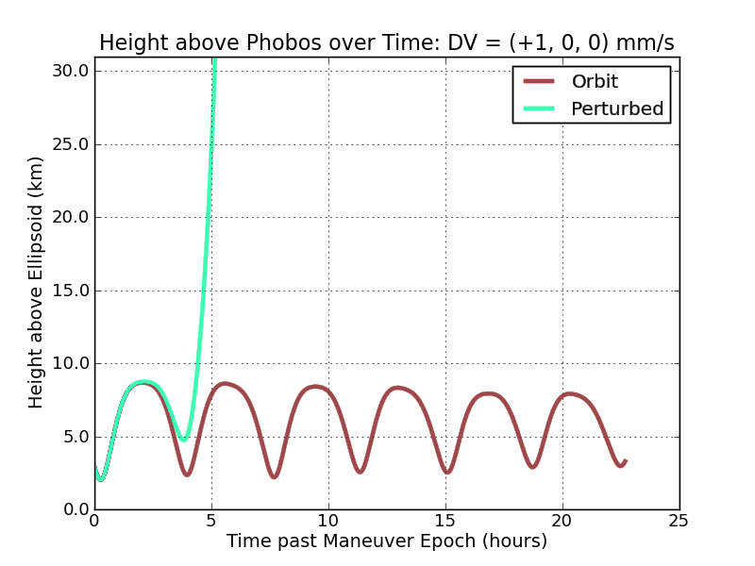
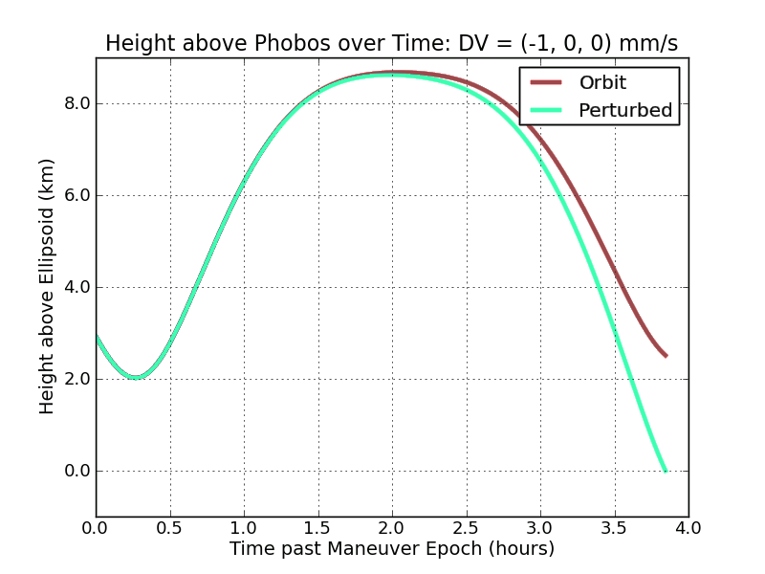
What happens if you stop station keeping? (Halo)
Departure
Impact
To Phobos-trailing orbit
Viewed from above

Slide 36
Dual Orbit Strategy
Equatorial DROs used as a safe “parking spot” for the DSH (Deep Space Hab) spacecraft
DSH spacecraft temporarily moved to Vertical Orbit during landings to monitor EVA
DSH spacecraft operated in “quiet mode” to maximize precision of orbit control
Vertical Orbit can be biased so that if control fails, DSH will escape Phobos instead of impacting
If DSH escapes, it can return in a few hours (because of Phobos’ short orbit period of 7.7 hours)
Vertical orbit will keep the DSH close to the crew for abort scenarios and above the horizon for com link and video

Slide 37
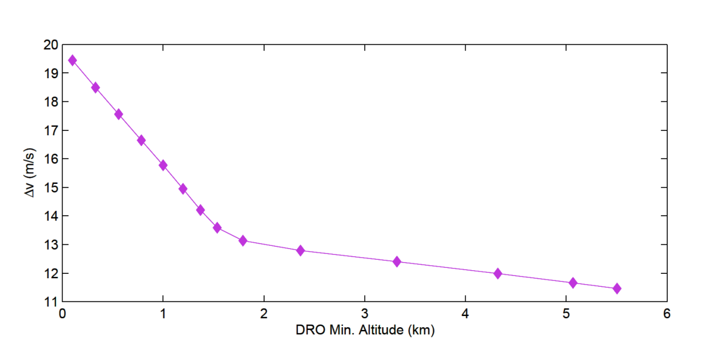
Phobos DRO to Vertical Orbit Transfer (Circular Restricted 3-Body Problem)
It costs from 11-20 m/s to transfer from a DRO to a vertical orbit
To go from a DRO to the libration point (L₁ or L₂) costs roughly 11.5 m/s
DROs
Δv versus DRO close approach altitude

Slide 38
Mars Mission Trade Study
Chemical Propulsion for Crew (CP-Crew)
300 kW SEP used to pre-place cargo at Deimos and High Earth Orbit (HEO)
CP used for all trajectories with crew onboard
Solar Electric Propulsion for Crew (SEP-Crew)
300 kW SEP used to pre-place cargo at Deimos and HEO
CP used for Crew to HEO and Earth Departure
700 kW SEP used for crewed interplanetary traj. to Mars
CP used for exploration of Deimos and Phobos

Slide 39
CP-Crew Mission
2.5-2.6 year mission; 1-1.5 years exploring Phobos and Deimos
Phobos
4. Each SEV can make two round-trips between Phobos and Deimos
Deimos
DSH and SEVs left at Deimos
Two SEVs and SCPSs pre-placed at Deimos
3. CP traj to Mars, CCPS used for MOI
5. CCPS used for DSV maneuvers at Mars and Earth Return
HEO
2. DSV uses CCPS to escape
1. Crew uses SCPS to get to HEO
DSV assembled and moved to HEO
6. CM direct entry
Earth

Slide 40
CP-Crew Trajectory Example

Slide 41
SEP-Crew Mission
2.7-2.8 year mission; 4-7 months exploring Phobos and Deimos
Phobos
4. Each SEV can make two round-trips between Phobos and Deimos
Deimos
DSH and SEVs left at Deimos
Two SEVs and SCPSs pre-placed at Deimos
3. SEPS takes DSV to Mars and spirals to Deimos
5. SEPS used for Earth Return
7. SEPS returns DSV to HEO
HEO
2. DSV uses SCPS to escape
1. Crew uses SCPS to get to HEO
DSV assembled and moved to HEO
6. CM direct entry
Earth

Slide 42
SEP-Crew Trajectory Example

Slide 43
IMLEO Comparison

Slide 44
Thoughts on Refueling
Chemical Booster Refueling
A chemical boost stage can be thought of as a propellant depot with engines.
For many mission the boosters will have excess capability or unused abort propellant.
If the boosters could transfer propellant between each other, this excess propellant could be accumulated and used on later missions.
SEP Stage Refueling
SEP stages also carry 10% missed thrust margin that could be transferred from used stages to new ones.
However, SEP stages have large arrays that are expensive, so there is also a potential benefit to having fuel tanks at a refueling waypoint to enable reuse of SEP stages.

Slide 45
Modular SEP Stages
Eight 40 kW SEP Stages could provide an effective 320 kW Stage…
In this example configuration, the arrays would only shadow each other when the Sun was directly along the axis of the central cylinder, but if the spacecraft rotates 180 deg around the thrust vector, the shadows are removed

Slide 46
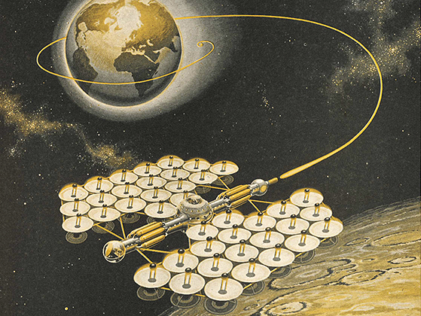
“Each of the fifty-foot parabolic mirrors in the wings concentrates the Sun’s rays on a boiler at its focal point. Steam is developed, which drives a 200-kw turbo-generator in the base.”
“The current thus generated drives the main propulsions unit, an ion rocket in which powerful electric fields accelerate charged particles, shooting them from the rear of the rocket exactly as the electron gun in your TV set bombards the screen. Sunlight, then, is the power source, whereas cesium is the propellant.”
“Since its thrust is entirely inadequate to cope with the gravity of major planets, the Cosmic Butterfly never lands. It is assembled in space and shuttles between artificial satellites.”
The “Cosmic Butterfly” 1954,
Ernst Stuhlinger

